Slide 1

APPLICATION OF NBS GIS DATABASE
Presented to Sub-regional workshop on integration of administrative data, big data and geospatial information for the compilation of SDG indicators
23-25 April,2018
Addis Ababa, Ethiopia
By: Deogratius Malamsha
National Bureau of Statistics
Tanzania

Slide 2
Overview
Census maps of varying levels of specificity are an integral part of modern Population and Housing Censuses
  They provide necessary spatial reference for the population eligible for enumeration
  They help to ensure total coverage of the population during enumeration as they make it possible to avoid under/over enumeration
  They assist in planning and controlling the enumeration and ensure that the data is allocated to the correct administrative units.
  They provide the basic frame for sampling

Slide 3
Background
The 2002 census preparatory mapping work spread over a period of approx 4 yrs( Feb 1997 –June 2002)
Although the 2002 census was successfully carried out, the cartographic preparations experienced many difficulties, including lack of up to date topographic base maps
After the census, it was decided to develop a comprehensive inter-censal mapping programme with an objective of developing GIS within NBS and continual updating of the census geographic frame to improve its accuracy and content

Slide 4
Main activities:
1) Adjustment of Enumeration Areas used during 2002 Population and Housing Census
What is involved?
    Review EA size – 60 to 100 hhs in both urban & rural
    Revision of the Coding Scheme – 12 digits instead of 10
    Collection of additional data for GIS input
        spatial and non-spatial data for village/ward offices, educational and health facilities, water points, police stations, etc;
        village altitudes – i.e. height above mean sea level;
    Transform from analogue to digital (digitization of EA boundaries)

Slide 5
Procedure
  Physical visits to localities
  Capture and record on special form, GPS coordinates of individual features (spatial information) with their attributes like name and type of facility.
  Transfer map details onto base maps, (topo sheets, orthophoto maps, satellite images such as SPOT 5 , QUICKBIRD, etc. of useful resolution and detail for rural/urban settlements).
  Digitizing the updated map with EAS

Slide 6
GIS development (cont’d)
Enter all the field data into the database
    Create attribute tables
    Create geo-database
    Link data on features into GIS
    Spatial analysis for decision making like spatial planning and thematic mapping can be done at this stage
EA map, ward maps, etc., can be automatically generated as required

Slide 7
Material Used
Digital aerial photography and ortho photos
Satellite imagery
Topographic base maps of 1:50,000
TP and Village drawings
GIS, GPS and related software
A0 Scanner and A3 Printers

Slide 8
NBS GIS Data Portal
After making sure all Data/ Information is processed and well arranged, then the upload into a Portal follows.
All spatial and non-spatial data are uploaded respectively.
Visit www.nbs.go.tz, then navigate to GIS data portal

Slide 9
Application of the Database can be at:
Enumeration Area (EA) Level
Village Level
Ward Level
District Level
Regional Level
National Level

Slide 10
Population and Housing Census
Conducted by NBS on 26th August, 2012
Total number of EAs covered were 109,000
Both Spatial and Non- spatial Data is available at NBS

Slide 11
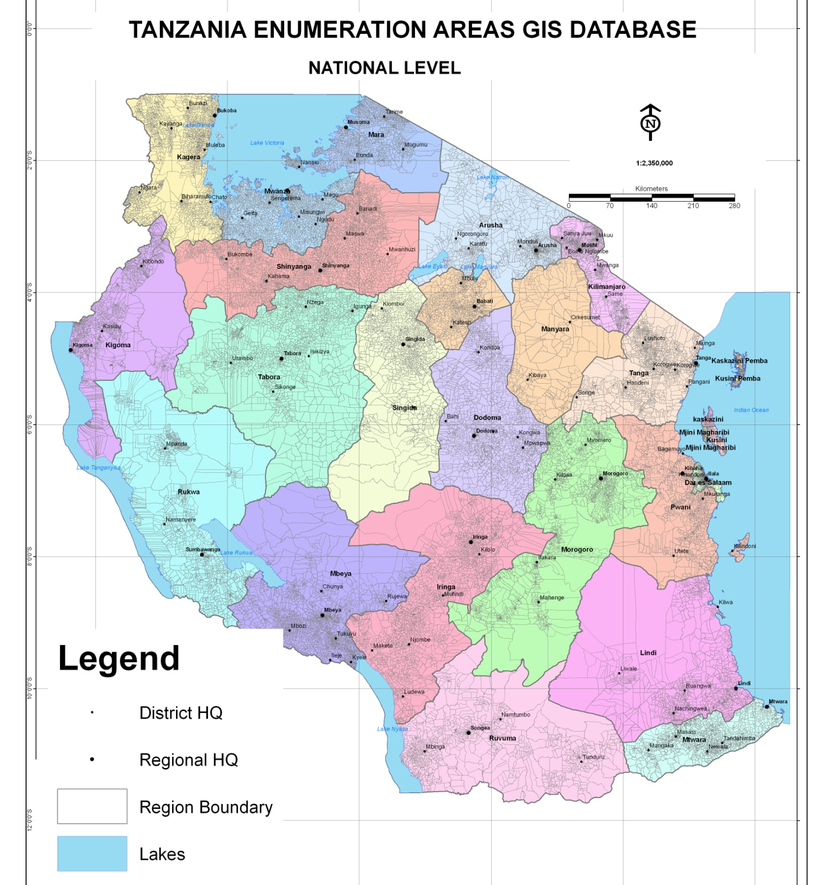


Slide 12
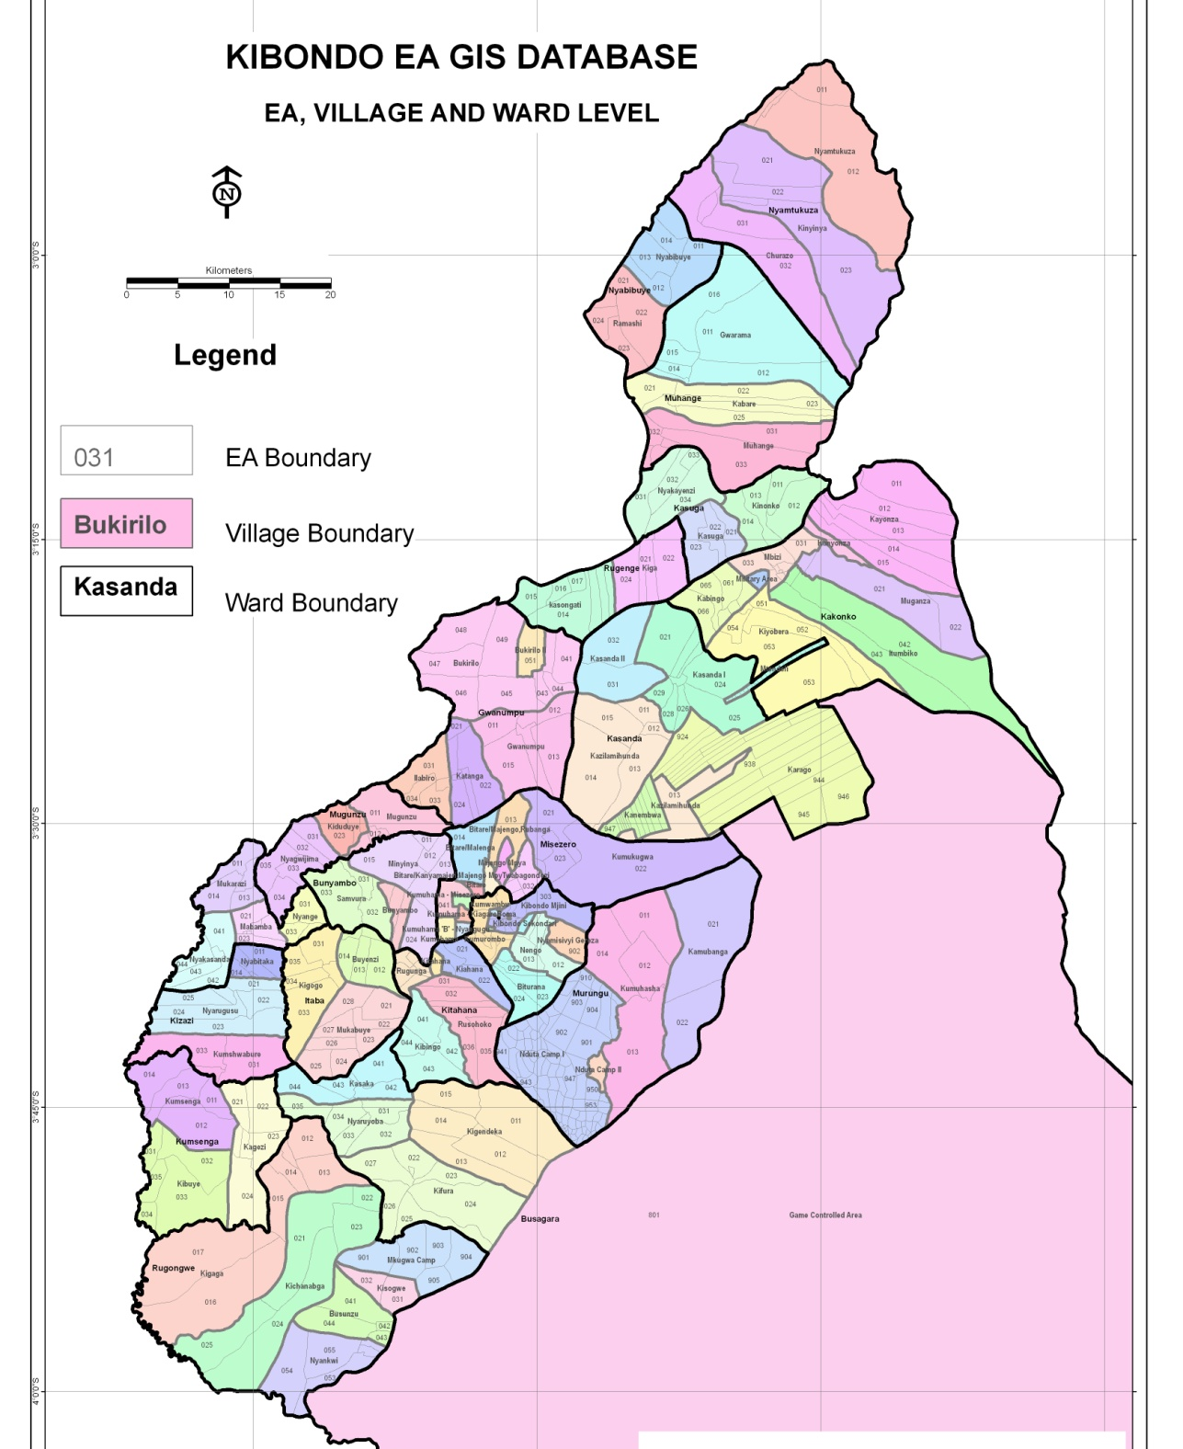


Slide 13
Socio- economic Application of the Database
Poverty Mapping
Education Facility Mapping
Health Facility Mapping
Sex Ratios etc,

Slide 14
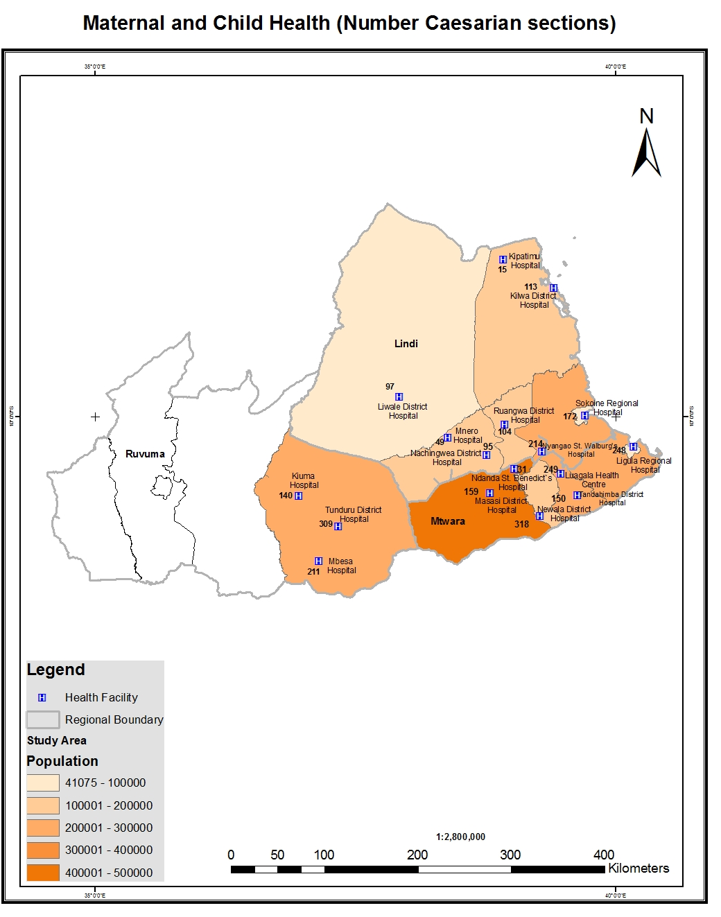

Slide 15
Thematic Applications
Health
Education
Telecommunication
Finance
Agriculture
Transportation
Land Administration
Defining New Administrative/Political Boundaries
Planning

Slide 16
Usefulness in health sector
Mapping of Disability Prevalence,
HIV & Malaria Prevalence,
Maternal and Child Health,
Tuberculosis (TB Register) etc
All these can be mapped by village, ward, district, region or zone

Slide 17
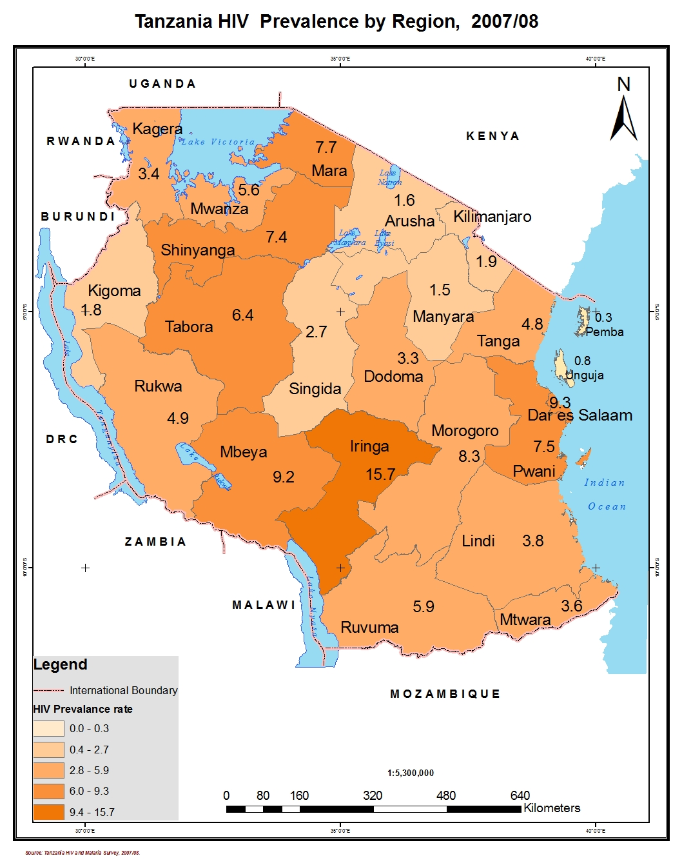

Slide 18
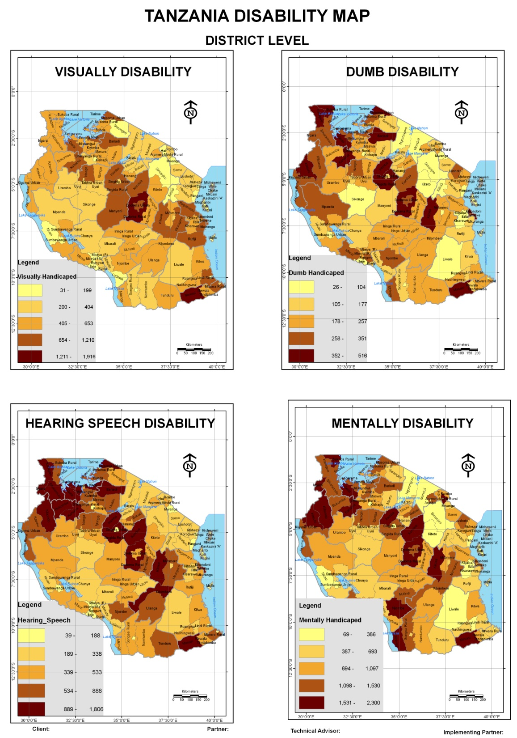

Slide 19
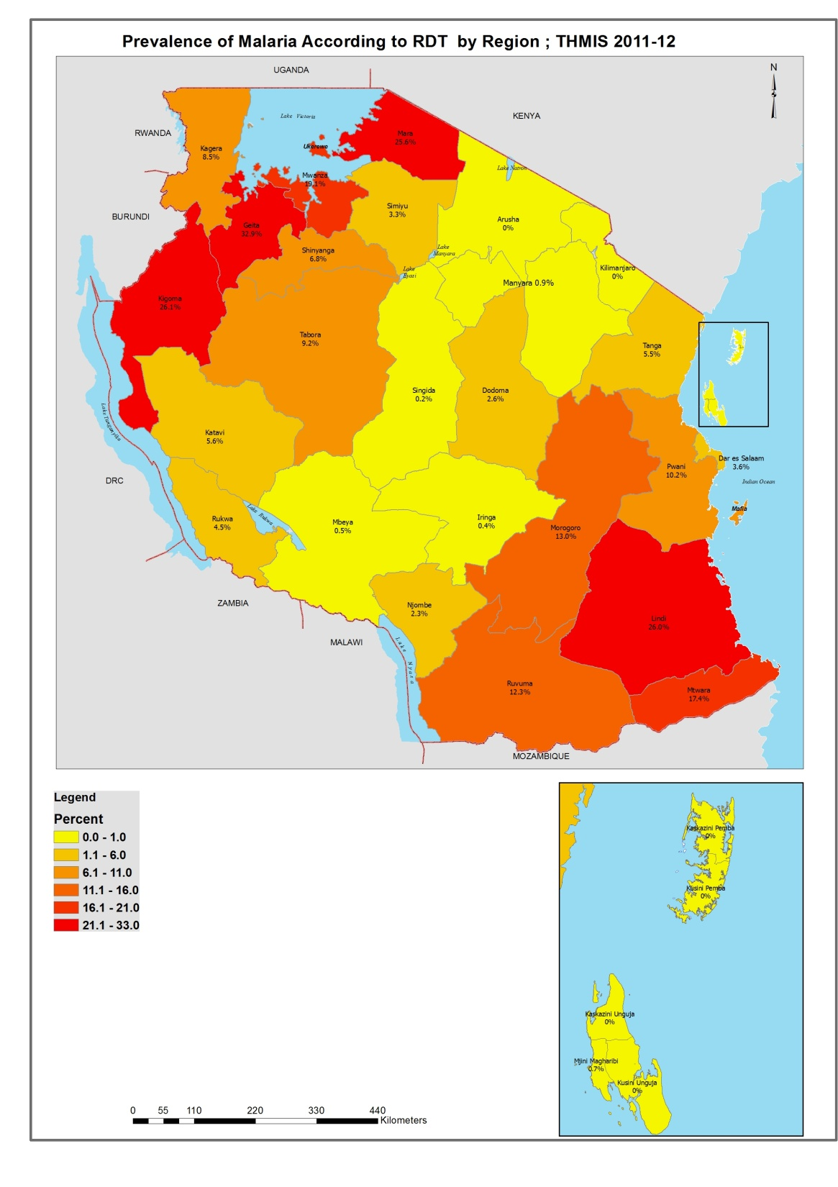

Slide 20
Water sector
Percent households using piped water
Surface water
Protected and unprotected wells
Households using flush toilets, etc

Slide 21
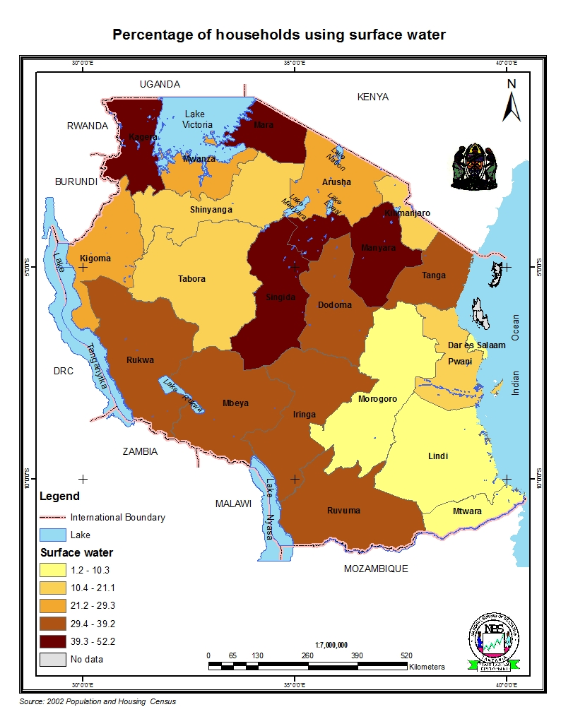
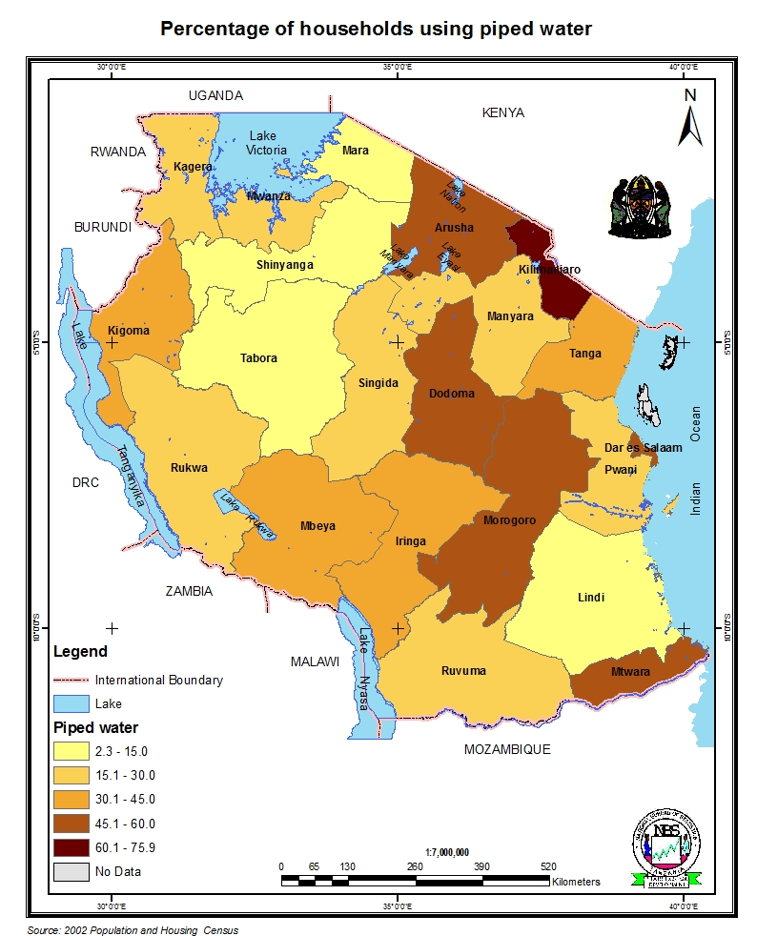

Slide 22
Agricultural sector
Diary Goat Production by Region
Cattle Population by Region
Improved Beef Cattle by Region
Harvest of Mize, etc

Slide 23
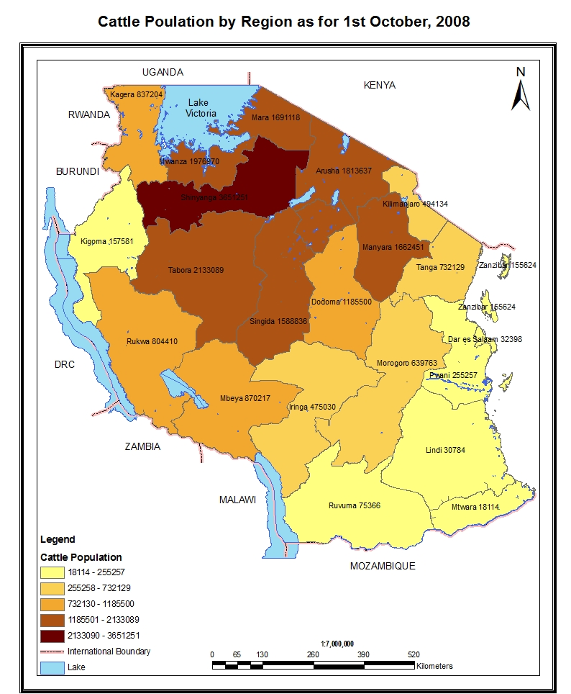
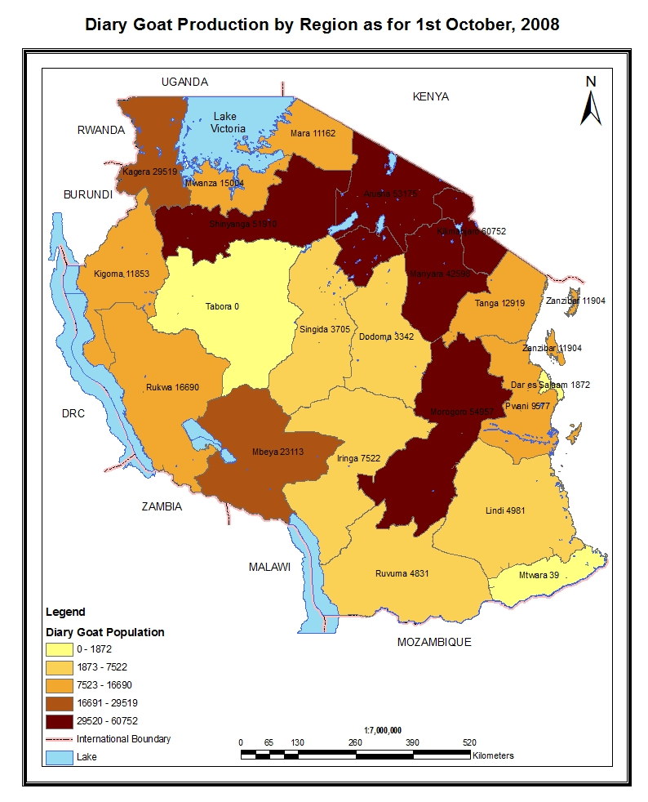

Slide 24
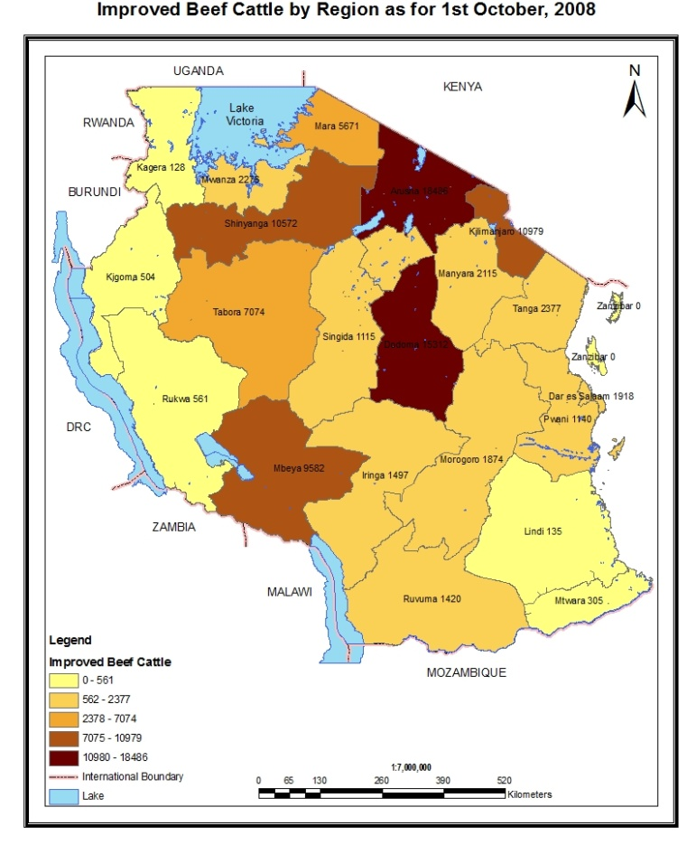
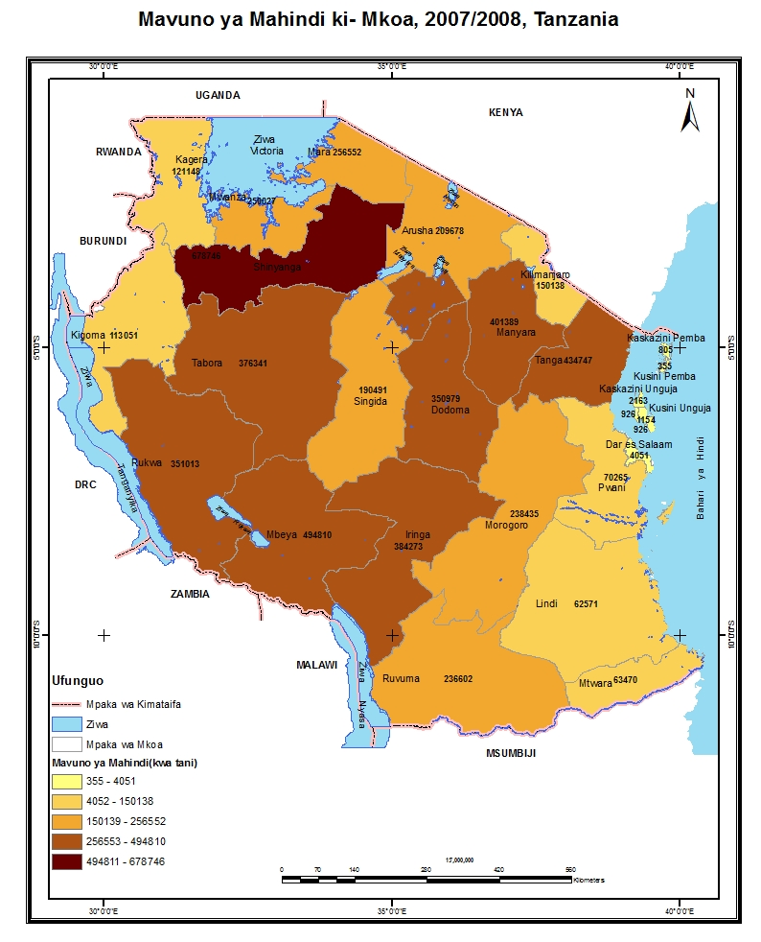

Slide 25
With the database we can also map:
Population density
Voting population
Dependency ratio
School enrolment ratio, etc

Slide 26
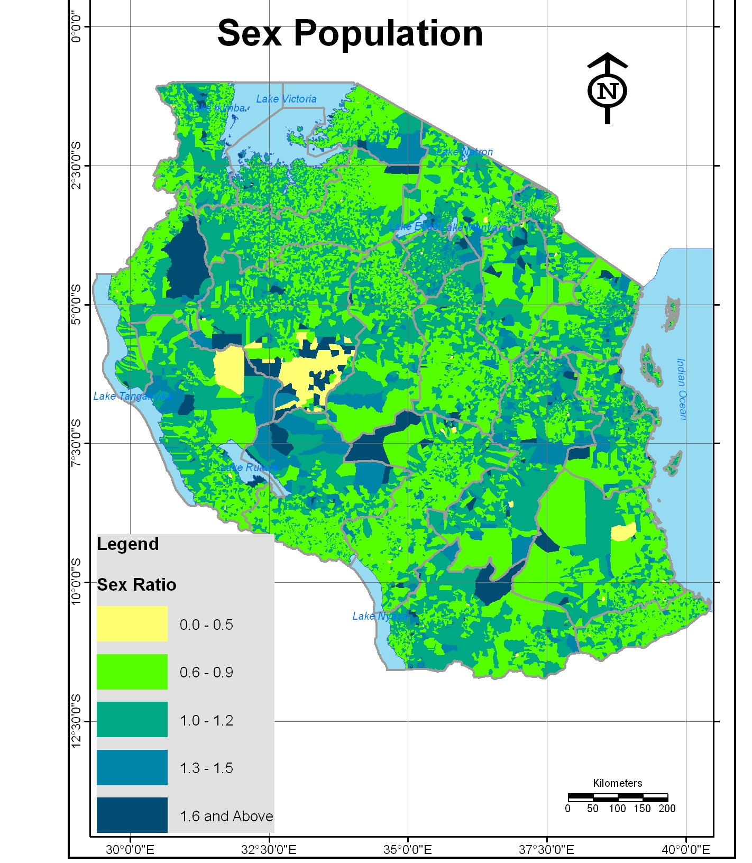

Slide 27
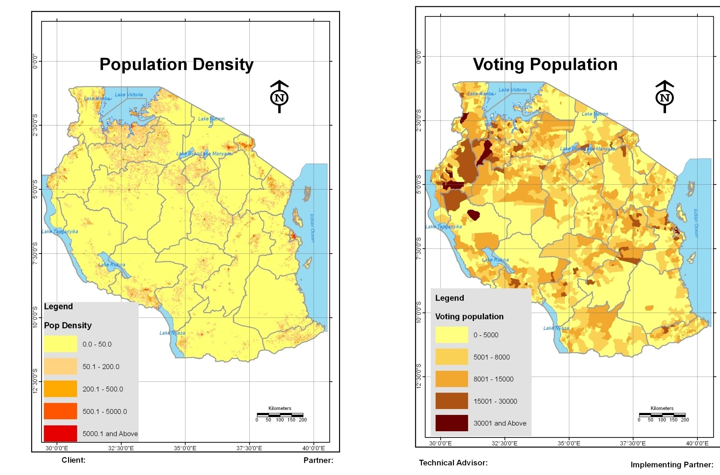

Slide 28
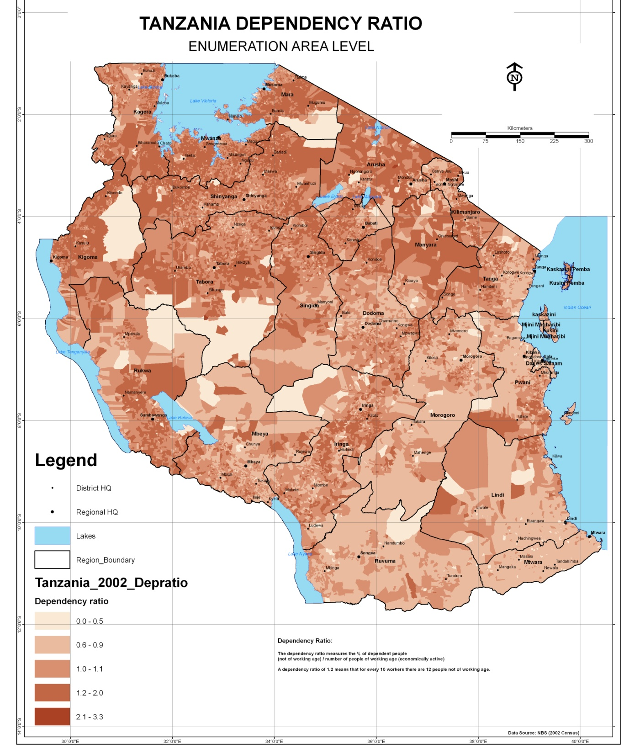

Slide 29
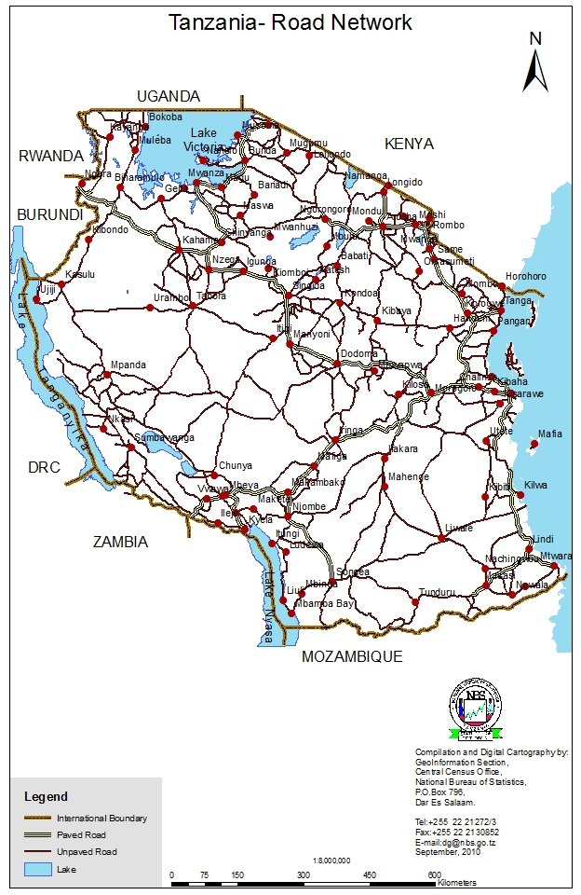

Slide 30
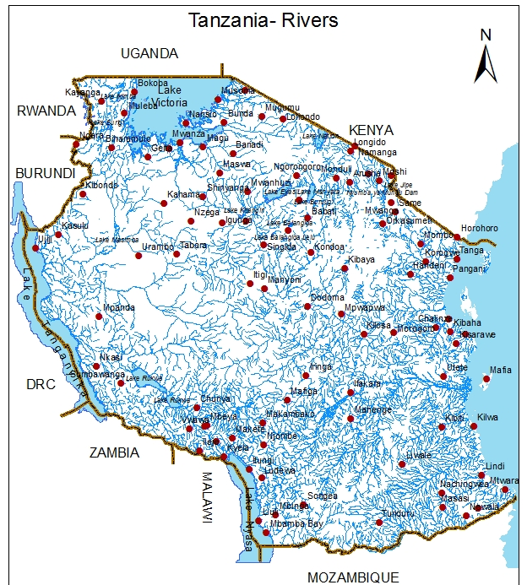

Slide 31
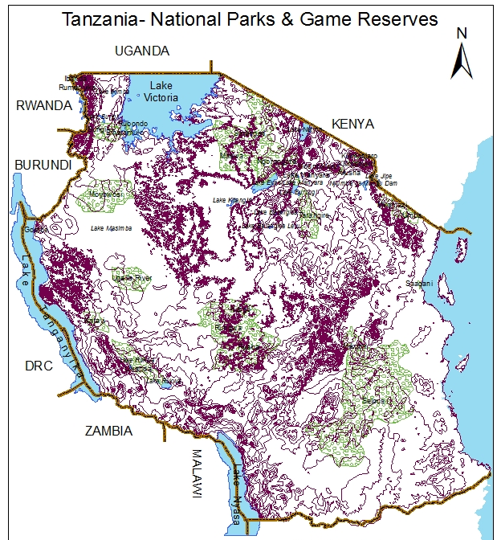

Slide 32
National Spatial Data Infrastructure (NSDI)
Technology (Infrastructure)
Policy (Data Sharing Policy)
Data Quality (Standards e.g. ISO etc)
People who collect data
Promote Geographical Data Sharing

Slide 33
National Spatial Data Infrastructure (NSDI) Status in Tanzania
National Steering Committee formed since 2003 soon after Population & Housing Census
Chaired by Dr E. Mtalo from Ardhi University
Draft of NSDI Policy is in place
There is a budget set by NBS to facilitate Steering Committee meetings

Slide 34
National Spatial Data Infrastructure (NSDI)
Not yet fully established within the Country
Only data exchange is done between NBS, SMD & IRDP
Both Spatial and Non-Spatial are Data shared
Other Organizations/ Ministries are encouraged to join/establish this infrastructure to facilitate data linking form these organizations

Slide 35
Data Sharing
At NBS we have a Dissemination Policy where the cost for our products are well documented
This enables data sharing with our stakeholders

Slide 36
Therefore:
All data from censuses and surveys can be presented spatially as seen in the maps shown.
Planning can be done spatially by looking at what is where instead of relying on assumptions
Decision makers and planners are highly encouraged to utilize the spatially referenced data for resource allocations.
Private sectors like banks, telecommunication companies, hotels etc can use the spatial data to plan for potential customers, suitable areas for new investments, etc

Slide 37
End
Thank you
Ahsanteni

