Slide 1


NAMIBIA –NATIONAL SPATIAL DATA INFRASTRUCTURE (NSDI)
ADDIS ABABA, ETHIOPIA
25 APPRIL 2018

Slide 2

OUTLINE
THE LEGAL FRAMEWORK
GOVERNANCE STRUCTURE AND INSTITUTIONAL ARRANGEMENTS
APPROACH FOR BUILDING A SPATIAL DATA INFRASTRUCTURE IN NAMIBIA
MECHANISMS FOR PRODUCING AND MAKING SPATIAL DATA ACCESSIBLE
NSDI LINKAGE TO NDP5 PILLARS
SUPPORTED SDGs INDICATORS
MILESTONES
CHALLENGES

Slide 3
The Legal Framework
Objectives of the Statistics Act, No. 9 of 2011 are to:
  Provide for the development of the National Statistics System and provide for its components and objectives;
  To establish the Namibia Statistics Agency and the Board of the Namibia Statistics Agency and provide for their powers and functions;
  To establish the National Spatial Data Infrastructure and provide for its objectives;
  To establish the Committee for Spatial Data and provide for its functions;
  To provide for incidental matters.
  Establishment of the NSDI is covered in detail in the Statistics Act, Sections 47 – 49.
Vision 2030
NSS (National Statistical System
NSDI (National Spatial Data Infrastructure
What, When
Where, How
--Continuum--
National Development Planning

Slide 4
The Legal Framework...Continued…
  The objectives for NSDI as set out in the Statistics Act 47 (2):
  facilitate the capture of spatial data through cooperation between government bodies and other organs of state;
  promote effective management and maintenance of spatial data;
  promote the use and sharing of spatial data in support of spatial planning, socioeconomic development and related activities;
  create an environment which facilitates coordination and cooperation among stakeholders regarding access to spatial data;
  eliminate duplication in the capturing of spatial data; and
  facilitate the protection of copyright of the state in works relating to spatial data.

Slide 5
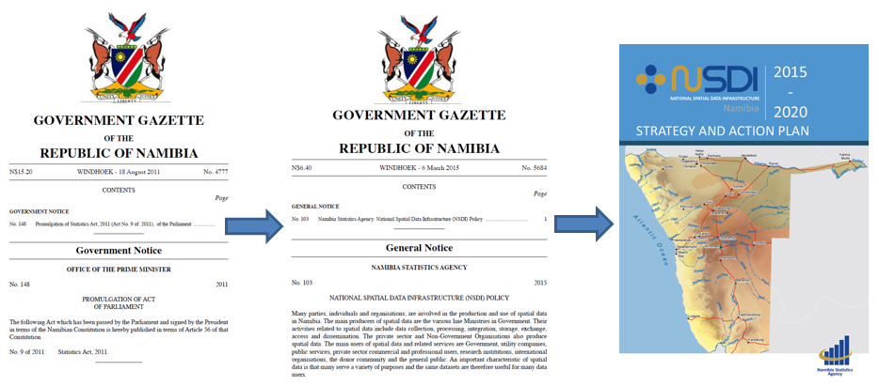
The Legal Framework...Continued…
Statistics Act 2011
NSDI Policy 2015
Strategic Plan 2015-2020

Slide 6

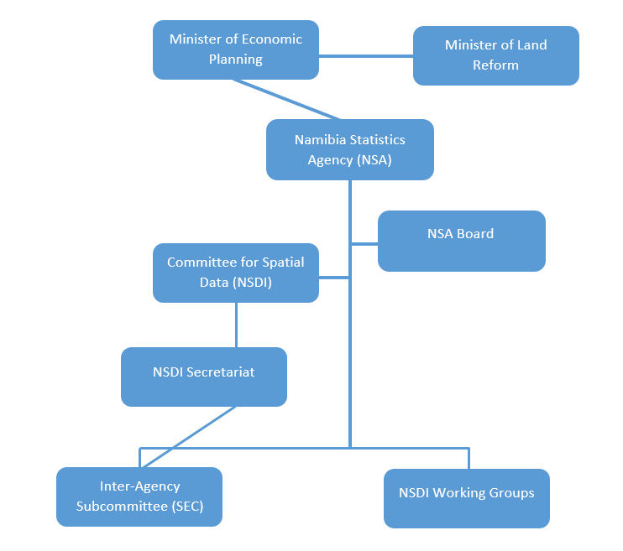
Governance Structure and Institutional Arrangements

Slide 7
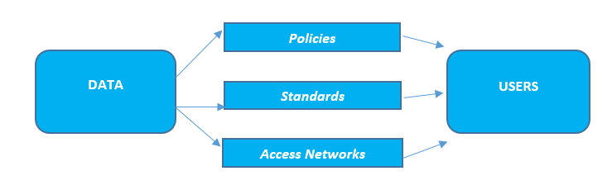
Implementation Approach/Model
Product-based model - This model according to Rajabifard (2002) links data to users through standards, policies and technologies facilitating data access.
Process-based model - emphasises on the different processes within the infrastructure.

Slide 8
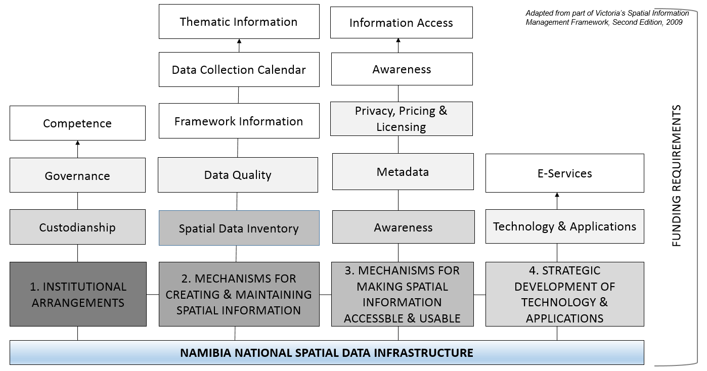
Approach for building a Spatial Data Infrastructure in Namibia

Slide 9
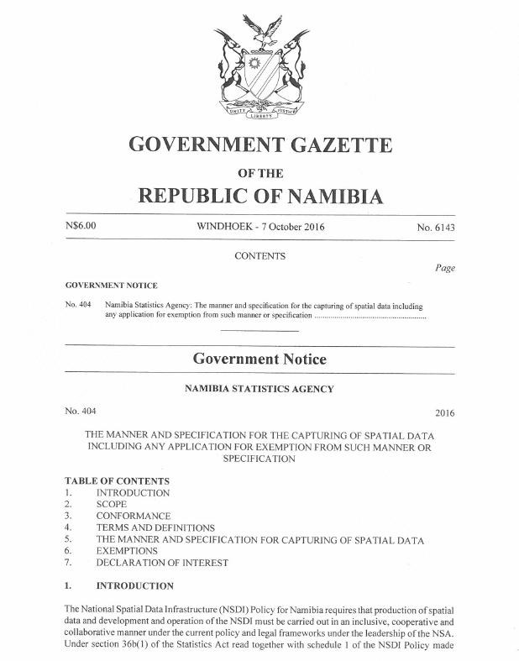
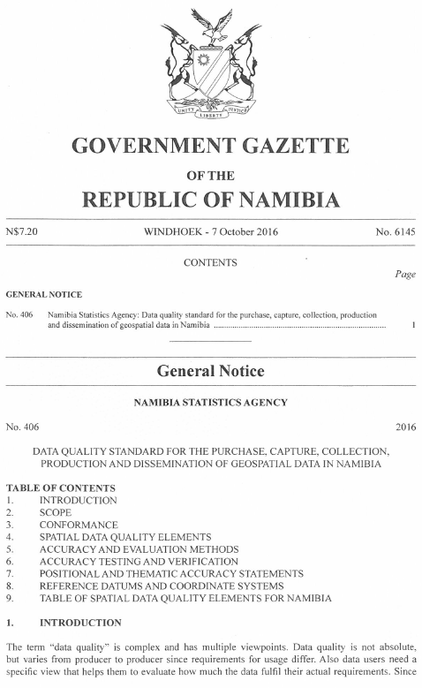
Mechanisms for creating and maintaining spatial information
Spatial Data Inventory for government
    388 datasets listed
    142 datasets with basic metadata
One guideline and a data quality standard gazetted in October 2016
Advance Data Collection Calendar (ADCC)
Conformance Programme to be developed in 2018/19

Slide 10
The Manner and Specification for Capturing Spatial Data - Gazette # 6143 of 2016
Mechanisms for creating and maintaining spatial information..Continued..
Requirements for data collection for fundamental datasets:
  1. Conformance
      Consent
      Notification with an improvement plan
  2. Metadata with quality statements
  3. Inclusion in the NSDI as country official dataset

Slide 11
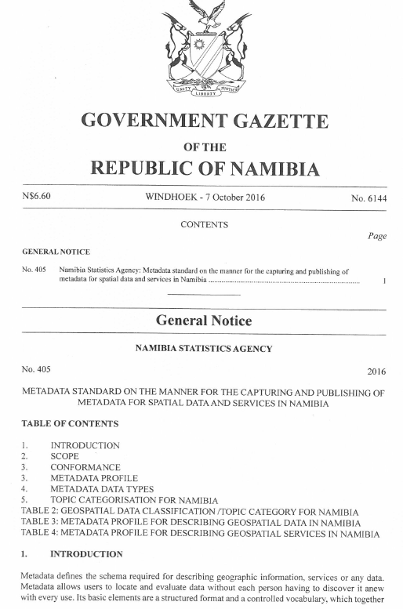
Mechanisms for making spatial information accessible
NSDI Communication Plan:
  National geographic portal
  NSDI Website, Newsletter, publications, communiques, Release Calendar (ADCC), Catalogue of data and services, etc.
  National Information Nodes e.g. kiosks, libraries, community centres

Slide 12
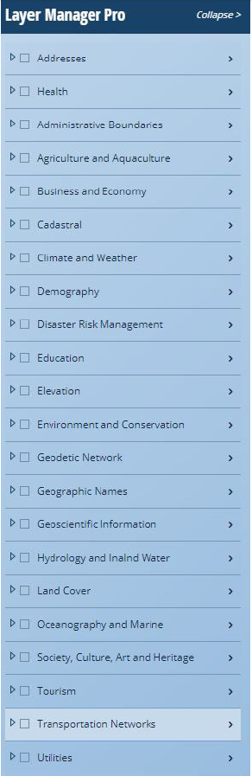
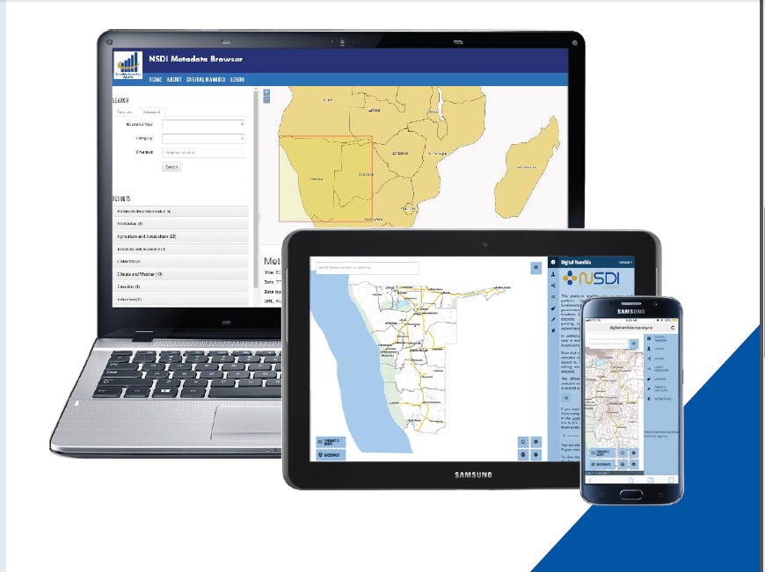
National Geographic Portal
http://geofind.nsa.org.na/
https://digitalnamibia.nsa.org.na/

Slide 13

NSDI linkage to NDP5 pillars
.
NSA high level products | NDP PILLARS
 | Economic progression | Social transformation | Environmental sustainability | Good governance
National accounts & sectoral statistics | x | X | x | x
Trade and price data | x | X | x | x
Income and expenditure patterns | x | X | x | x
Labour force statistics | x | X | x | x
Population dynamics and demographic profiles | x | X | x | x
Household statistics | x | X | x | x
Geographic information databases (NSDI) | x | X | x | x
Environmental statistics | x | X | x | x
Governance statistics | x | X | x | x

Slide 14
Supported SDGs Indicators
1.4.1 Proportion of population living in houses with access to basic services
1.4.2 Proportion of total adult population with secure tenure rights to land
6.1.1 Proportion of population using safely managed water resources
6.4.2 Level of water stress: freshwater withdrawal as a proportion of available freshwater resources

Slide 15
Supported SDGs indicators..Continued..
11.1.1 Proportion of urban population living in slums, informal settlements or inadequate housing
14.5.1 Coverage of protected areas in relation to marine areas
15.1.1 Forest area as a proportion of total land area
15. 3.1 Proportion of land that is degraded over total land area

Slide 16
Milestones
NSDI Policy - March 2015
NSDI High-level Awareness Workshops
NSDI Strategy & Action Plan 2015 – 2020: October 2015
Partnership Agreements – May 2016
Inter-Agency Steering Executive Subcommittee - August 2016
NSDI Capacity Building Programme 2016 - Ongoing
National Geographic Portal - August 2017

Slide 17
Challenges
Consultation, Cooperation and Coordination – the “3 C’s” for successful SDI implementation
Raising awareness at all levels
Facing and overcoming skills shortages among data owners, creators, and users - at all levels of government
Convincing high level stakeholders to join the initiative
Funding for NSDI (ICT infrastructures, standardization, national data priority, competence, and human resources)
Poor quality and outdated data sets – cost of data collection

Slide 18

Thank you

