Slide 1

Sub-Regional Workshop on
Integration of Administrative Data, Big Data and Geospatial Information for the Compilation of SDG Indicators
United Nations Development Account 10th Tranche Statistics and Data
ECA
Analysis of Country Responses
to the Country Assessment Questionnaire:
Integration of Statistical and Geospatial Information
Haile Mulualem, ECA
Addis Ababa, Ethiopia
23-25 April 2018

Slide 2
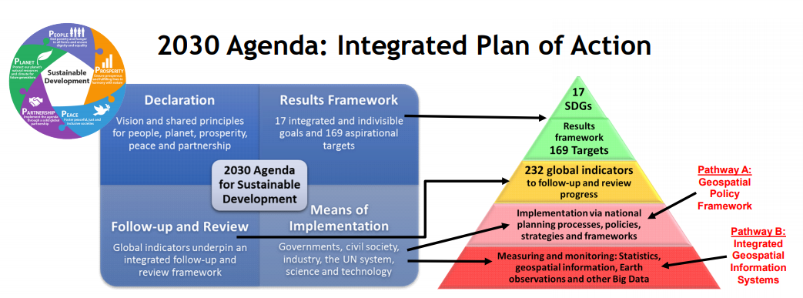
Any national SDG implementations will be sub-optimal without strategies and frameworks to integrate geospatial information into the measuring, monitoring and reporting processes.
NSSs must ensure that the coverage and level of data disaggregation for follow up and review of the 2030 Agenda leaves no one behind. NSSs need to invest in the technology and skills necessary to collect and integrate data from multiple sources, including integration of geospatial information with statistics and other data.
National geospatial and statistical information systems should be strengthened to facilitate and enable a ‘data ecosystem’ that leverages an accessible, integrative and interoperable local to global system-of-systems.
Notes:
The 2030 Agenda is an integrated plan of action structured in four main parts: (i) a vision and principles for transforming our world as set out in the Declaration; (ii) a results framework of 17 SDGs and 169 targets; (iii) a means of implementation through governments, society and global partnership; and (iv) a follow-up and review framework of global indicators. Any national SDG implementations will be sub-optimal without strategies and frameworks to integrate geospatial information into the measuring, monitoring and reporting processes.

Slide 3
Use of Geospatial Information at NSO

Slide 4
Procedures to investigate the potential use of geospatial information
10 NSOs have procedures in place to investigate the potential use of geospatial information for statistical purposes, including for the development of SDG indicators

Slide 5
Use of Geocoding to assign locations to statistical units
19 NSOs use geocoding to assign locations to statistical units
Access and use of Geospatial Information at NSO
18 NSOs have access to geocoded unit record data in a data management environment
These NSOs also use common geographies at the subnational level for the dissemination of statistics
Notes:
Geocoding can be broadly defined as the assignment of a code to a geographic location. Usually however, Geocoding refers to a more specific assignment of geographic coordinates (latitude,Longitude) to an individual address.

Slide 6
Relationship between NSO and Mapping agency
  In only 7 countries, the National Mapping Agency/Geospatial Authority is represented in a user advisory body (e.g. Statistical Council).
  In 8/22 NSOs, the NSDS have a relationship/coordination mechanism with the National Spatial Data Infrastructure (NSDI) and/or other National Policies (such as standardization, interoperability, and data sharing).

Slide 7
ECA
Thank You

