Slide 1
Sub-regional workshop on integration of administrative data, big data and geospatial information for the compilation of SDG indicators for English-speaking African countries
23-25 April 2018, Addis Ababa, Ethiopia
Non-traditional data sources for official statistics: what to retain from the current dynamics?
Léandre Ngogang, ECA

Slide 2
Are non-traditional data useful for official statistics?
UN-Fundamental Principles for Official Statistics:
“Official statistics provide an indispensable element in the information system of a democratic society, serving the Government, the economy, and the public with data about the economic, demographic, social and environmental situation” (principle 1)
“Data for statistical purposes may be drawn from all types of sources, be they statistical surveys or administrative records” (principle 5)

Slide 3
Are non-traditional data useful for official statistics?
African Charter on statistics:
“Data used for statistical purposes may be collected from diverse sources such as censuses, statistics surveys and/or administrative records. The statistics organizations shall choose their sources in consideration of the quality of data offered by such sources and their topicality, particularly the costs incurred by the respondents and sponsors” (principle 2)

Slide 4
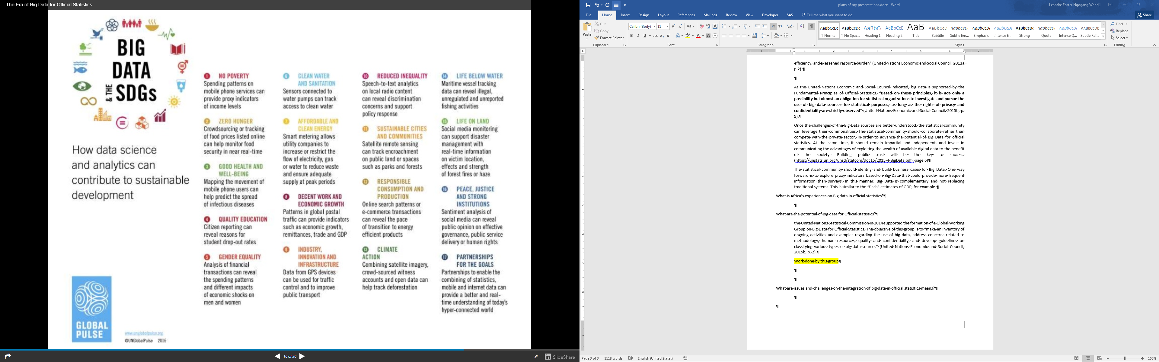

Slide 5
Are non-traditional data useful for official statistics?
45th UNSC: “by incorporating big data sources into their production of official statistics, national, regional and international statistical organizations could be better positioned to obtain official statistics on the economy, society and the environment in terms of improved timeliness and cost efficiency, and a lessened resource burden”
United Nations as a champion of data revolution, UN Global agenda for big data
Are non-traditional data useful for official statistics? No more a pertinent question!

Slide 6
What does big data sources mean for official statistics?
Legal framework ➔ right to access data from both government and non-government organizations
Privacy ➔ Guidelines, law
Partnerships ➔ Guidelines, collaboration between NSS and: academia, commercial partners, etc. to harness big data sources
Quality ➔ Guidelines , methodologies
Resources ➔ skills, human resources and capacity-building needed to address new data sources and big data required for dealing with Big Data
IT / methodological issues ➔ Standards, methodology, infrastructure

Slide 7
The way forward
Define how non-traditional data sources can be incorporated into official statistics
Development of guidelines, methodologies (proactive efforts in Africa)
  Conduct pilot studies
  Conduct researches on possible non-traditional data sources relevant for Africa’s realities
Guiding frameworks:
  UN Fundamental Principles for Official Statistics
  African Charter on Statistics

Slide 8


Thanks
For questions and comments:
Léandre Ngogang
African Centre for Statistics
Economic Commission for Africa
ngogangwandji@un.org

