Slide 1

Geospatial data and the 2030 Agenda
Who, what, where, when
Dany Ghafari /SDG and environment Statistics unit
Addis Ababa, Ethiopia, 23-25 April 2018

Slide 2
Geospatial data
Geospatial data sources
Geospatial based censuses and surveys
Physical mapping of land features, ecosystems, boundaries, ownership and other information
Earth Observation information, including satellite imagery, environmental monitoring stations and other in situ monitoring
Geospatial analysis
Turning geospatial data into indicators.
Using geospatial data to analyze state, trends, impacts and relationships.
© NABU/Holger Schulz
Photo credit to be given
as shown alongside
(in black or in white)
Notes:
People tend to use the term geospatial data and geospatial analysis interchangeably. However, for me, geospatial data includes any data which is already being compiled by its location where as geospatial analysis is using geospatial data to analyze a geographical or spatial aspect of sustainable development. More specifically, according to wikipedia, geospatial data is simply defined as “data and information having an implicit or explicit association with a location relative to the Earth”. Geospatial data includes a bulk of information as most census and surveys are moving toward using GIS; earth observation data also includes geolocation.
Geospatial analysis is how geospatial data are used to improve analysis of sustainable development, including looking at interactions between the social, environmental and economic aspects of development. For example, assume 95% of water bodies in a country have good ambient water quality, what are the environmental and social impacts of water quality? This question can only be answered by drilling down to the location of the water bodies that do not have good ambient water quality – who lives near these water bodies, what ecosystems are near these water bodies, what are the factors impacting water quality? All these involve geospatial analysis.

Slide 3
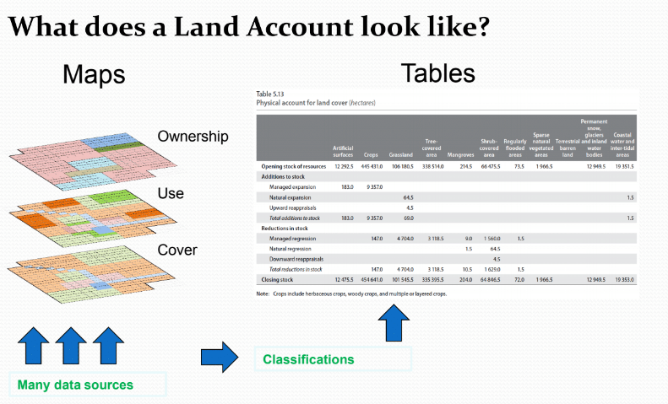
Land accounting
© NABU/Holger Schulz
Photo credit to be given
as shown alongside
(in black or in white)
Notes:
I just wanted to quickly touch on land accounting as a framework for turning geospatial data into statistics. Geospatial analysis can be used to combine many maps and then to convert those to statistics (by sub-national region or by water basin or by any designated location).

Slide 4
Geospatially relevant SDGs
The UN Group on Geospatial Information Management reviewed the SDGs from a geospatial lens and found:
15 indicators where geospatial information together with statistical data can be used to produce the indicator:
  □ Tier I: 9.c.1 14.5.1 15.1.1 15.1.2
  □ Tier II: 6.3.2 6.6.1 11.2.1 11.3.1 15.4.1
  □ Tier III: 2.4.1 6.5.2 9.1.1 11.7.1 14.2.1 15.3.1
  9 indicators where geospatial information can significantly support the production of indicator:
  □ Tier I: 1.1.1 4.5.1
  □ Tier II: 5.2.2 5.4.1 15.4.2
  □ Tier III: 1.4.2 5.a.1 5.a.2 11.7.2
© NABU/Holger Schulz
Photo credit to be given
as shown alongside
(in black or in white)
Notes:
The UNGGIM looked at where the source of data would likely come from GIS information, UN Environment is a custodian agency for 5 of these indicators and it is highlighted in Blue. This list is not exhaustive but reflects the views of the group on where GIS data can add value to the production of the indicator. This list relates more to where the group know of existing geospatial datasets that can be used for the production of the indicator (for example, 6.3.2 on water quality could be derived from existing earth observation data or 14.5.1 on marine protected areas from existing maps of protected areas, or 2.4.1 on the proportion of agriculture under sustainable agriculture could be derived from a mapping of agricultural land by type of agricultural practices).
The list does not represent a complete list of indicators for which geo-spatial analysis is important for understanding the situation, for example, 6.6.1 and 7.1.1 on the proportion of the population with access to water and energy, respectively, are not included, however, geospatial analysis of surveys would be important to identify where people are experiencing these challenges. Thus, the number of indicators for which geospatial disaggregation is much larger than those shown above. Particularly when analysing the linkages between people and the environment.

Slide 5



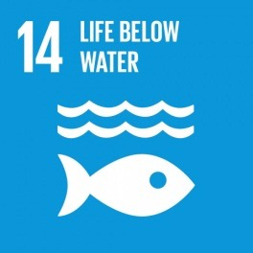


UN Environment Indicators
Water quality, water resource management and freshwater ecosystems
6.3.2, 6.5.1, 6.6.1
8.4.1, 8.4.2, 12.1.1, 12.2.1, 12.2.2, 12.3.1, 12.4.1,
12.4.2, 12.5.1, 12.6.1, 12.7.1, 12.a.1, 12.c.1
Sustainable consumption and production, including material flow accounts, chemicals and wastes, environmental policy, food waste and fossil fuels.
Ocean related indicators on marine litter, eutrophication, marine management and coverage of protected areas
14.1.1, 14.2.1, 14.5.1
15.1.2, 15.4.1, 15.9.1, 15.a.1, 15.b.1
Protected areas, including mountains, and national CBD targets, public expenditure on conservation and biodiversity
Environmentally sound technology and sustainable development policy
17.7.1, 17.14.1
Notes:
UN Environment is the custodian for 26 SDG indicators and we are involved in the analysis related to many other indicators. In terms of the indicators where we are developing the methodologies, many of our indicators are national level investment or policy-type indicators where geospatial data or analysis is not currently being explored (for example, integrated water resource management, SCP policy, fossil fuel subsidies, etc.) However, we do have a number of indicators that which be based on geospatial data or involve geospatial analysis (5 Indicators as mentioned in he previous slide 6.3.2, 6.6.1, 14.5.1, 15.1.2, 15.4.1).

Slide 6
UN Environment Indicators
Water quality and freshwater ecosystems
Chemicals and wastes and potentially corporate sustainability reporting
Ocean related indicators on marine litter, eutrophication, marine management and coverage of protected areas
Protected areas, including mountains
Notes:
Chemicals and waste and CSR are not likely to be derived from geospatial data in the same way as the others on this list – that are expected to come from earth observation or physical mapping data. However, we are looking to promote mapping of hazardous waste (some of this is already being done in the context of different MEAs) and we are looking to promote the collection of waste statistics and CSR at the city level in addition to the national level.
For three of the above indicators, water quality, freshwater ecosystem extent and eutrophication and marine litter, UN Environment is exploring opportunities to being satellite data into the picture in order to improve data availability and regularity of data collection. In particular, for freshwater ecosystem extent, using existing global land cover products as the starting point for ground truthing is being promoted not only for 6.6.1 but also for 15.3.1 on land degradation and 15.1.1 on forest extent.
UN Environment has a partnership with NASA, ESA and JRC related to satellite image usage in the SDGs.

Slide 7
Earth Observation
There are some resources already available:
(1) Moderate resolution, 250 m: The Climate Change Initiative Land Cover map (CCI-LC) includes maps of land cover for all countries
(2) High Resolution, Landsat, 30 m: Maps of water bodies from the Global Surface Water Explorer are publically available and UN Environment is collaborating with NASA on mapping wetlands at 30m resolution.
(3) Very High Resolution, 0.5 - 2 m: Data is available for purchase. UN Environment with NASA is planning a pilot to test the benefits of this level of resolution.
© NABU/Holger Schulz
Photo credit to be given
as shown alongside
(in black or in white)
Notes:
CCI-LC 250 M
Global Surface Water Explorer 30 M
Very High resolution 0.5 to 2 m data is available to purchase

Slide 8
Earth Observation and land cover
Two major global land cover products: The European Space Agencies (ESA) Climate Change Initiative land cover dataset (CCI-LC) and the United States NASA Moderate resolution Analysis (MODIS) at 250m resolution.
CCI-LC is proposed for the use in monitoring SDG indicator 15.3.1.
For water bodies, UN Environment is proposing the Global Surface Water Explorer at 30m resolution (available online)
© NABU/Holger Schulz
Photo credit to be given
as shown alongside
(in black or in white)
Notes:
These next slides provide additional detail on land cover for measuring ecosystem extent and what we are proposing for 6.6.1.

Slide 9
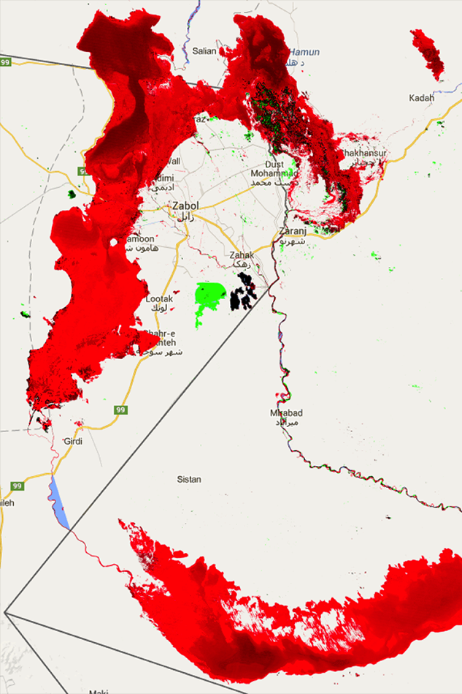
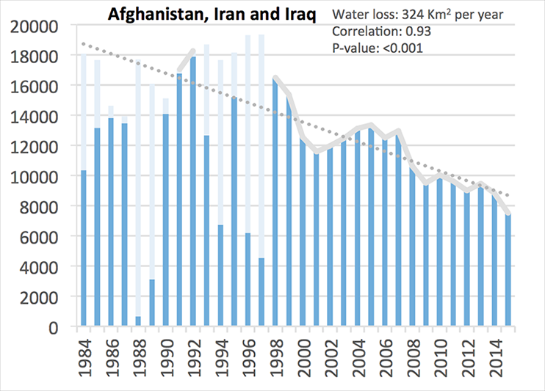
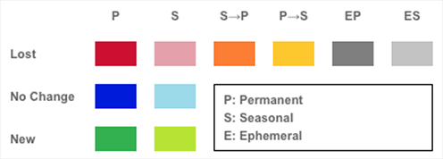
Example: Prepared by JRC
Map
Generated statistics
Tabulation of area
Iran and Afghanistan have lost 56% and 54% of the permanent surface water area they had in the 1980s: people, agriculture and ecosystems suffer
Notes:
JRC has created this demonstration of the global surface water explorer can be used to measure water body extent (as it relates to 6.6.1)
I just wanted to show a quick real example of using geospatial analysis to convert a map can into a simple indicator. In this case both the map and the generated statistics are useful for understanding the situation. Here we can measure the total number of pixels from the satellite image and convert to statistics
By User:Staecker - Own work, Public Domain, https://commons.wikimedia.org/w/index.php?curid=658367

Slide 10
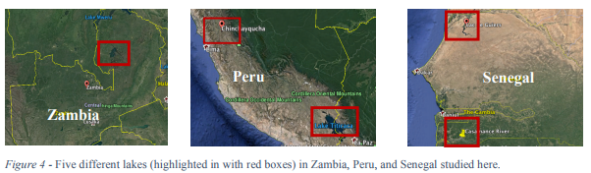
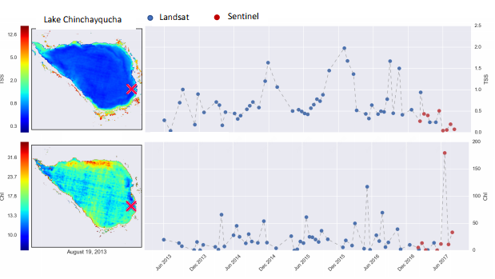
Example: Prepared by NASA
© NABU/Holger Schulz
Photo credit to be given
as shown alongside
(in black or in white)
Notes:
NASA has created this demonstration of how radar : data can be combined with Landsat and Sentinel to better understand water quality. The graph is showing Chlorophyll A and turbidity as an indicator of water quality which can be determined using satellite data.

Slide 11
Opportunities and challenges
Global products may not have the level of detail or exact classification types which are relevant for national stakeholders.
There is still a need for ground truthing of Earth Observation information.
Earth Observation does have challenges in terms of measuring the environment, but it presents a tremendous opportunity in that it can provide data for countries with limited capacity and can ensure comparability across locations and time.
© NABU/Holger Schulz
Photo credit to be given
as shown alongside
(in black or in white)
Notes:
Unfortunately, we do not have time to go into additional detail on EO; however, we are currently working on a user guide with NASA and with ESA and JRC on user friendly products. We would be happy to discuss further when there is more time.

Slide 12
Demo links
CCI-LC: https://www.esa-landcover-cci.org/?q=node/158
Global Surface Water Explorer: https://global-surface-water.appspot.com/
MODIS Land Cover (from https://modis-land.gsfc.nasa.gov)
European Environment Agency CORINE Land Cover example (from http://land.copernicus.eu/pan-european/corine-land-cover)
http://www.fao.org/faostat/en/#data/LC/visualize
© NABU/Holger Schulz
Photo credit to be given
as shown alongside
(in black or in white)

Slide 13
Thank you
Dany Ghafari /SDG and environment Statistics unit
Addis Ababa, Ethiopia, 23-25 April 2018
www.environmentlive.unep.org/statistics

