Slide 1

Bolster Data for the SDGs:
International Capacity Building Initiatives
Benjamin Rae
UNSD
28 September 2017
Lilongwe, Malawi

Slide 2

Overview
The Cape Town Global Action Plan and the First UN World Data Forum
10th Tranche Development Account Programme on Data and Statistics for the 2030 Agenda
UNSD-DFID Project on SDG Monitoring
Notes:
Developed by the HLG-PCCB
Informally launched at the first UN World Data Forum
Result of extensive consultations conducted with data communities, including official statisticians, civil society, private sector and academia.

Slide 3


The Cape Town Global Action Plan
for Sustainable Development Data was adopted by the Statistical Commission at its 48th Session in 2017
Developed by HLG-PCCB
Launched at the first UN World Data Forum in Cape Town, South Africa in January 2017

Slide 4
Cape Town Global Action Plan for
Sustainable Development Data
Framework for the design and implementation of country-led statistical capacity building activities necessary to achieve the 2030 Agenda
Proposes key actions under six strategic areas:
    Coordination and strategic leadership
    Innovation and modernization of NSS
    Basic statistical activities and programmes
    Data dissemination and use
    Multi-stakeholder partnerships
    Resource mobilization
Notes:
Developed by the HLG-PCCB
Informally launched at the first UN World Data Forum
Result of extensive consultations conducted with data communities, including official statisticians, civil society, private sector and academia.

Slide 5
UNSC Mechanisms in support of capacity building
High-level Group for Partnership, Coordination and Capacity-Building for statistics for the 2030 Agenda for Sustainable Development (HLG-PCCB)
Joint sub-group composed of members of both the HLG and the Inter-Agency and Expert Group on SDG indicators (IAEG-SDGs) -- developing a plan to address the immediate priorities for the implementation of the global SDG indicators

Slide 6
Next steps
Implementation guide for the CTGAP
Coordination of ongoing work in the area of capacity building
Follow up on the Objectives of the CTGAP at the Second UN World Data Forum in Dubai, October 2018
Notes:
A drafting group made up of members from the HLG-PCCB and PARIS21 as a key stakeholder was formed to develop the implementation guide for the CTGAP.

Slide 7
First United Nations World Data Forum
January 2017
Cape Town, South Africa
Over 80 sessions during the three-day event
Over 300 speakers and moderators
Brought together over 1,500 participants

Slide 8
Programme for the First UN WDF
Developed by the Programme Committee
Co-chairs Argentina and PARIS21
Consisted of 16 organizations, including three representatives from the HLG-PCCB.
  Private sector, academia, media, NGOs, etc.
Six thematic areas
  New approaches to capacity development for better data
  Innovations and synergies across different data ecosystems
  Leaving no one behind
  Understanding the world through data
  Data principles and governance
  The way forward
Notes:
Consisted of members from 16 organizations, including three representatives from NSOs who are part of the HLG-PCCB.
Argentina
Denmark
Mongolia
ISI
Paris21
UNICEF
Telefonica
Gapminder
Af Dev Bank
ECA
UN Foundation
World Bank
Columbia University
Development Initiatives
CEPEI
Data Pop Alliance

Slide 9
10th Tranche Development Account Programme on Statistics and Data (DA10)
Objective:
To strengthen the statistical capacity of developing countries to measure, monitor and report on the sustainable development goals in an accurate, reliable and timely manner for evidence-based policymaking
Principles:
Adapt to the needs of the countries and the evolving agenda
Build on comparative advantages of the Development Account implementing entities
Build on existing initiatives and programmes (coordination)
Encourage external participation and funding (partnership)

Slide 10
DA10 Implementing Agencies
Global Entities | Regional Entities
UNSD (DESA) UN Statistics Division | ECA UN Economic Commission for Africa
UNCTAD UN Conference on Trade and Development | ECE UN Economic Commission for Europe
UNEP UN Environmental Programme | ECLAC UN Economic Commission for Latin America and the Caribbean
UN-Habitat UN Human Settlements Programme | ESCAP UN Economic and Social Commission for Asia and the Pacific
UNODC UN Office on Drugs and Crime | ESCWA UN Economic and Social Commission for Western Asia
10th Tranche Development Account Programme on Statistics and Data (DA10)
Objective:
To strengthen the statistical capacity of developing countries to measure, monitor and report on the sustainable development goals in an accurate, reliable and timely manner for evidence-based policymaking
Principles:
Adapt to the needs of the countries and the evolving agenda
Build on comparative advantages of the Development Account implementing entities
Build on existing initiatives and programmes (coordination)
Encourage external participation and funding (partnership)

Slide 11
DA10 Implementing Agencies
Global Action Plan [HLG-PCCB]
Framework for reflection, planning, and implementation of statistical building programmes to achieve the scope and intent of the 2030 Agenda.
Environmental pillar
Social & demographic pillar
Economic pillar
Guidelines to support SDG country reporting [UNDG]
Global Indicator Framework [IAEG-SDGs]
Means of Implementation

Slide 12
DA10 Activities and Deliveries
Regional, sub-regional and national workshops / seminars / trainings
Expert group / technical group meetings
Advisory services / country missions
Guidelines / methodology / tools
Training material / e-learning / case studies / best practices
DA10: budget and timeframe
USD 10M
Sept 2017 – Dec 2019
Subsequent tranches of DA could complement or extend the DA10

Slide 13
4 Pillars of DA10
Pillar 1: Means of implementation
Cross-cutting pillar aiming at enhancing capacity of developing countries to strengthen statistical institutional environments and production processes across multiple statistical domains (integration)
Pillar 2 – 4: Statistical domains
Sectoral pillars aiming at strengthening capacity in developing countries to measure and monitor sustainable development goal indicators in environment [2], social and demographic [3], and economic [4] statistics areas
The social and demographic pillar [3] is subdivided in 4 components: population and demographic statistics; gender statistics; poverty and inequality statistics; and peaceful and inclusive society statistics

Slide 14
DA10: Some Key Activities Under Pillar 1
Opening workshops
(Sub-) Regional Workshop on institutional environment, cooperation, dialogue and partnerships for production and utilization of SDG indicators
(Sub-) Regional Workshop on data disaggregation
(Sub-) Regional Workshop on integration of administrative data, big data and geospatial information for the compilation of SDG indicators
Advisory services
E-learning platform on Official Statistics

Slide 15
UNSD-DFID Project on SDG Monitoring
Purpose:
To make Sustainable Development Goals indicators available to the broadest possible audience, and to strengthen the capacity of partner countries in the compilation and use of these indicators.

Slide 16
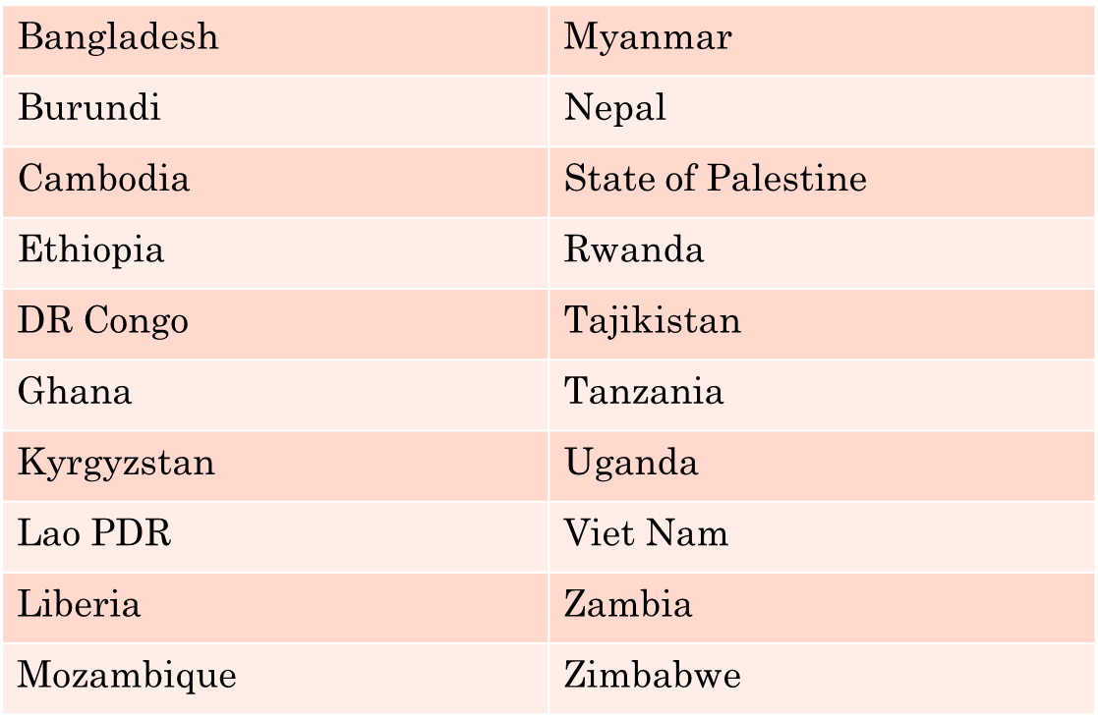
UNSD-DFID Project on SDG Monitoring
Project Countries:

Slide 17
UNSD-DFID Project on SDG Monitoring
Major Activities:
Research and analysis of country capacities
Develop National SDGs Monitoring Strategies
Create or upgrade national repositories of SDG indicators
Technical assistance; missions; workshops at national and international level; study visits
Development of the SDG Data and Visualization Platform/Country Data Lab; setting up automated data exchange

Slide 18
UNSD-DFID Project on SDG Monitoring
National Dissemination Platforms:
The project will work with each country to identify a suitable statistical dissemination platform
  Not necessarily limited to SDGs
Training in the use of the platform as well as other support will be provided as necessary
SDMX Data and Metadata exchange modules will be developed and supported
  National experts will be trained to enable the NSOs to operate data dissemination and exchange

Slide 19
UNSD-DFID Project on SDG Monitoring
User Engagement:
Concerns raised over the efficacy of and demand for national dissemination platforms
  PARIS21 research paints a bleak picture
Identifying users and addressing their needs a major feature of the project
Lesson learned: NSO staff is one of the most important user groups
  Dissemination systems tend to see little use by the staff themselves, resulting in a vicious circle of deteriorating quality and reduced interest
  But user engagement is by no means limited to the NSO staff!

Slide 20
UNSD-DFID Project on SDG Monitoring
Metadata:
A major focus of the project
  Key to establishing methodology and quality as well as explaining differences between the international and national datasets
The project will assist the countries in the compilation of metadata for SDGs indicators
Training, capacity development, and other support will be provided
Publication of metadata will be facilitated
  Nationally and, through SDMX exchange, at the SDGs platform

Slide 21

THANK YOU

