Slide 1

Capacity Building for Monitoring and Reporting on SDG 11
Make Cities and Human Settlements Inclusive, Safe, Resilient and Sustainable
Inception Meeting
Lilongwe, Malawi
27 - 29 September 2017

Slide 2



SDG Indicators with Urban Component
240 Indicators are part of the Global Monitoring Framework adopted by the Statistical Commission
Around one third of them can be measured at the local level
Around 80 indicators have an urban component
Direct connection to urban policies and clear impact on cities and human settlements
e.g Indicator 1.4.2 Proportion of total adult population with secure tenure rights to land, with legally recognized documentation and who perceive their rights to land as secure, by sex and by type of tenure

Slide 3
Targets: Goal 11 contains 10 Targets
Outcome-oriented | Process-Oriented
11.1: Housing and Slums | 11.a: Urban-rural linkages
11.2: Sustainable transport | 11.b: Risk reduction
11.3: Participatory planning | 11.c: Sustainable buildings
11.4: Cultural heritage
11.5: Disaster Reduction
11.6: Air Quality and Waste Management
11.7: Public spaces
Other Human settlements indicators are in other goal and targets

Slide 4
Target | Indicator | Tier
1.4 By 2030, ensure that all men and women, in particular the poor and the vulnerable, have equal rights to economic resources, as well as access to basic services, ownership and control over land and other forms of property, inheritance, natural resources, appropriate new technology and financial services, including microfinance. | 1.4.1: Proportion of population living on households with access to basic services | Tier III
 | 1.4.2: Proportion of total adult population with secure tenure rights to land, with legally recognized documentation and who perceive their rights to land as secure, by sex and by type of tenure | Tier III
6.3 By 2030,improve water quality by reducing pollution, eliminating dumping and minimizing release of hazardous chemicals and materials, halving the proportion of untreated wastewater and substantially increasing recycling and safe reuse globally | 6.3.1: Proportion of wastewater safely treated | Tier III
11.1 By 2030, ensure access for all to adequate, safe and affordable housing and basic services and upgrade slums | 11.1.1: Proportion of urban population living in slums, informal settlements or inadequate housing | Tier II
11.2 By 2030, provide access to safe, accessible and sustainable transport systems for all, improving road safety, notably by expanding public transport, with special attention to the needs of those in vulnerable situations, women, children, persons with disabilities and older persons. | 11.2.1: Proportion of population that has convenient access to public transport, by sex, age and persons with disabilities | Tier II

Slide 5
Target | Indicator | Tier
11.3 By 2030, enhance inclusive and sustainable urbanization and capacity for participatory, integrated and sustainable human settlements planning and management in all countries | 11.3.1: Ratio of land consumption rate to population growth rate | Tier II
 | 11.3.2: Proportion of cities with a direct participation structure of civil society in urban planning and management that operate regularly and democratically | Tier III
11.4 Strengthen efforts to protect and safeguard the world’s cultural and natural heritage | 11.4.1: Total expenditure (public and private) per capita spent on the preservation, protection and conservation of all cultural and natural heritage, by type of heritage (cultural, natural, mixed and world heritage center designation), level of government (national, regional and local/municipal), type of expenditure (operating expenditure/investment) and type of private funding (donations in kind, private non-profit sector and sponsorship | Tier III
11.5 By 2030, significantly reduce the number of people affected and substantially decrease the direct economic losses relative to global gross domestic product caused by disasters, including water-related disasters, with a focus on protecting the poor and people in vulnerable situations. | 11.5.1: Number of deaths, missing persons and directly affected persons attributed to disaster per 100,000 population | Tier II
 | 11.5.2: Direct economic loss in relation loss to global GDP, damage to critical infrastructure and number if disruption to basic services, attributed to disasters. | Tier II
11.6 By 2030, reduce the adverse per capita environmental impact of cities, including by paying special attention to air quality and municipal and other waste management | 11.6.1: Proportion of urban solid waste regularly collected and with adequate final discharge out of total urban solid waste generated, by cities | Tier II
 | 11.6.2: Annual mean levels of fine particulate matter (e.g. PM 2.5 and PM10) in cities (population weighted) | Tier I

Slide 6
Target | Indicator | Tier
11.7 By 2030, provide universal access to safe, inclusive and accessible, green and public spaces, in particular for women and children, older persons and persons with disabilities | 11.7.1: Average share of the built-up area of cities that is open space for public use for all, by sex, age and persons with disabilities | Tier III
 | 11.7.2: Proportion of persons victim of physical or sexual harassment, by sex, age, disability status and place of occurrence, in the previous 12 months. | Tier III
11.a Support positive economic, social and environmental links between urban, peri-urban and rural areas by strengthening national and regional development planning. | 11.a.1: Proportion of population living in cities that implement urban and regional development plans integrating population projections and resource needs, by size of city. | Tier III
11.b By 2020, substantially increase the number of cities and human settlements adopting and implementing integrated policies and plans towards inclusion, resource efficiency, mitigation and adaptation to climate change, resilient to disasters, and develop and implement, in line with Sendai Framework for Disaster Risk Reduction 2015-2030, holistic disaster risk management at all levels. | 11.b.1: Proportion of local governments that adopt and implement local disaster risk reduction strategies in line with national disaster risk reduction strategies. | Tier III
 | 11.b.2: Proportion of financial support to the least developed countries that is allocated to the construction and retrofitting of sustainable, resilient and resources-efficient buildings utilizing local materials. | Tier II
11.c Support least developed countries, including through financial and technical assistance, in building and resilient buildings utilizing local materials. | 11.c.1: Proportion of financial support to the least developed countries that is allocated to the construction and retrofitting of sustainable, resilient and resource-efficient buildings utilizing local materials | Tier III

Slide 7

UN-Habitat challenges
1: Monitoring SDGs. Spatial Indicators
Indicators with a spatial component
Geospatial data, adequate technology and management system will be needed for the measurement of the spatial indicators of the Goal 11
Spatial disaggregated data provides relevant information for policy-makers to decide on local-level allocation of resources and monitoring of equitable outcomes.
11.1 11.1 11.3
Slums and housing
Transport
Land Consumption
11.7
New form of collection
New form of analysis
Public Space

Slide 8
Some SDG implementation challenges ….
Reporting for Goal 11
How to manage spatial data needs ?
How to deal with countries with many cities/urban centers?
Variations in understanding definitional issues of indicators at various levels
Technological needs for monitoring
Defining what a city or urban area or human settlements is?
Partnerships arrangements
Different reporting levels
Several indicators require to be collected locally:
11.2 11.3 11.4
Public Transport
Land Consumption
Cultural heritage
11.6 11.7
Solid waste and
air quality
Public Space

Slide 9



CAPACITY BUILDING EFFORTS
DA 10 project on monitoring and reporting on SDG 11
Pilot Countries in Africa
The Project will support countries to:
Design monitoring tools to improve availability and access to data at city & urban national levels for systematic reporting over time
Create a consistent sample set of cities for national level reporting (territory, geography, size, history)
Strengthen capacities for quality data production, multilevel coordination & inter-linking with SDG 11 and others related with urban components to monitor and report
Pilots also planned in Ecuador and Colombia

Slide 10
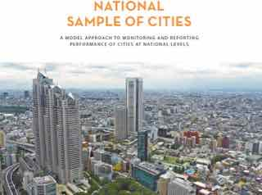
CAPACITY BUILDING EFFORTS
2: National Sample of Cities
Indicators that need a local collection of data
National governments need to create a consistent set of cities that is representative of their territory, geography, governance and history.
NSC provides tools to ensure consistency in the analysis, comparability in results, proper evaluation of progress, uniformity in reporting, and better connection to national policies
11.1 11.2 11.3
Slums and housing
Transport
Land Consumption
11.6 11.7
Solid waste and
air quality
Public Space

Slide 11
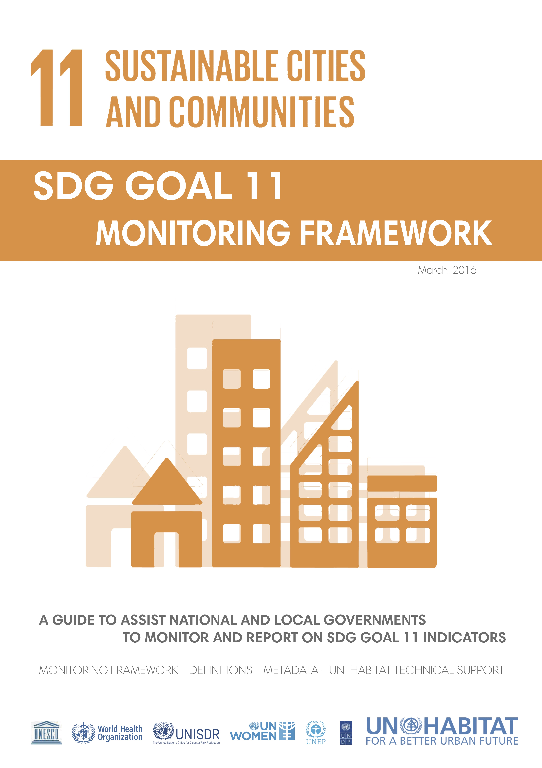
What UN-Habitat is doing
3. SDG Goal 11 Indicators: Definitions and Metadata
A Global Monitoring Tool that serves as a guide to assist national and local governments in their efforts to collect, analyze, validate data and information in view of the preparation of country-based reports.
The Metadata provides necessary definitions, method of computation and technics to estimate indicators, including spatial indicators.

Slide 12

What UN-Habitat is doing
3. Expert Group Meetings and Workshops
First Technical workshop held in February 2017,Naivasha, Kenya.
Geospatial Technical EGM held in Brussels, Belgium in April 2017
Main objective: Help UN-Habitat and partners to refine indicators classified as Tiers II and III.
Discuss and agree on the approach, methodology and ways of computation of specific indicators with outstanding challenges related to the monitoring of the SDGs at local levels, particularly spatial indicators.

Slide 13
What UN-Habitat is doing
1. Development of training modules:
Highlights type of data acquired from the data sources
Step-wise procedures of computing the indicators.
Indicator interpretation
Support in training sessions
Regional workshops to be conducted
ECA workshop to be conducted in November in Botswana
  7 training modules developed
Country support missions
2. Strengthen national statistical capacity and improve reporting mechanisms.

Slide 14

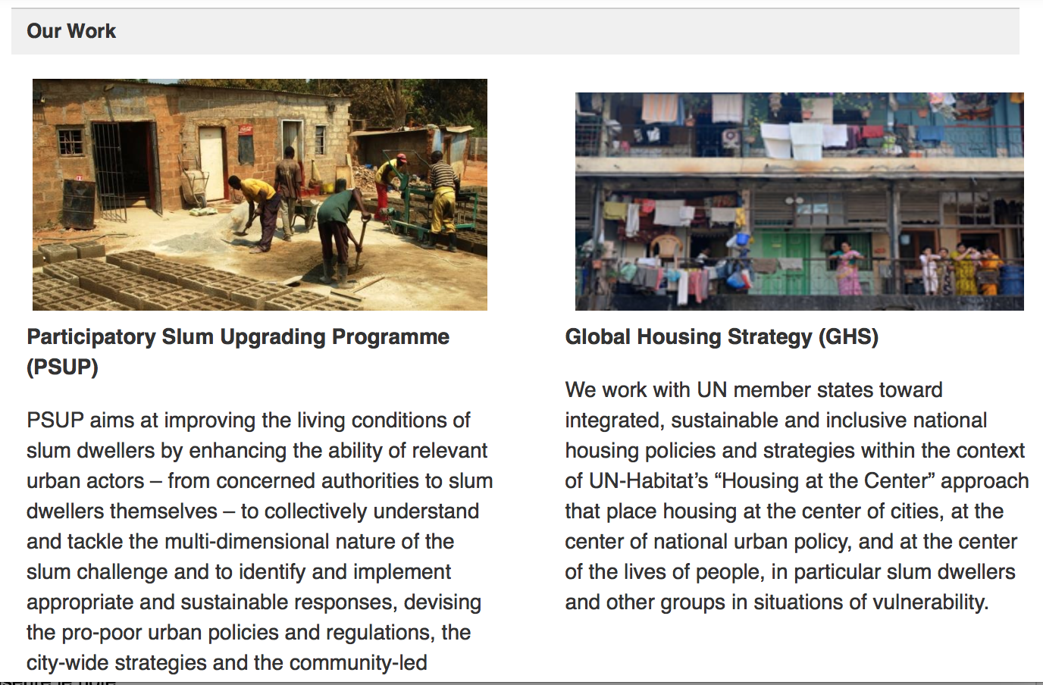
What UN-Habitat is doing
4. UN-Habitat SDGs Webpage
A website dedicated to UN-Habitat approach, involvement and support to SDGs, with a particular focus on Goal 11 and other urban related indicators
Countries, local governments and other stakeholders will find information on the SDGs process, on Goal 11 indicators and all the tools, projects and activities of UN-Habitat related to the SDGs

Slide 15


THANK YOU
Donatien Beguy, PhD
UN-HABITAT Nairobi, Kenya.
Email: donatien.beguy@unhabitat.org

