Slide 1


WELCOME TO SOMALI FEDERAL GOVERMENT PRESENTATION
(Somali Statistic Office)
ABDINASIR ROBLE ABUKAR
27-29 September 2017

Slide 2

Welcome to
Presentation of
Statistical Capacity Building initiatives

Slide 3
Outlines
Introduction-Somalia
The concept of capacity
Why is important capacity
Achievements
Challenges
Opportunities
How can we improve our capacity
Current status (where we are –and activities

Slide 4
Somalia History
Somalia Is one of the African Arab countries, located in the east of the continent of Africa, a region known as the Horn of Africa bounded on the east by the Gulf of Aden and Indian Ocean. Somalia has been inhabited since the Paleolithic period. Cave paintings said to date back to 9000 BC have been found in the northern part of the country. Somalia has long been known as a nation of poets Because of the beautiful views.

Slide 5
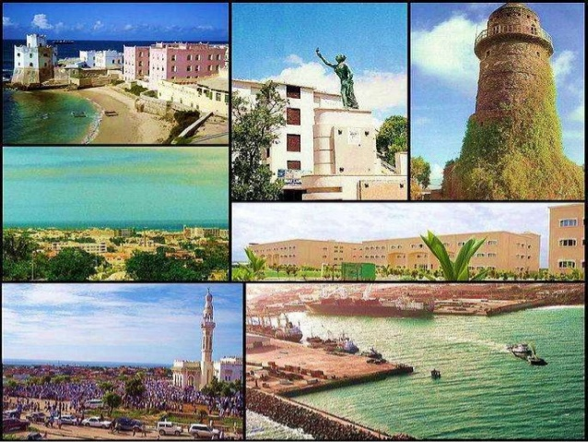
Historical Places

Slide 6
Geography
Somalia, situated in the Horn of Africa, lies along the Gulf of Aden and the Indian Ocean. It is bounded by Djibouti in the northwest, Ethiopia in the west, and Kenya in the southwest. In area it is slightly smaller than Texas. Generally arid and barren, Somalia has two chief rivers, the Shebelle and the Juba.

Slide 7
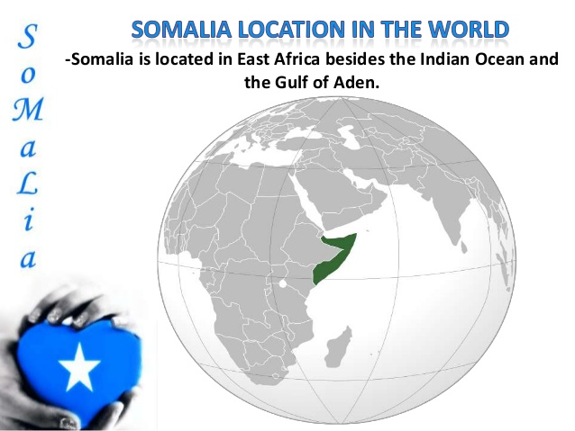
Somali location

Slide 8
Concept of Capacity building
What is a capacity building?
“A process that focuses on enhancing the skills, knowledge and social capabilities available to individuals, individuals, social and political systems” (UN)
“The sustainable creation, utilization and retention of capacity, in order to reduce poverty, enhance skills, achieve growth, equalize opportunities and enhance people’s lives”(UNDP)

Slide 9
Concept of Capacity building (cont.…)
Capacity building covers a wide range of issues, including actions to strengthen and further develop human resources, infrastructures or organizational arrangements within a community or organization.
Capacity building in the context of social entrepreneurship: needs and current practices e.g. ability of whole countries to manage their affairs successfully - to the micro and the operational, e.g. the ability of staff to talk effectively to one another.

Slide 10
Why is important capacity
Capacity building is particularly important in dealing with the improvement of employee skills, expertizing and to have ability for doing/exercising a good performance or service delivery. Capacity building is the all-important “infrastructure” that supports and shapes Organizations into forces for good. Capacity building enables the organizations and their leaders to develop competencies and skills that can make them more effective and sustainable, thus increasing the potential for charitable nonprofits to enrich lives and solve society’s most intractable problems

Slide 11
Challenges
  Parallel efforts by IC and within government
  The effect of conflict
  Limited skilled staff and tools due to financial constraint
  Lack of continuous funding for statistical activities;
  Uncorrelated & not Harmonized;
  Insufficient allocation of funding for statistical actions and activities; (Budgets);

Slide 12
Solutions & Opportunities
Access to Somali Diaspora Network and local academic institutions ( Creating pools for Capacity Development Initiatives);
linking statistical activities to our very new National Development Plan ( NDP to SDGs alignment);
Partnerships at national, regional and international levels;
      South- Africa, Rwanda, Arab countries;
Modernisation of Statistical Law – New act in-front of the cabinet and set go to the Federal Parliament when new government is formed;
Better use of administrative and big data in order to reduce costs - Less dependency of primary data collection;

Slide 13
Achievements
The Population Estimation Survey in 2014
(PESS) is the first extensive household sample survey to be carried out among the Somali population in decades. This report provides reliable and comprehensive population estimates by region and important demographic characteristics. Prior to this, Somalis have had to endure a long spell of absence of information on the numbers of people in each region and important characteristics of the Somali people.

Slide 14
Achievements (cont.….)
The last information available on population is from a census conducted in 1975, the second conducted from 1985 to 1986 .
4500 enumerators across the country
More than 20 data analysis trained
Mapping
Sampling frame

Slide 15
How can we improve our capacity
Coordination
On job training
Act
Implementing NSDS
Commitment (partners and Government)
Technical and financial support
Country-led, country-own

Slide 16
Current status (where we are –and activities)
Economic division produces data of consumer price index (CPI) in monthly, reports and publishes to Directorate of national statistics (DNS) website quarterly and etc.
Social division is produces health, education, traffic accidents data reports and etc.
Survey division designs and draws empowering the team to equipping skills/knowledge for preparation the largest data collection surveys at nation level (e.g. Demographic health survey is going to start now) and etc.
Demographic division is a most analyzes social statistics, as of the births, deaths, diseases, marriages data producer sector and etc.

Slide 17
Cont.…
Statistical Information and Publication (SIP) Division
The Statistical Information and Publication (SIP),This Section is responsible for data processing of surveys and censuses carried out, the Local Area Network (LAN), Hardware, Software, Internet, External Web Site, Intranet, Security, Backup, and Digitized maps, Documentation, Archiving, Data-bases and ICT Training etc. To accomplish its mission, the SIP Section.

Slide 18
Thank for your attention

