Slide 1

The importance of measuring the nexus between the environment and the social dimension of development
Lowri Angharad Rees
UN Environment
Africa Office

Slide 2
Social-economic-environment nexus
Transforming our World
An Integrated Approach for People, Planet and Prosperity, fostering Peaceful, just and inclusive societies through a revitalized global Partnership
Socio-Environmental Nexus
Sustainably manage natural resources to support needs of present and future generations
Basis for all economic activity
Access to basic services (water, energy)
Food security
Prevention of conflicts and disasters
Social Dimension
End poverty and hunger
Combat inequalities
Protect human rights
Promote gender equality
Empower women and girls
Foster peaceful societies
Universal access: education, health
Leave no one behind
Environmental Dimension
Live in harmony with nature
Protect wildlife and other living species
Sustainably use all natural resources —air, land, mountains, rivers, lakes , aquifers , oceans, seas
Develop and apply technology that is climate-sensitive, and respects biodiversity
Leave no one behind
Economic Dimension
Inclusive and sustained economic growth
Shared prosperity
Decent work for all
Safe, resilient and sustainable human habitats
Universal access to affordable, reliable and sustainable energy
Leave no one behind
Socio-Economic Nexus
Inequality and inclusive prosperity
Decent jobs
Sustainable consumption and production
Sustainable cities
Economy-Environment Nexus
Resource efficiency
Sustainable growth
Decent (green) jobs
Detoxify
Notes:
Sustainable development has diverse nexus areas on which policy makers focus to meet their objectives.
Most common of these Nexus areas link two of three dimensions of sustainable development of immediate concern. These include:
Socio-environmental
Economic-environmental
Socio-economic
The 17 SDGs of the 2030 Agenda are indivisible and integrated.
Integrated approach – Note that one cannot integrate on everything with everyone everywhere
Nexus approach is a subset of the Integrated Approach
Nexus approach stresses integration of all three dimensions of sustainable development
Though a subset the Integrated Approach, nexus integration sharpens boundaries of focus
Nexus approach contributes to transforming our world

Slide 3
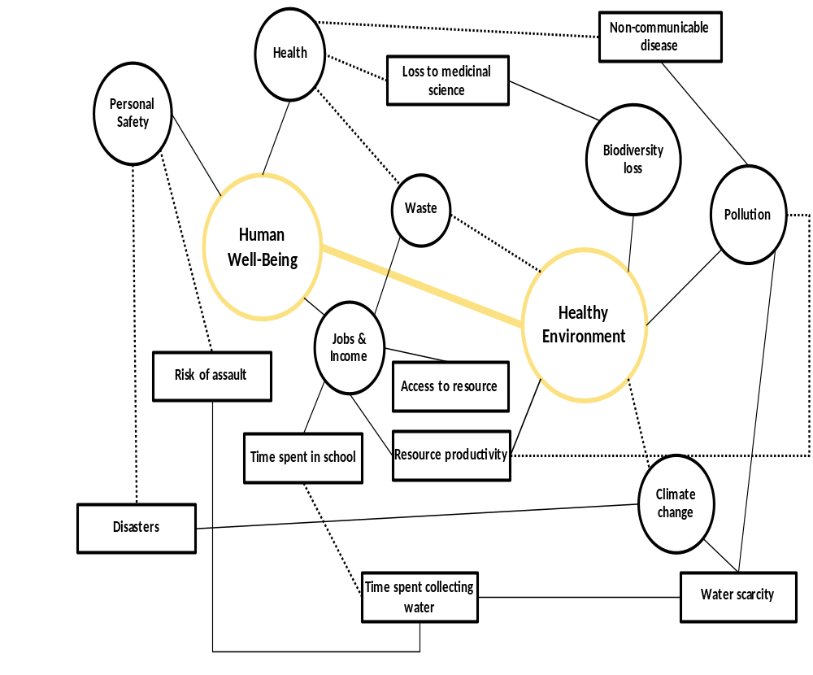
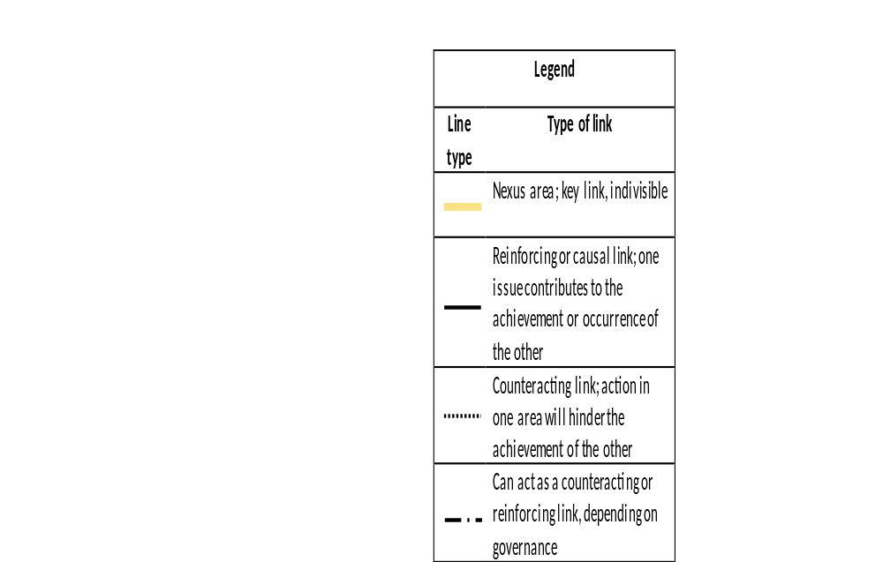
Human well-being and healthy environment
Notes:
Human well-being & environment nexus: well-articulated in sustainable development policy documents, international summits and conferences, from the 1972 Stockholm Declaration to the 2030 Agenda; + major scientific work: 2005 Millennium Ecosystem Assessment, which defined human well-being as: the extent to which individuals have the ability and the opportunity to live the kinds of lives they have reason to value (encompasses health, personal safety, jobs & income)
Links between human well-being and healthy environment include:
More & more everyday products contain hazardous substances, including persistent, bioaccumulative and toxic substances (PBTs), meaning that home and workplace environments expose people to carcinogenic chemicals, pollutants or radiation – estimated in 2012 to have caused a loss of 49 million Disability Adjusted Life Years (DALYs) per year (UNEP, 2016).
Climate change reflective of an unhealthy environment, contributes to ecosystem degradation – also heightens risk of disasters which can threaten personal safety and human health.
Impact of healthy environment on resource productivity. In developing world, agriculture engages 80% of labour force; and over 1 billion small-scale farmers are responsible for most rural employment in developing countries. Via this reinforcing linkage, healthy environment can contribute to resource productivity, contributing to jobs and income, household security and human well-being.
Remember vulnerabilities – not all costs or effects are created equal. Informal waste collectors may be harmed by an attempt to formalize waste management, but they may also be located in settlements more likely to be exposed to hazards; on the other hand conservation may improve ecosystem health but for the enjoyment of wealthier locals who can afford access to recreation areas, and fail to preserve the well-being of the small-scale farmers if their access is curtailed
So low regret measures need to be carefully thought through

Slide 4
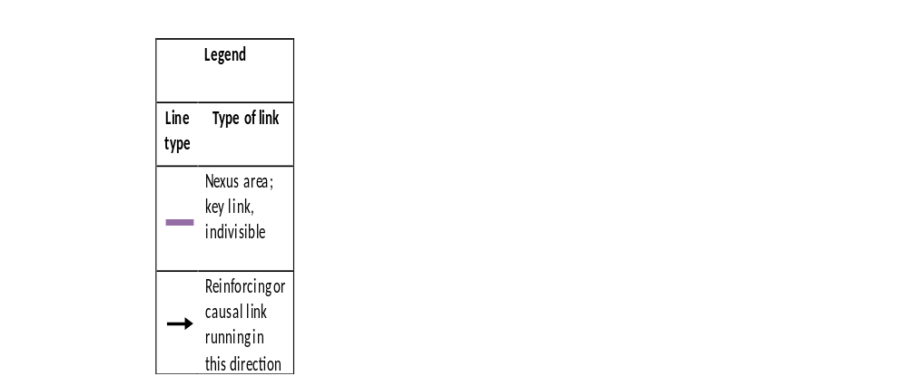
Climate Change, Disasters, Migration and Conflict
Deterrence of investment
Climate Change
Disasters
Declining agricultural productivity
Resource competition
Loss of assets and infrastructural damage
Migration
Vulnerability to assault and theft
Illness and injury
Expenditure on humanitarian aid and relief
Conflict
Governance gaps
Notes:
More than 90 percent of recorded major disasters in past 20 years were climate- and weather events (IUCN, 2015) – climate change expected to increase frequency and intensity
Interlinkages include:
Declining resource productivity due to disasters can increase resource competition and likelihood of conflict. For this reason and the possible creation of a ‘governance gap’ due to damage and losses, the correlation between disasters and conflict is strong enough for scientists to have suggested using disaster data to predict where future violence might flare up (US Department of Defense, 2014)
Declining resource productivity, loss of assets and infrastructural damage, incentivize or compel populations to seek refuge and prosperity elsewhere (IPCC, 2012)
Shared vulnerabilities:
Both disasters and migration patterns are affected by climate change; because climate change increases likelihood of disasters, it can also be said that its impact on migration can (but is not necessarily) mediated by increased number of disasters
Both disasters and conflict reduce attractiveness for investors
All three may necessitate increased expenditure on humanitarian aid and relief
Migrants and victims of conflict can suffer increased risk of assault and theft
Note obvious linkages to other nexus area of human well-being.
Remember power relations and vulnerabilities: increased vulnerability to sexual assault falls especially on women, well-documented

Slide 5
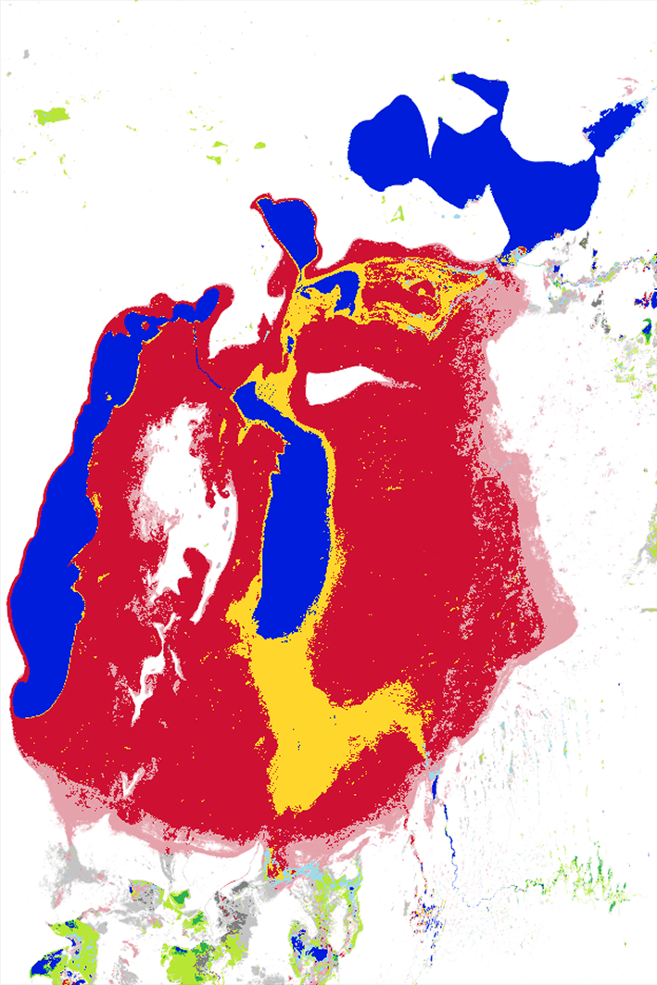
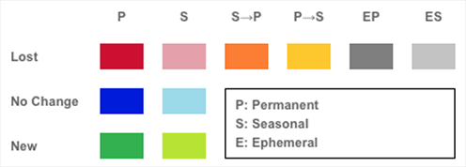
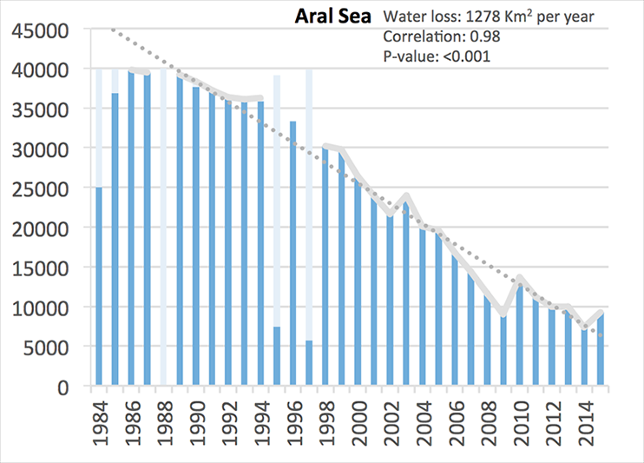
Map of Aral Sea
Generated statistics
Tabulation of area
Notes:
A map can be used to calculate the area of each type of ecosystem or feature in order to generate statistics (for example the extent of the aral sea)
By User:Staecker – Own work, Public Domain, https://commons.wikimedia.org/w/index.php?curid=658367
Aral sea - a lake, bordered by Kazakhstan and Uzbekistan, and once, at 26,000 square miles, the fourth largest on the planet — has been slowly dying; geologists estimate that it is now one-tenth its former size. Starting in the 1960s, the Soviet Union engineered the large-scale diversion of the two major rivers that fed the sea. Since then the Syr Darya, in the north, and the Amu Darya, in the south, each of which carried water across the Central Asian steppes from as far away as the mountain ranges of Tien-Shan and the Pamirs, have flowed not into the Aral but instead into a canal system that irrigates vast fields of cotton. The cotton generated so much cash that the Soviet government called it “white gold.”
With its water sources dramatically reduced — from 28,000,000 cubic feet per second to 5,500 cubic feet — the Aral Sea began to shrink. The environmental and economic devastation that followed has been well documented. The lakebed is now a vast salt flat permeated with pesticides from the runoff of surrounding agricultural fields. Local people are suffering significantly greater incidence of chronic disease, and a few years ago it was reported that in Karakalpakstan, Uzbekistan (on the south of the Aral Sea), the toxicity of the environment was such that the breast milk of mothers was contaminated, resulting in one of the highest infant mortality rates in the world. Fish species have died off, and a once prosperous fishing industry, which employed thousands on large ships and in processing plants and canneries and at railyards that stocked Moscow-bound trains, has collapsed. Many of the old ships still litter the dry harbors.

Slide 6
Social-environment nexus
People affect the environment and the environment affects people. An understanding of both is necessary.
But not all people are affected equally and often the most vulnerable populations are the most affected by environmental degradation.
Importance of considering these linkages when working towards and measuring progress towards the SDGs
© NABU/Holger Schulz
Photo credit to be given
as shown alongside
(in black or in white)

Slide 7
Climate Change (disasters, water availability, food security)
Energy (air quality, indoor pollution)
Pollution (chemicals and hazardous substances, air quality, water quality)
Human Health
Waste (hazardous substances, pollution, waster quality)
Water (availability, quality, pollution, diseases)
Nutrient management (food security,water pollution)

Slide 8
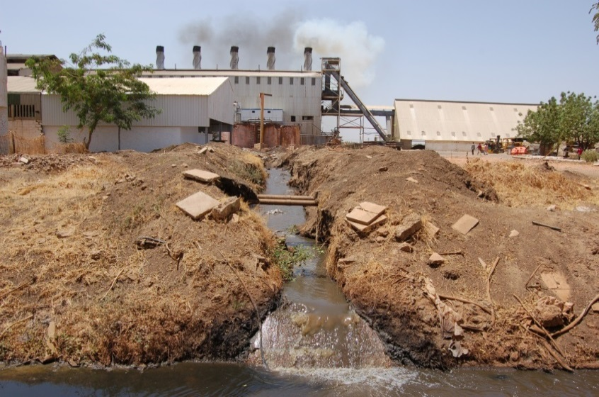
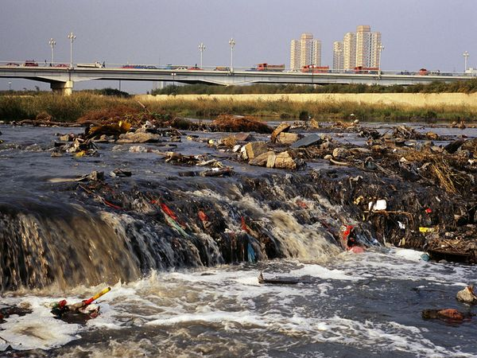
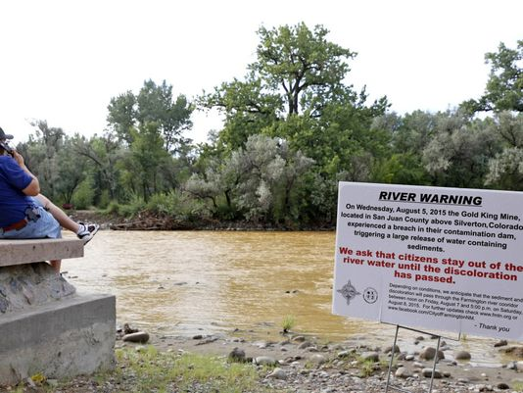
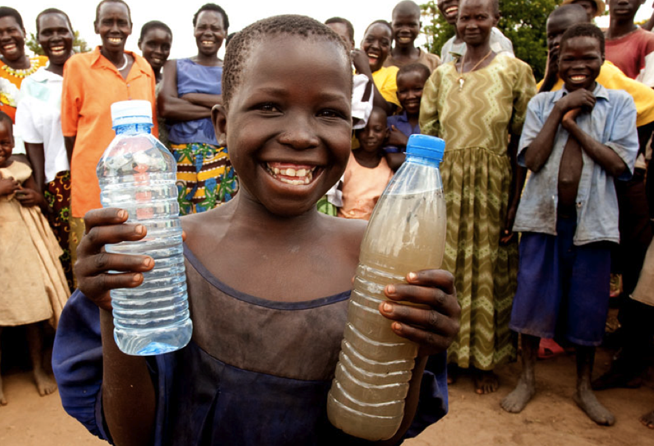
Water
Aquatic ecosystems services are deteriorating faster than many other natural systems. Increasing water pollution in developing countries poses a risk to public health, food security, and the economy.
Each year diarrhoea kills around 760 000 children under five (WHO)

Slide 9
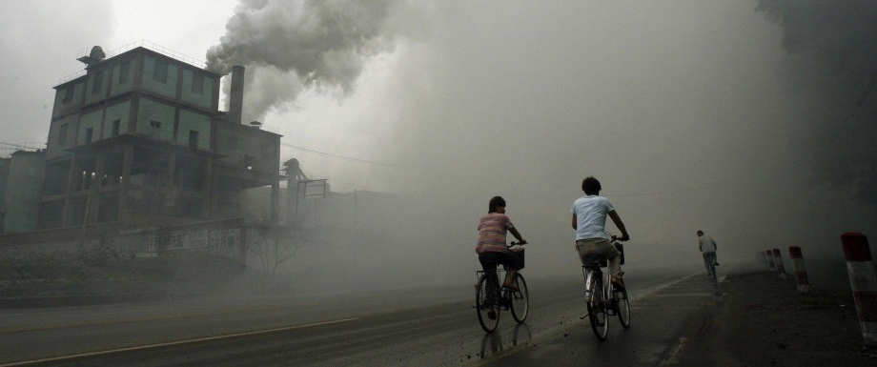
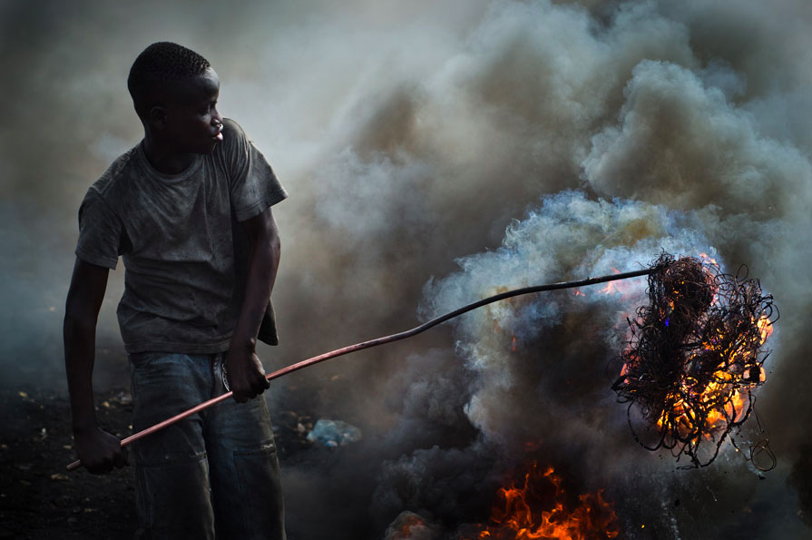
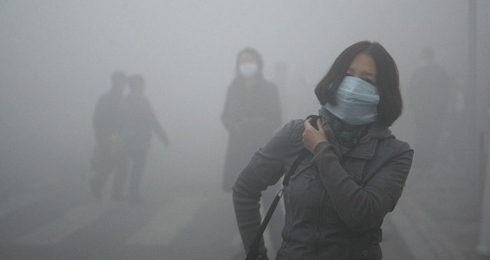
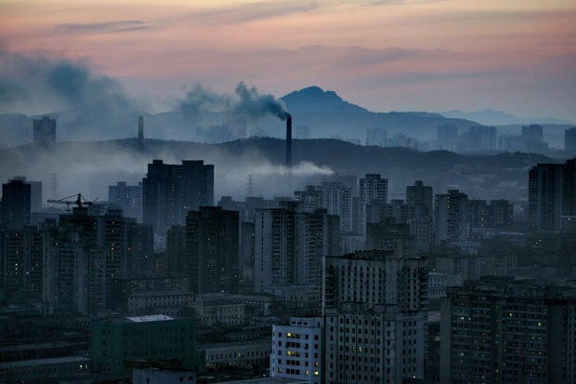
Air quality
the World Bank estimates that the welfare losses from air pollution are more than $5tn a year.
Global air pollution contributes to an estimated 600,000 child deaths a year
Unsustainable consumption and production and accelerated urbanization has created air quality problems around the globe

Slide 10
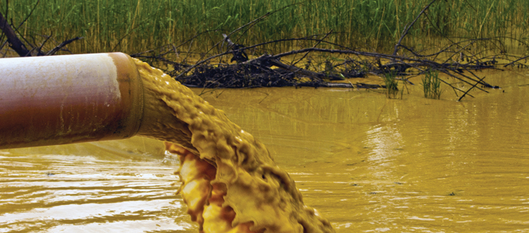
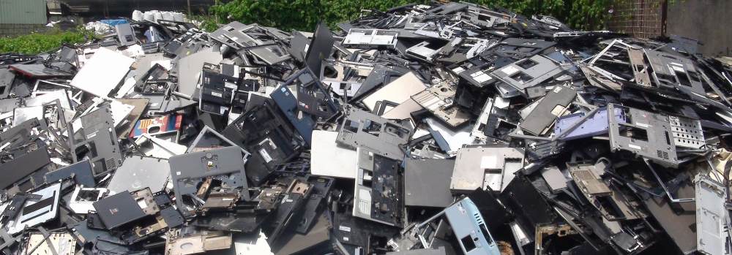
Waste
New challenges are arising from wastes and hazardous waste, including e-wastes

Slide 11
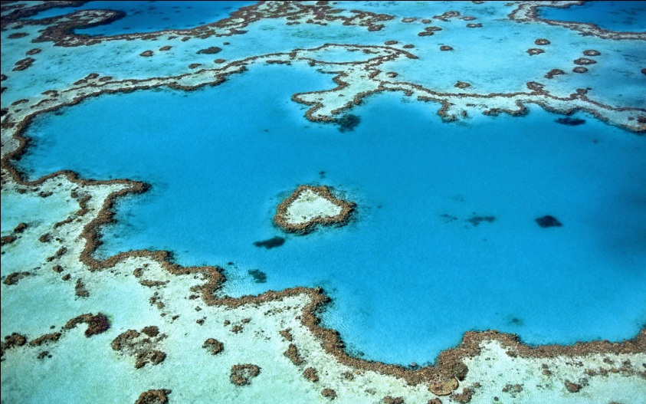
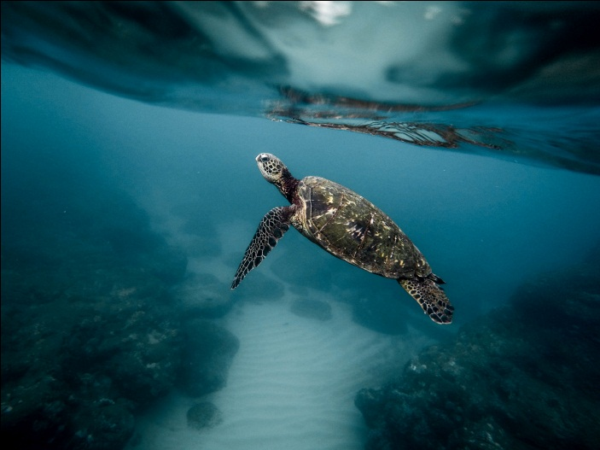

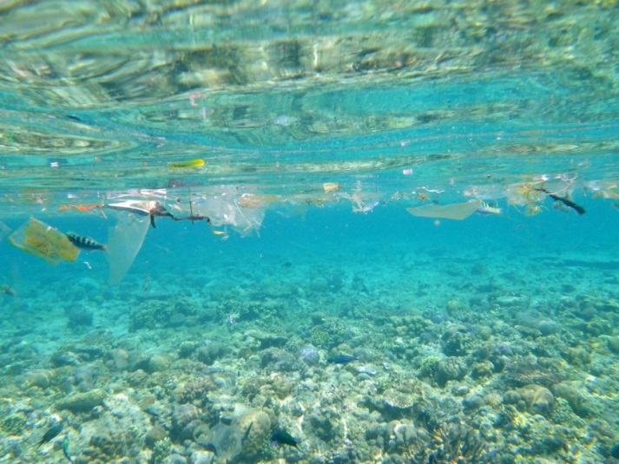
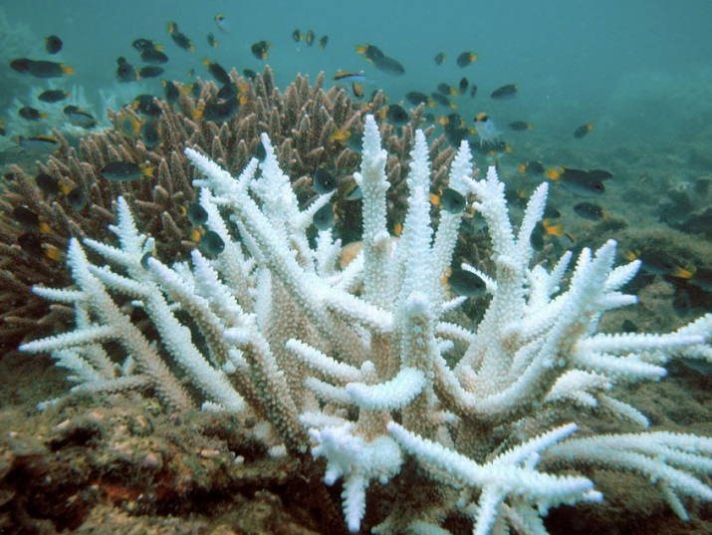
Oceans
Oceans are some of the most diverse ecosystems on the planet and provide food, medicines and various other products that contribute to human well-being.
Marine debris impacts biodiversity through entanglement or ingestion of debris items by organisms.
About 20 per cent of coral reefs have been effectively destroyed and show no prospects for recovery.
UN Environment estimates the cumulative economic impact of poor ocean management practices is at least US$200 billion per year.

Slide 12
Gender linkage
Need greater understanding of gender dynamics and how environmental conditions shape the lives of women and men in different ways (women and girls often disproportionaly affected).
The Global Gender and Environment Outlook (GGEO) 2016 found three key gender-environment related issues:
Priority issue 1: Rights/access to land and natural resources
Priority issue 2: Access to food, energy, water and sanitation
Priority issue 3: well-being, climate change, sustainable consumption and production, and health
© NABU/Holger Schulz
Photo credit to be given
as shown alongside
(in black or in white)

Slide 13
UN Environment’s role
UN Environment is working on guidance on measuring the nexus between gender and the environment
UN Environment provides poverty-environment, and gender-poverty-environment, policy analysis, support and planning through the Poverty Environment Initiative
© NABU/Holger Schulz
Photo credit to be given
as shown alongside
(in black or in white)

Slide 14
Thank you
Lowri Angharad Rees/
Africa Office / Resource Efficiency Unit
UN Environment
United Nations Office in Nairobi, Kenya
Lowri.rees@unep.org
www.unep.org

