Slide 1

  Integration of Various Sources for Producing Land and Urban-related Indicators
  Sub-regional workshop on Data disaggregation
  Lilongwe, Malawi
  27-29 September 2017

Slide 2
Indicator 1.4.2
Target 1.4: By 2030, ensure that all men and women, in particular the poor and the vulnerable, have equal rights to economic resources, as well as access to basic services, ownership and control over land and other forms of property, inheritance, natural resources, appropriate new technology and financial services, including microfinance.
Indicator 1.4.2: Proportion of total adult population with secure tenure rights to land, with legally recognized documentation and who perceive their rights to land as secure, by sex and by type of tenure.
Custodian Agencies : UN-Habitat and World Bank
Classified as Tier III
Product of extensive debate and policy dialogue coordinated by the Global Donor Working Group on Land (GDWGL) and the Global Land Tool Network – Global Land Indicators Initiative (GLTN/GLII)

Slide 3
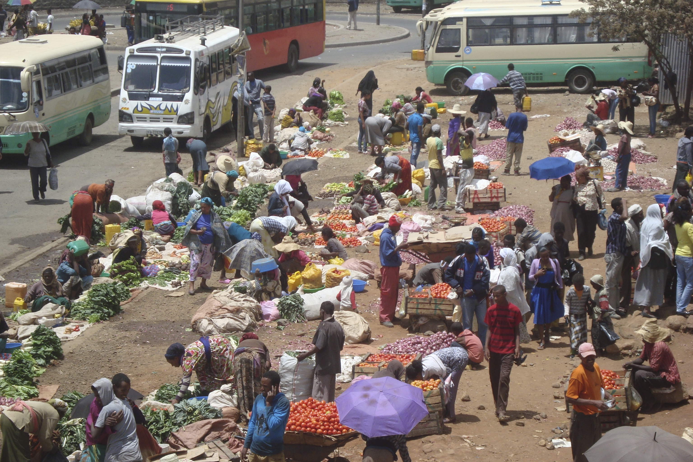
Indicator 1.4.2
Related to:
  Targets 5.a.1 (agricultural people/land) and 5.a.2 (legal framework)
  Targets 11.1 (access to affordable housing/upgrading slums) and target 11. 3 (sustainable urbanization/settlement planning).
Goal 15 on sustainable use of land and natural resources.
  Land tenure also influences land use
Goal 16 for promoting peace and inclusive societies and institutions
  Land is a significant source of conflict

Slide 4
Relevance
Indicator 1.4.2…relevance
Land is a key asset that is essential for poverty reduction and equality of opportunity including by gender
Regular reporting help in :
  Informing governments and non-state actors to what extent countries’ legal and institutional frameworks recognize and support different land tenure categories, and implementation capacity to protect such rights in practice, as well as progress made
    Enable targeted actions at the country level as well as at a subnational level
  Providing incentives for governments to improve land governance performance
  Achieving better understanding of the strengths and weaknesses of existing land governance policies and practices.
Notes:
Administrative data on land is in most cases not complete or fully reliable and coverage is often quite limited in terms of geographical areas, proportion of total land parcels, different forms of tenure and their associated social groups, and women’s land rights. However the World Bank estimated that 60-70% of all countries have nearly complete records and maps, and 40% of these have all the information digitalized – but not necessarily disaggregated by gender (GLTN 2014). The available data can be improved over time, and in most cases would require critical expert and stakeholder interpretation and analysis.
Expert assessments are another robust source of information for answering the land indicators pertaining to Legal recognition of land tenure, land administration services and land dispute and conflict resolution. Like national household surveys, there are many on-going data initiatives which provide already established platforms for partners working on land indicator to work towards harmonizing data requirements, standards and assessment processes.

Slide 5
Indicator 1.4.2 …Concepts
Tenure: Tenure systems determine who can use which resources, for how long, and under what conditions and may be based on formal policies and laws, as well as customs and practices. A tenure typology refers to categories of tenure rights, like for example customary, leasehold, public, freehold, and is county specific.
Legally recognized documentation: refers to the recording and publication of information on the nature and location of land, rights and right holders in a form that is recognized by government, and therefore legal.
Perception of tenure security: Tenure is perceived to be secure if individuals or households do not feel a threat of being deprived of legitimately acquired use or ownership rights to land or of these rights being disputed by others (either the Government of individuals).
  Important in settings where formal documentation does not exist or where, largely due to gaps in institutional quality or the transparency with which land records are administered, formal documents may not increase tenure security.
Notes:
Administrative data on land is in most cases not complete or fully reliable and coverage is often quite limited in terms of geographical areas, proportion of total land parcels, different forms of tenure and their associated social groups, and women’s land rights. However the World Bank estimated that 60-70% of all countries have nearly complete records and maps, and 40% of these have all the information digitalized – but not necessarily disaggregated by gender (GLTN 2014). The available data can be improved over time, and in most cases would require critical expert and stakeholder interpretation and analysis.
Expert assessments are another robust source of information for answering the land indicators pertaining to Legal recognition of land tenure, land administration services and land dispute and conflict resolution. Like national household surveys, there are many on-going data initiatives which provide already established platforms for partners working on land indicator to work towards harmonizing data requirements, standards and assessment processes.

Slide 6
Ongoing Work
Expert Group Meeting on Land Tenure Security to develop a set of (household) survey questions for monitoring SDG Indicator 1.4.2
  Define the essential questions required for household survey programs for monitoring indicator 1.4.2, data collection mechanisms, harmonization with other SDG indicator (in particular 5.1.a), complementary with other data collection efforts in particular by NGOs and capacity building requirements.
Expert Group Meeting: Using Administrative Data to Monitor SDG land Indicator
  Agree on a methodology to monitor the part of SDG indicator 1.4.2 pertaining to legally documented rights using administrative data;
  Assess availability of existing data and explore ways of institutionalizing reporting at country and regional level; and
  Explore options for building on administrative data to advocate for and measure progress with sustainability of land policy reform.

Slide 7
Ongoing Work
EGMs agreed on four key elements needed to construct the indicator:
  Land access including lease, ownership and group rights;
  Existence of valid, legally recognized documentation of land tenure rights, registered in public agencies or legally recognized institutions.
  Perceived security by the ability to transfer rights by bequest.
  Perceived security, i.e. the fact that land is protected against involuntary loss of rights
Consultations with various stakeholders
Piloting of the essential questions for this indicator done

Slide 8
Data Sources
In many countries:
Limited capacities for land management, data collection and monitoring, and inadequate existing land information systems, poorly kept land registries, and limited data on large or densely populated geographical areas.
➔ Complementarity in data reporting combining administrative and survey data.
The main sources of data, therefore, are:
  Administrative records reported by national land institutions (in most cases land registries),
  Census and multi-topic household surveys conducted by National Statistical Agencies.
Important to include questions about land holding or tenure security within large scale surveys, periodic national censuses and agricultural censuses
Create comparable data sources and enable global-scale monitoring of indicator 1.4.2.

Slide 9
Data Sources
Administrative records
  Provide data on number and area of registered parcels by tenure type
  Core function of public registries, timely, possible to disaggregate
  Good coverage, including communal land and large farms
Production of land records and maps is a core function of public registries and reporting on the number of registered parcels or the number and area of parcels mapped is not difficult in principle
  Number of parcels formally registered
  Number of parcels formally mapped
  Population covered in the areas where formally registered land is available.
Land registry records provide data on the number of individually registered parcels

Slide 10
Data Sources
Nationally representative household surveys
  Provide data for areas/populations not covered by formal systems, on informality, gender barriers to land access, perceived value of titles
  Administrative records may be outdated
Type of information:
  Land access and tenure type
  Perception of tenure security
  Availability legally recognized documentation of tenure rights to land
Surveys
  Urban Inequities Surveys, LSMS, censuses, MICS and DHS - publicly available, mostly for developing countries at multiple points in time.

Slide 11
Data Sources
Possible disaggregation dimensions
  Urban/rural, Regions, administrative units
  Age
  Sex
  Tenure type
  Poverty status
  Wealth/income category
  Migration status
  Education of HH head
  Ethnicity/religion/language
  Disability status

Slide 12
In conclusion
Regular reporting on indicator 1.4.2 will help:
  Improve the availability of data on land tenure form surveys
  Improve the regularity of reporting by registries and other line agencies holding administrative data
  Increase in-country accountability.
The expansion of digitization will facilitate the ease of reporting.

Slide 13
In conclusion
However:
  Coverage of administrative data may be geographically skewed e.g. towards urban or specific rural regions where cadastral coverage is concentrated, and therefore sub-national dimensions should be properly considered
  Interviewing women is key to obtaining perception of tenure data on women, which can be cross tabulated against other factors of difference.
  Sample design is also important, where different members of the household and types of households are included, as the realization of women’s land rights is complicated by the interplay of intra-household and community level inequalities, along with different tenure regimes.

Slide 14
Way forward
Metadata revised
Agreed and approved land questions on access to land, legally recognized documentation and perceptions of tenure security will be added to upcoming national surveys (or censuses)
Capacity building materials
Request for reclassification to Tier II to be submitted to IAEG-SDGs

Slide 15



