Slide 1

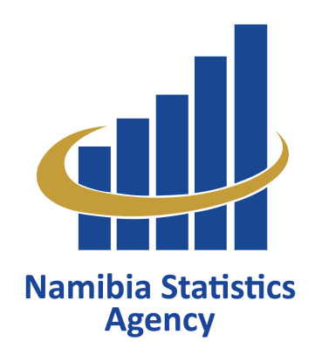
Namibia’s methodological approach on integration of data in the National Statistical System
PRESENTED BY: OTJA TJIPETEKERA
United Nations Development Account 10th tranche
Sub-regional workshop on Data disaggregation
Lilongwe, Malawi, 27-29 September 2017

Slide 2

Outline
Introduction
Methodology
National SDGs Indicator’s Framework Template
The integration of the SDGs Indicators in the NSS
Conclusion

Slide 3
Introduction
The role of quality, accessible, reliable and timely data is undeniable crucial to track the progress and what’s needed to achieve the SDGs.
The SDGs were domesticated and aligned to national priorities for the development of our newly National Development Goals 5 (NDP5).
the Namibia Statistics Agency (NSA) being the central statistical authority and the coordinator of the National Statistical System (NSS) is expected to compile and provide data for global reporting.

Slide 4
Methodology
The NSA is responsible to compile and provide data for global reporting while National Planning Commission (NPC) is responsible for drafting the report of the National Development Goals, Agenda 2063 and SDGs.
The NSA developed a National SDGs Indicator’s Framework template for reporting which was presented and adopted by the National SDGs multi-stakeholder’s Committee.
The National SDGs multi-stakeholder’s Committee consist of:
Line Ministries
State Owned Enterprises
Academia
NGOs

Slide 5
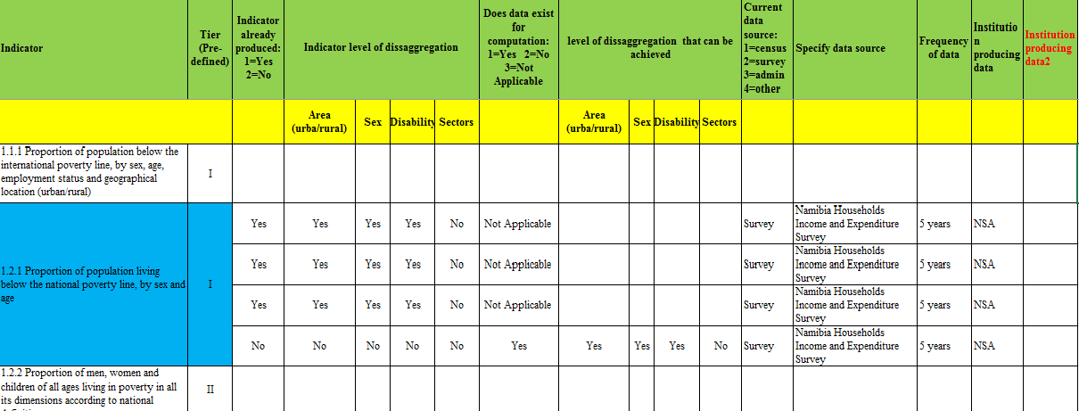

Slide 6
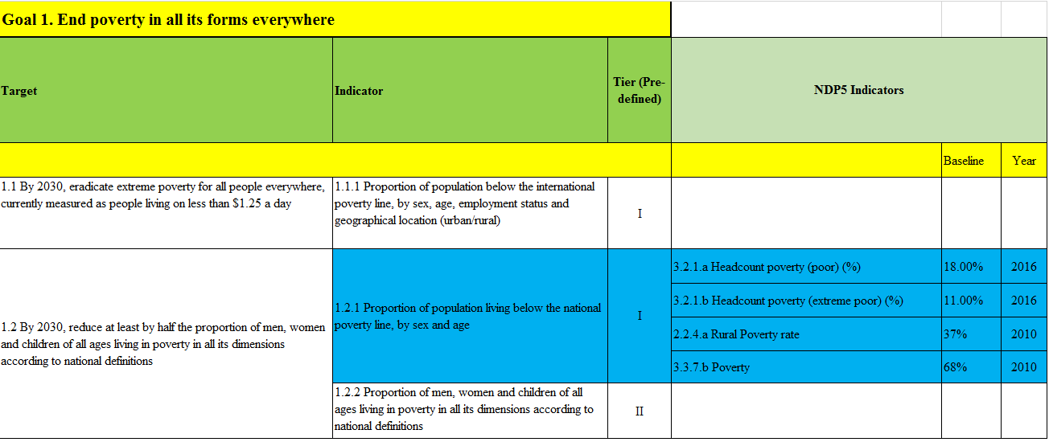

Slide 7
The three phases on the implementation of SDGs Indicator’s Framework
SENSITIZATION & APPROVED
NSS- Data Producers & Users
POPULATED
NSS- Data Producers
SENSITIZATION & VALIDATION
NSS

Slide 8
Conclusion
The Benefits of integration of the SDGs Indicators in the NSS exercise:
Capacity of NSA strengthened to coordinate the NSS
New partnerships developed to start the process for further modernization in collection and analysis including through big data and data visualization
Data gap analysis
Technical expertise around all key thematic issues were shared for certain goals/indicators.

Slide 9


