Slide 1

Geospatial disaggregation as key to understanding where people are vulnerable
Lowri Angharad Rees
Un Environment
Africa Office

Slide 2
What is geospatial data?
Overarching principle of Agenda 2030:
  Data which is high-quality, accessible, timely, reliable and disaggregated by income, sex, age, race, ethnicity, migration status, disability and geographic location and other characteristics relevant in national contexts (A/RES/70/1)
Data tied to specific geographic/locational information.
Slide numbers to be added
as shown alongside
Notes:
The word geospatial is used to indicate that data that has a geographic component to it. This means that the records in a dataset have locational information tied to them. Data will provide information for specific locations.

Slide 3
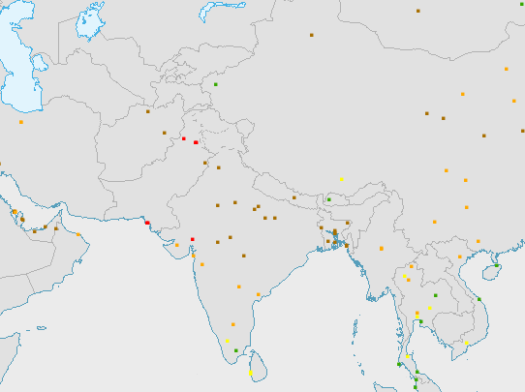
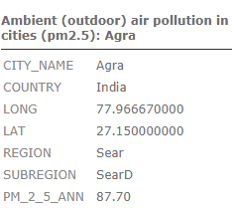
Data from monitoring stations
Point based map of air quality monitoring
Statistical data with GIS coordinates added to a map
Notes:
Or a map of air or water quality monitoring stations can tell the situation at a particular location. Or this same approach applies to data from a census or survey where the statistical data collected is paired with GIS (Geographic Information Systems) point coordinates.
Source: WHO

Slide 4
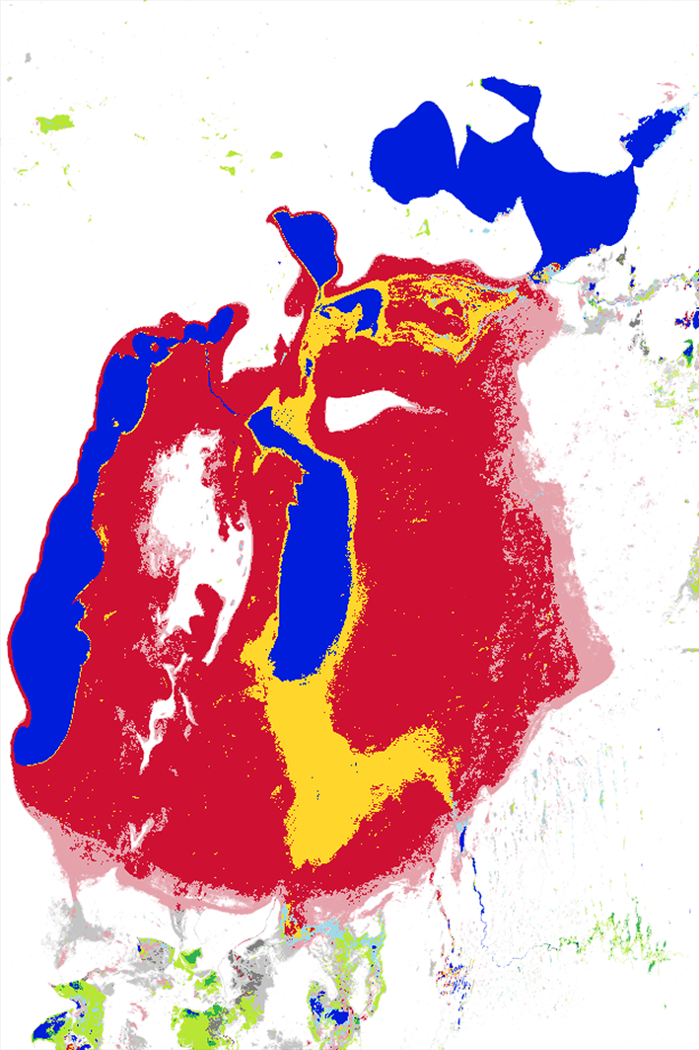
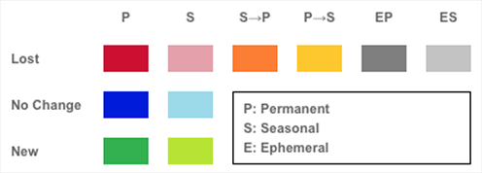
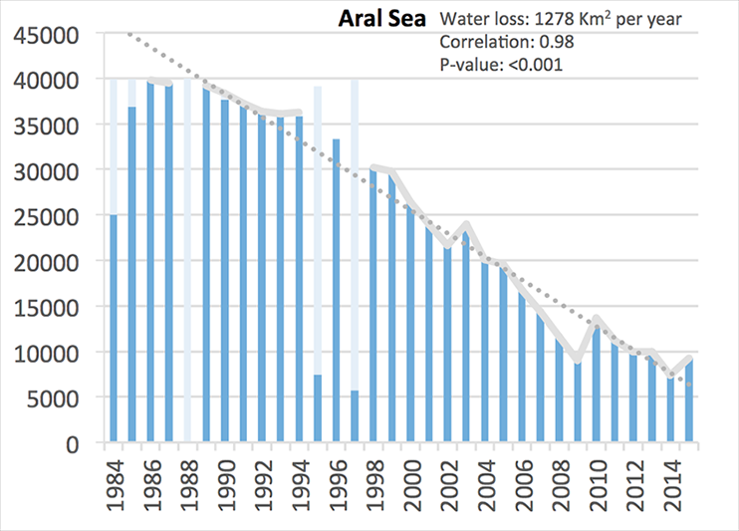
Map of Aral Sea
Generated statistics
Tabulation of area
Notes:
A map can be used to calculate the area of each type of ecosystem or feature in order to generate statistics (for example the extent of the aral sea)
By User:Staecker – Own work, Public Domain, https://commons.wikimedia.org/w/index.php?curid=658367
Aral sea - a lake, bordered by Kazakhstan and Uzbekistan, and once, at 26,000 square miles, the fourth largest on the planet — has been slowly dying; geologists estimate that it is now one-tenth its former size. Starting in the 1960s, the Soviet Union engineered the large-scale diversion of the two major rivers that fed the sea. Since then the Syr Darya, in the north, and the Amu Darya, in the south, each of which carried water across the Central Asian steppes from as far away as the mountain ranges of Tien-Shan and the Pamirs, have flowed not into the Aral but instead into a canal system that irrigates vast fields of cotton. The cotton generated so much cash that the Soviet government called it “white gold.”
With its water sources dramatically reduced — from 28,000,000 cubic feet per second to 5,500 cubic feet — the Aral Sea began to shrink. The environmental and economic devastation that followed has been well documented. The lakebed is now a vast salt flat permeated with pesticides from the runoff of surrounding agricultural fields. Local people are suffering significantly greater incidence of chronic disease, and a few years ago it was reported that in Karakalpakstan, Uzbekistan (on the south of the Aral Sea), the toxicity of the environment was such that the breast milk of mothers was contaminated, resulting in one of the highest infant mortality rates in the world. Fish species have died off, and a once prosperous fishing industry, which employed thousands on large ships and in processing plants and canneries and at railyards that stocked Moscow-bound trains, has collapsed. Many of the old ships still litter the dry harbors.

Slide 5
United Nations Committee of Experts on Global Geospatial Information Management (UN-GGIM)
Review the global indicator framework through a ‘geographic location’ lens
Identify geospatial data gaps, geospatial methodological and measurement issues
Consider how geospatial information can contribute to the indicators and metadata.
© NABU/Holger Schulz
Photo credit to be given
as shown alongside
(in black or in white)

Slide 6
Geospatially relevant SDGs
15 indicators where geospatial information together with statistical data can be used to produce the indicator:
  □ Tier I: 9.c.1 14.5.1 15.1.1 15.1.2
  □ Tier II: 11.2.1 11.3.1 15.4.1
      □ Tier III: 2.4.1 6.3.2 6.5.2 6.6.1 9.1.1 11.7.1
      14.2.1 15.3.1
  9 indicators where geospatial information can significantly support the production of indicator:
  □ Tier I: 1.1.1 4.5.1
  □ Tier II: 5.2.2 5.4.1 15.4.2
  □ Tier III: 1.4.2 5.a.1 5.a.2 11.7.2
  These indicators cut across Goal 1 on poverty and disasters, Goal 5 on gender, goal 2 on agriculture, goal 14 on oceans, goal 6 on water, goal 11 on cities, goal 9 on infrastructure, goal 15 on land.
© NABU/Holger Schulz
Photo credit to be given
as shown alongside
(in black or in white)
Notes:
For a full list of the SDG indicators that correspond with these numbers go to the IAEG SDG website. These indicators cut across Goal 1 on poverty and disasters, Goal 5 on gender, goal 2 on agriculture, goal 14 on oceans, goal 6 on water, goal 11 on cities, goal 9 on infrastructure, goal 15 on land.
Also importance of 14.1.1

Slide 7
Geospatial analysis
Conducting geospatial analysis is just as important as collecting geospatial data.
Geospatial data can link populations to the environment by capturing where certain conditions exist, and thus determining who is affected.
© NABU/Holger Schulz
Photo credit to be given
as shown alongside
(in black or in white)

Slide 8
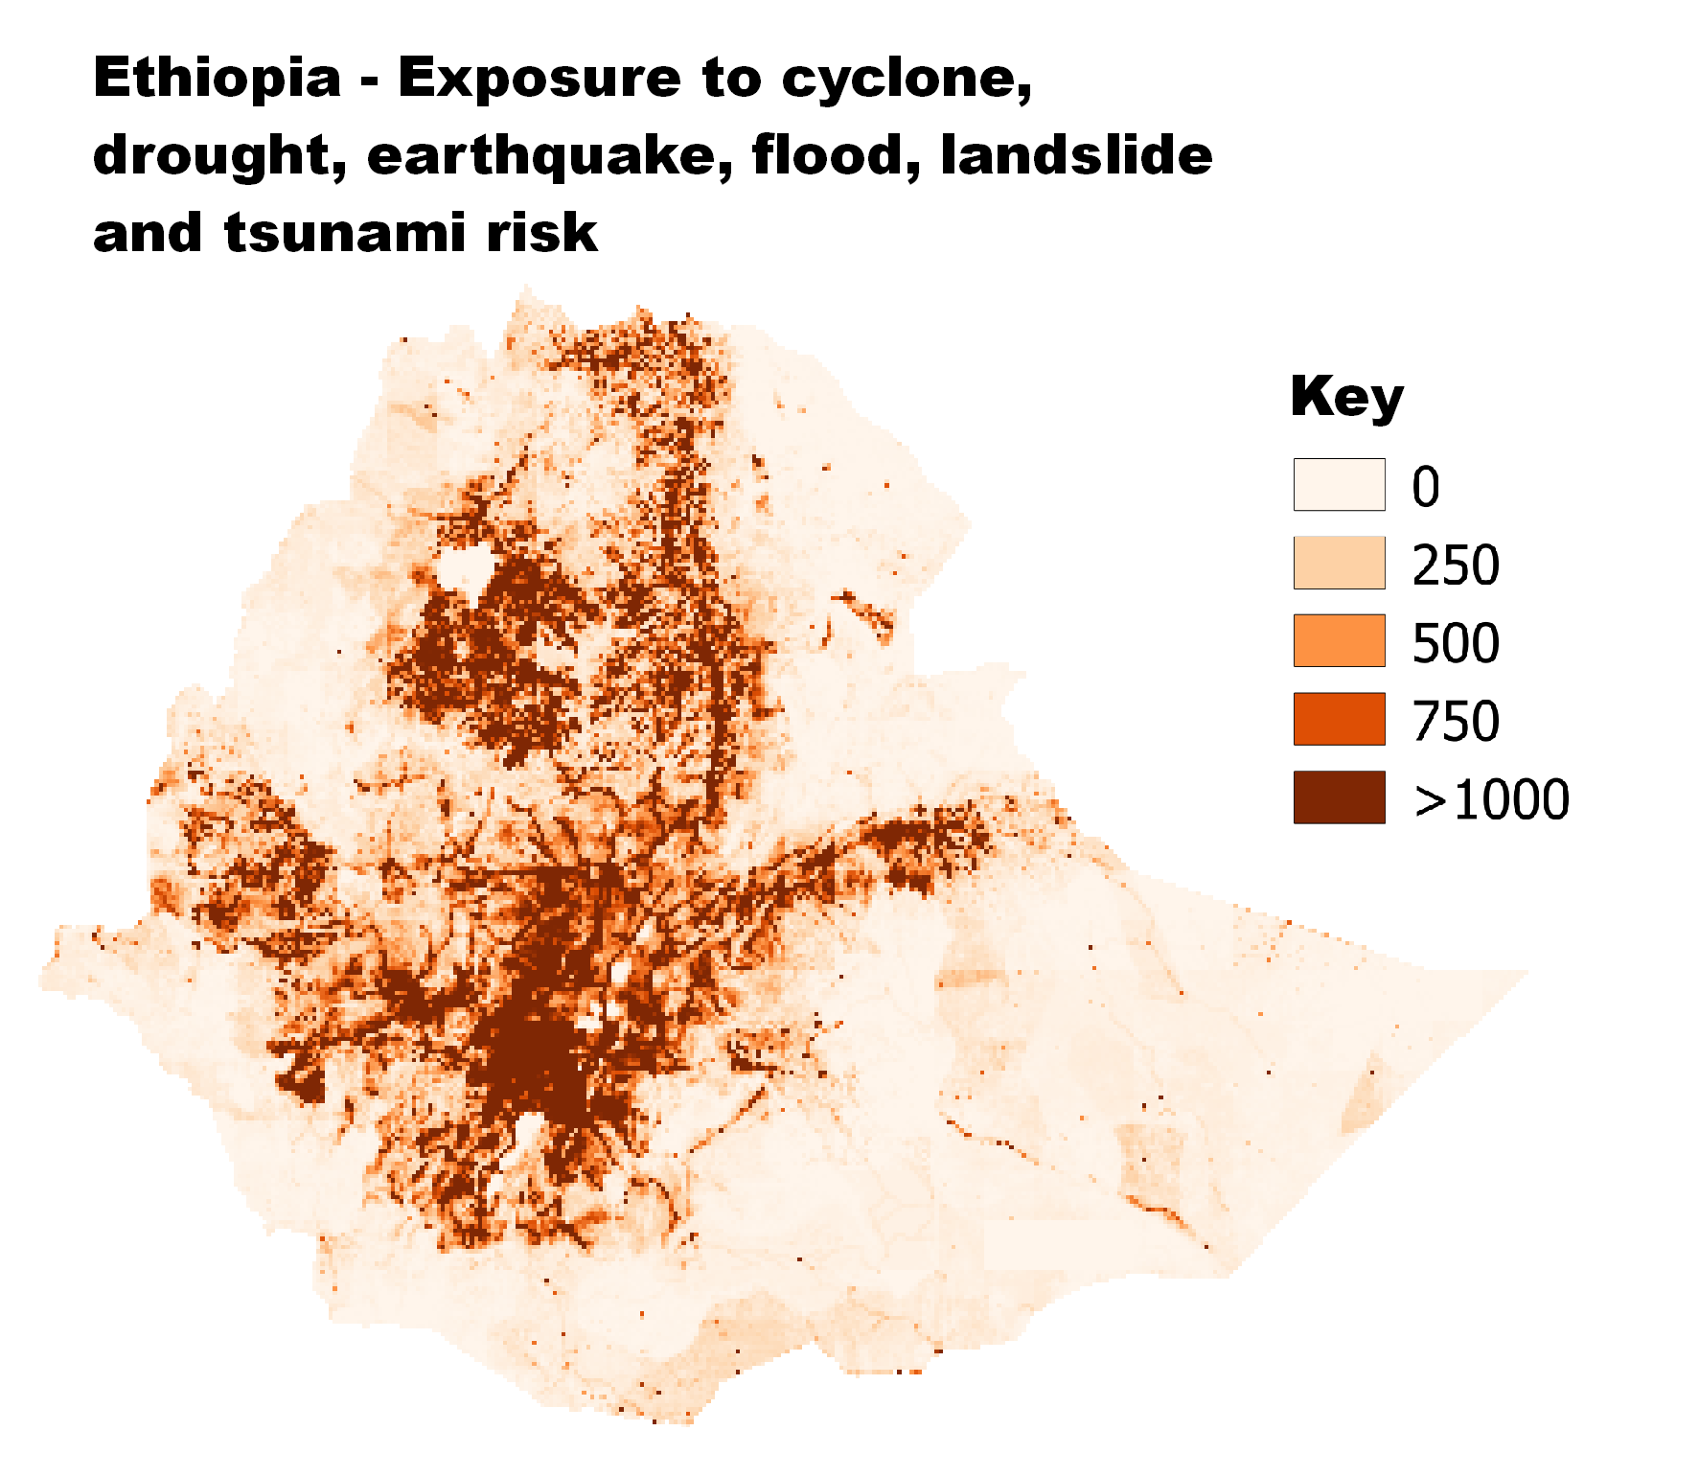
Geospatial analysis: Example 1
Population vulnerable to disasters in Ethiopia (source: preview.grid.unep.org)
© NABU/Holger Schulz
Photo credit to be given
as shown alongside
(in black or in white)

Slide 9
Geospatial analysis: Example 2
SDG indicator 6.3.2: proportion of water bodies with good ambient water quality.
If a country has 90% of water bodies with good ambient water quality, is this good?
  - It depends on where the 10% of ‘bad’ water bodies are. If the poor water quality is where the bulk of the population live and withdraw water then this could mean that large populations are affected by poor water quality.
© NABU/Holger Schulz
Photo credit to be given
as shown alongside
(in black or in white)

Slide 10
National Challenges
Geospatial experts and statisticians often do not work together and geospatial expertise may be weak
Many countries lack to the capacity to effectively measure environmental conditions
Even if GIS is used in censuses and surveys the capacity to analyze the data may be weak
© NABU/Holger Schulz
Photo credit to be given
as shown alongside
(in black or in white)

Slide 11

Earth Observation potential
Earth Observation can provide data for countries with limited capacity and can ensure comparability across locations and time.
© NABU/Holger Schulz
Photo credit to be given
as shown alongside
(in black or in white)

Slide 12
Earth Observation and land cover
Two global land cover products:
The European Space Agencies (ESA) Climate Change Initiative land cover dataset (CCI-LC)
NASA Moderate resolution Analysis (MODIS)
Both are publically available.
CCI-LC is proposed for the use in monitoring SDG indicator 15.3.1. (proportion of land that is degraded over total land area)
The land cover classes in CCI-LC appear to be a slightly better match to 6.6.1 than the MODIS categories (change in the extent of water-related ecosystems over time)
© NABU/Holger Schulz
Photo credit to be given
as shown alongside
(in black or in white)

Slide 13
Earth Observation
(1) Moderate resolution, 250 m: The Climate Change Initiative Land Cover map (CCI-LC) includes maps of land cover for all countries
(2) High Resolution, Landsat, 30 m: Maps of water bodies from the Global Surface Water Explorer are publically available
  UN Environment is collaborating with NASA on mapping wetlands at 30m resolution
UN Environment is also partnering with the Gallileo Reference Centre (GRC) to produce water body maps for every country (will be ready by November 2017)
(3) Very High Resolution, 0.5 - 2 m: Data is available for purchase.
UN Environment with NASA is planning a pilot to test the benefits of this level of resolution.
© NABU/Holger Schulz
Photo credit to be given
as shown alongside
(in black or in white)

Slide 14
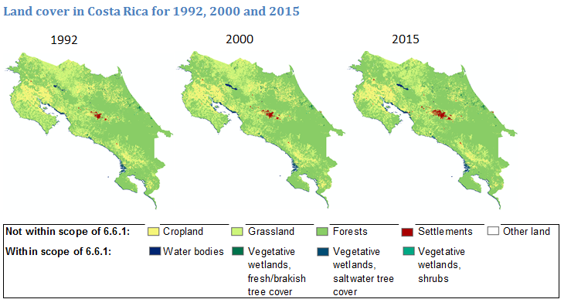
Land cover from CCI-LC: Example
Note: Costa Rica was chosen for illustrative purposes only.
© NABU/Holger Schulz
Photo credit to be given
as shown alongside
(in black or in white)
Notes:
6.6 – by 2020 protect and restore water-related ecosystems, including mountains, forests, wetlands, rivers, aquafers and lakes

Slide 15
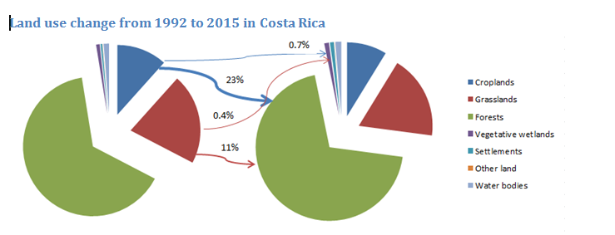
The data from the previous slide can be tabulated into statistics
Note: Costa Rica was chosen for illustrative purposes only.
© NABU/Holger Schulz
Photo credit to be given
as shown alongside
(in black or in white)

Slide 16
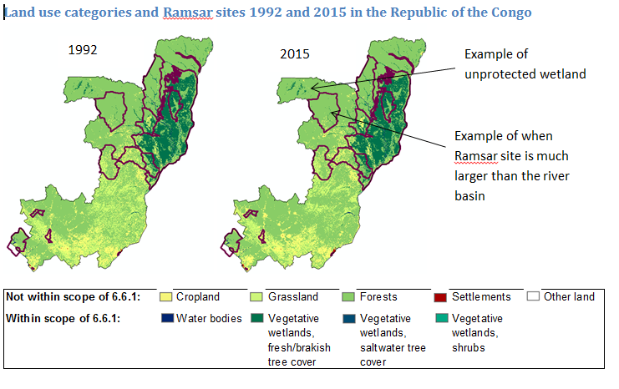
CCI-LC can be overlaid with other maps or population maps
Note: Republic of the Congo was chosen for illustrative purposes only.
© NABU/Holger Schulz
Photo credit to be given
as shown alongside
(in black or in white)
Notes:
Ramsar convention on wetlands of international importance

Slide 17
Conclusions
High potential for using Earth Observation for other indicators related to land, oceans, population and disaster related SDG indicators.
There is still a need for ground truthing of information, particularly for the information to be useful for national policy making.
Collaboration is vital to support this work and to ensure consistency between SDG indicators.
© NABU/Holger Schulz
Photo credit to be given
as shown alongside
(in black or in white)
Notes:
Ground truthing:
250m large area. System can have difficulties in recognising ecosystem type and boundaries, or may not match national definitions of ecosystems – e.g. national defnition of forests. Might not recognise small bodies of water.
Seasonal variations (system will take several shots and aggregate over the year)
Excellent starting point but worth doing point checking with hand-held devices
Collaboration:
Internal – statistics offices, ministries of env, water, agriculture, GIS

Slide 18
Side Event: Measuring Ecosystems using Earth Observation Systems
27th November, Mexico City
Back-to-back with the UN-GGIM Fifth High Level Forum on United Nations Global Geospatial Information Management (Mexico City, 28 – 30 November 2017)
© NABU/Holger Schulz
Photo credit to be given
as shown alongside
(in black or in white)

Slide 19
Thank you
Lowri Angharad Rees/
Africa Office / Resource Efficiency Unit
UN Environment
United Nations Office in Nairobi, Kenya
Lowri.rees@unep.org
www.unep.org

