Slide 1

Experiences and challenges in producing disaggregated data in South Africa
Ms Malerato Mosiane
Lilongwe – 27 September 2017

Slide 2
Experiences

Slide 3
Experiences
Data disaggregation is currently done as far as possible
    Age
    Sex
    Race / population group
    Geography
    Disability
    Migratory status
    Earnings / income

Slide 4
Experiences
Data sources
Traditional data sources | Administrative data souces
Census GHS QLFS Volunteer work Child labour survey Informal sector survey Migration (Section in QLFS) SWTS TUS SADHS IES VOCS DTS | DHMIS CRVS HEMIS National Education Infrastructure Management System (NEIMS) SOCPEN Crime statistics (SAPS) Etc

Slide 5
Experiences
Age
Included in all household surveys and censuses
    Collect age and date of birth (dd/mm/yyyy)
    Disaggregation by age included in statistical releases and reports
    5-year age groups used in publications
    Specific age groupings used for some surveys – Child labour survey (SAYP)
Sex
Included in all household surveys and censuses
    Disaggregation by sex included in statistical releases and reports

Slide 6
Experiences
Race / population group
South Africa’s Apartheid past would seem to be a strong argument in favour of dropping race as a measure to disaggregate
However as race was a measure used to actively disenfranchise sections of the population, there are equally important reasons to use it for readdressing past inequality

Slide 7
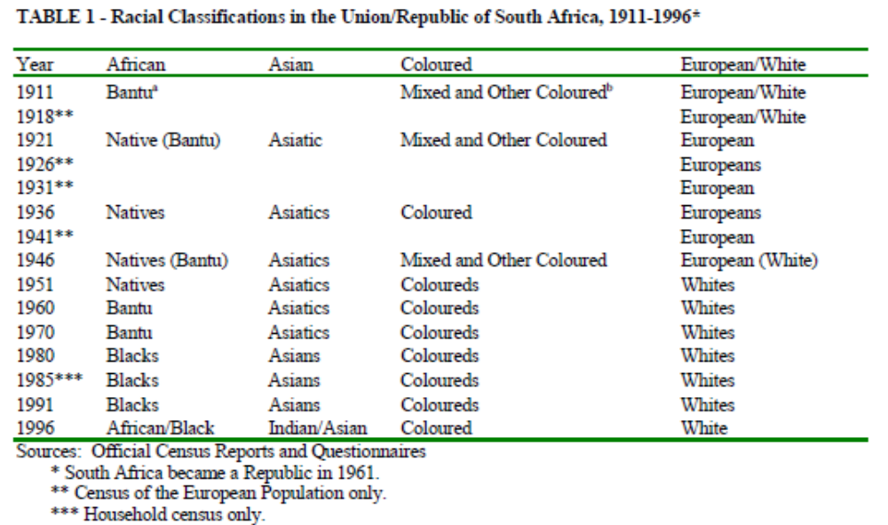
Racial classifications in the Union/Republic of South Africa, 1911-1996

Slide 8
Experiences
Race / population group
Included in all household surveys and censuses
  Disaggregation by sex /race (population group) included in statistical releases and reports

Slide 9
Experiences
Geography
Integral part of Enumeration Areas from which data is collected
HH surveys - report at national, provincial and metro level
  Disaggregation by geographic area included in statistical releases and reports
Censuses – low level reporting
Community survey – municipality level (local government level – important for planning)

Slide 10
Experiences
Disability status
Only included in Census, Community survey and General household survey
  Disaggregation included in reports

Slide 11
Experiences
Migratory status
Only included in Census, Community survey and QLFS (once every 5 years)
Typical questions include:
  the year foreign residents were born
  the year they moved to South Africa;
  the municipalities / province where foreigners moved;
  the period during which migration took place;
  the year and month during which person moved;
  previous province / country of residence; and
  the reasons for the move.

Slide 12
Experiences
Migratory status
Asylum seeker and refugee statistics from administrative sources such as DHA, is highlighted monthly in tourism and migration statistical release, and the annual report on documented immigrants

Slide 13
Experiences
Earnings / income
Only included in Census, Community survey, IES, LCS, QLFS and QES
QLFS
  Earnings of employees and earnings for own account workers and employers after expenses
  Employees - including tips and commission
  Actual amounts or categories where actual amounts cannot be provided

Slide 14
Experiences
QLFS…
  Because of their superiority when describing the distribution of earnings, and because of their much greater stability through time, Stats SA only uses medians and other quintiles in published data
  In order to increase the precision of the earnings data, only annual averages are published

Slide 15
Challenges

Slide 16
Challenges
Age
Sometimes age is missing

Slide 17
Race and sex
Race: There are challenges in continuing to ask for racial classification
Challenges
Age
Sometimes age is missing
Black/African
Coloured
Indian / Asian
White
Other

Slide 18
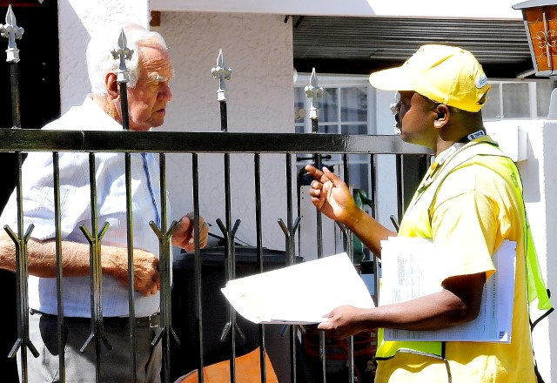
From a respondent perspective:
  Non-South Africans may display sense of disconnectedness to the categories and do not respond
  Some groups feel marginalised
  Some view the groupings with suspicion-used to disadvantage certain groups (Fairness)
  Feeling that classification works against building non-racial society-Out of kilter with constitution
  They may seek a finer disaggregation as current groupings do not cater for them

Slide 19
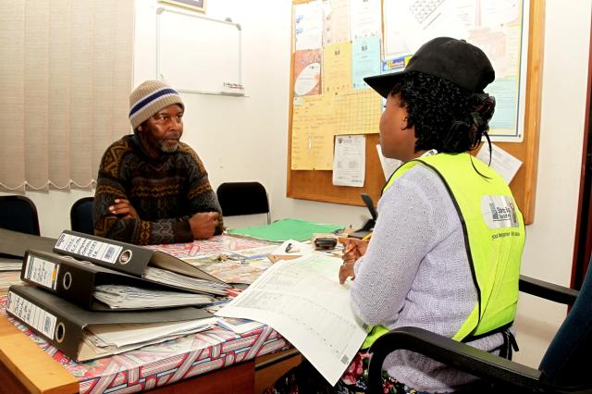
From an interviewer perspective: Asking the self classification question
  May do self classification on behalf of respondent
  Culture (Questioning older persons about sex and race - population grouping (seen as obvious)
  Fear of damaging rapport with respondent
  Time-saving (as these are viewed as obvious)
  Sensitive matter

Slide 20
Challenges
Geography
Lack of small area data for planning purposes
  Requires a large sample size – costly
  Need to find ways of getting low level data – maybe through modelling
Disability
Not included in all survey instruments
Need to adjust QLFS, IES and LCS, at least, to include disability

Slide 21
Challenges
Migratory status
Not regularly collected through HH surveys – but is this an issue?

Slide 22
Challenges
Earnings / income
QLFS collects earnings on a quarterly basis but reported on annually

Slide 23
Thank you

Slide 24
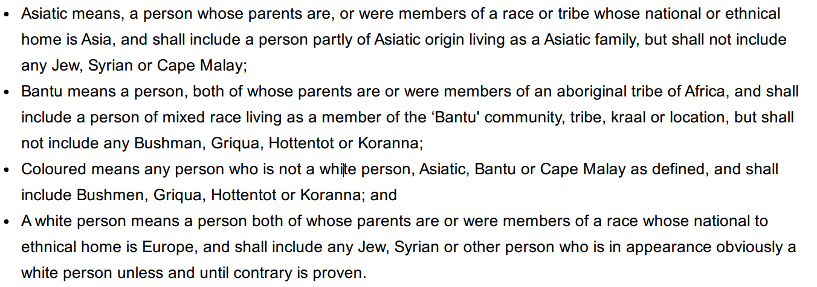
Statistics and Racial Segregation
System of racial classification for the 1951 census
Source: The strange career of race classification in South Africa ­
Wilmot James

