Slide 1
Sub-regional workshop on Data disaggregation
Ethiopian Experiences
By
Abate Sidelel
Lilongwe, Malawi,
27-29 September 2017

Slide 2
              Country overview
              Experiences
              Challenges

Slide 3
Introduction
Ethiopia is located in North East Africa – in the Horn of Africa
Physical
  Area:- covers a total area of 1.1 million square kilometers (420 million square miles)
  Vicinal location:- Sudan and South Sudan, Djibouti, Eritrea, Somalia and Kenya
  Absolute location:- between latitudes 3° and 15°N, and longitudes 33° and 48°E
Population
  estimated 94,352,000 on July 1, 2017
  A multilingual nation with around 80 ethno-linguistic groups
Economy
  Agriculture is predominantly the source of the country’s economy and accounts for almost 41% of the Gross Domestic Product (GDP), 80% of exports, and 80% of the labor force

Slide 4
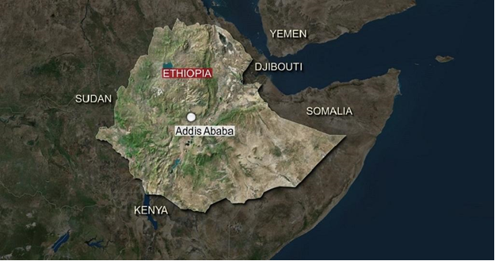

Slide 5
count
  The Ethiopian economy has been registering an impressive growth rate annually over the years
  However, it should be proved by monitoring, evaluating and measuring the developmental progress using adequate and quality data
    It would be difficult to imagine the modern world without statistical data or with no numeric presentation of the situation as a basis for determining priorities, development of proper tools to fight problems and evaluation of the results.
    The data may aggregated or disaggregated
    Aggregate data refers to numerical or non-numerical information that is
    collected from multiple sources and/or on multiple measures, variables, or individuals and
    (2) compiled into data summaries or summary reports

Slide 6
count
    Disaggregated data refers to numerical or non-numerical information that has been
    (1) collected from multiple sources and/or on multiple measures, variables, or individuals;
    (2) compiled into aggregate data—i.e., summaries of data—typically for the purposes of public reporting or statistical analysis; and then
    (3) broken down in component parts or smaller units of data
  Disaggregation means taking “overall” or “total” figures and breaking them down by subgroups
  Disaggregation can be important because subgroups may differ substantially, in ways that are obscured by the overall or total figures. In some cases, it will turn out that the overall or total figures are driven mostly by just one subgroup
  Looking at the overall figures could be misleading. Disaggregating data is important to reveal patterns that can be masked by larger, aggregate data.

Slide 7
Scope of the National Statistical System (NSS)
The scope of the NSS has been institutionalized by the Central Statistical Agency, and the work programme has been approved by the National Statistics Council (NSC)
  NSC is led by the National Planning Commission (NPC),
  Representatives of the sector Ministries, Departments, Agencies (MADs) and all regional states are members
  The NSS is a combination of data producers, data users, and suppliers of raw data, development partners and the media.

Slide 8
Some of the Surveys Done by CSA During the First & Second NSDS (2010/11 – 2016/17) and Their Outcomes
Household Consumption and Expenditure Survey; 2011, 2016
Demographic characteristics of households, wealth status, type of household food and other necessity items consumed, size and bulk of the food and necessity items, amount of expenditure, calorie intake, etc.
Welfare Monitoring Survey; 2011
the welfare status and monitoring indicators of the community
disaggregated data by AGE; 2017
CSA produced disaggregated data by AGE for Youth Development Planning purpose to National Planning Commission and Regions to allocate financial support for each Regions, Zones and Weredas.
The data were produced from Ethiopian Population projected data that was based on 2007 Census and supported by 2012 Inter-censal Population survey.

Slide 9
Cont
Urban Employment and Unemployment Survey for Addis Ababa; 2013, 2014
the demographic characteristics of Addis Ababa City population,
active population, inactive population,
employed population,
unemployed population,
training and skill availability,
usual and current status of employment,
participation of employed population in Industry,
  Service,
  agriculture and government offices, and
data about informal sector,
wage and salary from employment etc..

Slide 10
Cont
Urban Employment and Unemployment Survey; 2011, 2012, 2013, 2014, 2015, 2016
Report on the demographic characteristics of urban population,
active population,
inactive population,
employed population,
unemployed population,
training and skill availability
usual and current status of employment,
participation of employed population in industry,
  service,
  agriculture and government offices, and
data about informal sector,
wage and salary from employment, etc..

Slide 11
Cont
Time Use Survey; 2013
Report on the time use by gender and types of activity
Census Result Updating and Projection; 2011, 2013
National level population projection report based on the 2007 Population and Housing Census Result and
projected by considering major demographic characteristics

Slide 12
Cont
Ethiopian Demographic and Health Survey; 2011, 2016
Report on characteristics of the respondent,
marriage and sexual activity,
fertility level, trend, differentials, fertility preference,
family planning,
infant and child mortality,
maternal health,
child health,
nutrition of child adult nutritional status,
HIV prevalence, knowledge and attitude,
women empowerment,
adult and maternal mortality

Slide 13
Cont
Inter Censual Survey, 2012
population characteristics,
ethnic group,
mother tongue,
religion and
marital status,
disability and
orphan hood,
literacy and education,
economic activity,
population dynamics,
migration,
fertility,
mortality,
housing characteristics and conditions

Slide 14
Challenges
Inadequate human power both in terms of number and skills
Below standard state of Management Information System for many sectors and absence of training to establish and operate MIS
Inadequate resources and supporting logistics for statistical production
High Staff turn-over for the betterments of life
Lack of data management software and databases in many sectors and absence of regular updating where available
Gaps in data in the areas of environment, tourism, horticulture, gender responsive statistics and in other emerging issues
Lack of statistical awareness and hence low level of cooperation in statistical operations on the part of the data providers
Inadequate statistical advocacy to raise the profile of statistics in the country and non-involvement of the media to create statistical awareness

Slide 15
Cont
9. Weak institutional knowledge management and functional organizations for statistical production within the NSS
10. Poor internet connectivity;
11. Unequal statistical capacity across the NSS
12. Poor record keeping, which hampers the development of administrative statistics from records of administrative actions – weak Management Information Systems across most of the MDAs
13. Lack of strong coordination within agencies

Slide 16
THANK YOU

