Slide 1

Data Disaggregation and the SDGs:
An Overview
Benjamin Rae
Statistics Division
UN Department of Economic and Social Affairs
^{27 September 2017}
^{Lilongwe, Malawi}
Notes:
https://sso.unite.un.org/adfs/ls/?client-request-id=f0f62c81-a89a-45b5-b93f-5f61649592c7&username=&wa=wsignin1.0&wtrealm=urn%3afederation%3aMicrosoftOnline&wctx=estsredirect%3d2%26estsrequest%3drQIIAY2RvWvUYACH771cQ1sKFifHIk5qPt43n3cgklwSq81dztZr1eXId1IvedMkl3gu4n9QCi43OojeqAgqOAudOjm4uoiTFBRHe7g49hkefvPzu0pAGnausP9A1MIUGwSQcv3F-o_84ur6s-u_f85evdM_3BzZ3vOjzzNATlIa5-EcXI7KMis6DIMn5RjjRzQOgtj1OVGgXZwwuLaZ9wCcADBvSiIn8lDgWZmXEeSh1BZpW-JkV-JdymEDmeLbgkc5siNQyHYCzxUE2fHQ1-YFS5mUEVoI5_ET_7S5EuA8GWW4KGdErbmlqWEl1BR1m1VLXhPUQZfbjQZKYbi2tZOocWXyBTcRjG5s6o6VjMVtpaZCfVir1t0CmaGe2lvpZlfP-9lwaBrhUBf703ivuhP37hnTQLDcUbVTaVCyDkawur8r7UfynDhXwDcEeVYiwekxQeLMT2PvpAV-tNZYorO8vLreuNTYaPxpgRdLZ6G_fDr69vIp0F6fRm9_MWuN4yVGRAfKQ8Vvqw_6e73bGfu45rSp4atbm9a4HPSRHV3Dkujso1u9G3IHHpLgkCS_k-Djyjmu-Qs1

Slide 2
Overview
    The Global SDG Indicator Framework
    The Concept of Leaving No-One Behind
    Data disaggregation and the SDGs
    Work of the IAEG-SDGs on data disaggregation

Slide 3
The Global indicator framework
232 unique indicators, at least one per target
    a few indicators repeated under different targets
Indicators are at different levels of development
    Tier 1 – metadata are fully developed and data are available
    Tier 2 – metadata are developed but data are very sparse
    Tier 3 – methodological work is needed to develop the indicator

Slide 4
The Concept of
Leaving no one behind
Member States have pledged to leave no one behind
IAEG-SDGs has included an overarching principle of data disaggregation:
“Sustainable Development Goal indicators should be disaggregated, where relevant, by income, sex, age, race, ethnicity, migratory status, disability and geographic location, or other characteristics, in accordance with the Fundamental Principles of Official Statistics (General Assembly resolution 68/261).”
The IAEG-SDGs also ensured that indicators cover specific population groups and other disaggregation elements specified in the targets.

Slide 5
The Concept of Leaving No one Behind:
Importance of data disaggregation
Aggregates mask what is happening at the individual level.
In order to measure progress detailed information about the most vulnerable needs to be available.

Slide 6
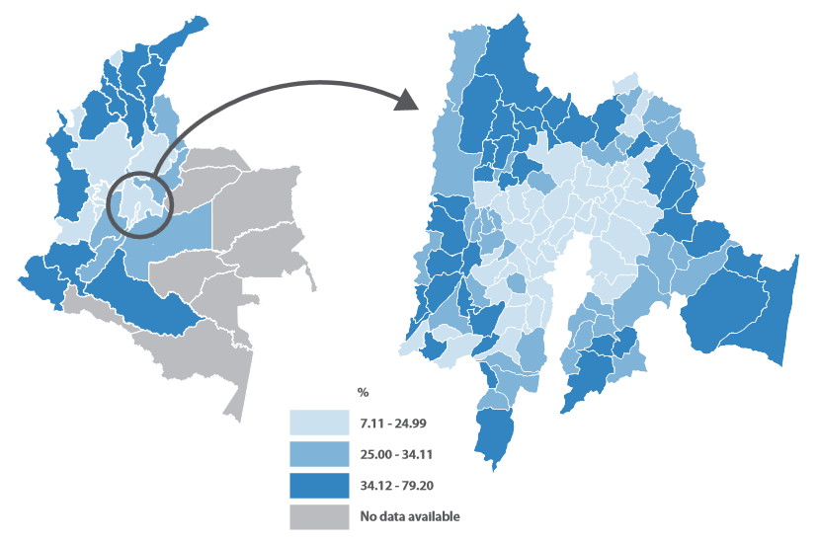
Example: Data disaggregation
Share of households per « Basic Unmet Needs » index, Colombia
Colombia
Zooming into Cundinamarca Department
National Administrative Department of Statistics, 2005

Slide 7
The Concept of
Leaving no one behind
In order to ensure no one is left behind, we need data sources that:
Capture every unit
Capture all relevant groups
We most also identify the most vulnerable (both people and groups) for better targeting

Slide 8
The Concept of
Leaving no one behind
Indicators defined with specific groups for disaggregation
Indicators with no specific disaggregation defined - yet
And from a data source point of view:
  Indicators with disaggregates as denominators: indicator based on a disaggregate
  For data sources that collect information on a higher level aggregate (e.g. total population)

Slide 9
The Concept of
Leaving no one behind
Leaving no one behind, disaggregation, exclusion closely related
If we need to leave no one behind in data work, we need to have disaggregated information for every one or every group, the most vulnerable
Excluded populations are usually the most vulnerable (hard to reach populations, ethnic groups) – exclusion by incomplete coverage

Slide 10
The Concept of
Leaving no one behind
Additionally, exclusion by design leads to absence of relevant disaggregation:
Household surveys will not include institutional populations
School based surveys will be confined to children attending school
Administrative data may cover only those enjoying services
Data sources need to “work together” to build the story

Slide 11
Opportunities in the SDGs
specific groups mentioned in the targets
Target 2.3 | by 2030 double the agricultural productivity and the incomes of small-scale food producers, particularly women, indigenous peoples, family farmers, pastoralists and fishers, including through secure and equal access to land, other productive resources and inputs, knowledge, financial services, markets, and opportunities for value addition and non-farm employment
Issues of disaggregation
Target 5.4 | by 2030, eliminate gender disparities in education and ensure equal access to all levels of education and vocational training for the vulnerable, including persons with disabilities, indigenous peoples, and children in vulnerable situations
Population groups
Target 8.8 | protect labour rights and promote safe and secure working environments of all workers, including migrant workers, particularly women migrants, and those in precarious employment

Slide 12
Data disaggregation and the SDGs: Challenges
More emphasis on disaggregation will lead to challenges in:
Cost to collect and analyze
Quality
Pressure to collect more information – stretching the boundaries
Sample sizes
Confidentiality
Politics of data, transparency
…….. and more

Slide 13
Data disaggregation and the SDGs: Challenges
The challenge is not disaggregation alone
The call is for high quality, timely, disaggregated data
….. for a very broad agenda
More targets, more indicators, more frequently, with more disaggregation
….. faster, deeper and wider
Demand for multi-dimensional disaggregation will increase:
Disaggregating within disaggregates – “child labour in poorest quintile in urban areas” – for better targeting
Many indicators are based on specific population groups – further disaggregation will be needed

Slide 14
Methodological work on data disaggregation
Methodological work needed for data disaggregation not to be underestimated
New and/or difficult disaggregates
Need methodological work to develop standards, measurement tools and protocols
Need to continue work on some “old disaggregates”
Methodological work still needed
Improve quality of data on disaggregates (e.g. age)
Set better standards (e.g. residence)

Slide 15
Methodological work on data disaggregation
Comparability:
Comparability of disaggregates may be more challenging than the indicators
If progress will be measured by reduction of inequalities, then comparability will be important, over time and within & across countries
We may need to aggregate the disaggregates – for example, for national or regional monitoring
Some disaggregates are more comparable than others (sex, age) while some are problematic although they do not seem to be (urban) – others are “new”

Slide 16
Data disaggregation and the SDGs
Concerns with disaggregation
How to ensure that the disaggregation is not pushed to the national level only--need to reflect this at the global level.
How do we include consistent listing of marginalized groups and disaggregation
  Do we have to? What role does national context play?
Feasibility of producing disaggregated data all levels
  Cost implications

Slide 17
IAEG-SDGs work on data disaggregation
Decisions of the Statistical Commission:
The 47th Statistical Commission decision 47/101 (n) requested the IAEG “develop the necessary statistical standards and tools, including by establishing a working group to work on data disaggregation as a subgroup of the Inter-Agency and Expert Group.”
The 48th Statistical Commission decision 48/101 (j) “welcomed the work stream on data disaggregation to ensure that the indicators respond to the ambition of the 2030 Agenda for Sustainable Development that no one will be left behind”

Slide 18
IAEG-SDGs work on data disaggregation
Definition of Disaggregation:
“Disaggregation is the breakdown of observations within a common branch of a hierarchy to a more detailed level to that at which detailed observations are taken. With standard hierarchical classifications […] categories can be split (disaggregated) when finer details are required and made possible by the codes given to the primary observations.”
Disaggregation dimensions – the characteristics by which data is to be disaggregated (by sex, age, disability, etc.)
Disaggregation categories – the different characteristics under a certain disaggregation dimension (female/male, etc.)

Slide 19
IAEG-SDGs data disaggregation work plan (1)
Proposal: Initial Starting Point for the disaggregation of each indicator
The initial starting point for disaggregation consists of the dimensions stated in the accompanying target as well as the dimensions stated in the indicator name itself
The work at this initial starting point for disaggregation will take place in three workflows:
Workflow A: Data availability for initial starting point disaggregation
Workflow B: Harmonization
Workflow C: Tools and Methods

Slide 20
IAEG-SDGs data disaggregation work plan (2)
Workflow A: Data availability for initial starting point for disaggregation
  Analyze data availability for the dimensions for the initial starting point for disaggregation. Should start with Tier I indicators since data should already be widely available. At national level, Tier II indicators with data availability could also be used.
  Develop an indicator classification system based on data disaggregation availability. Each dimension for every indicator would be classified into one of three groups based on data availability
  After Workflow B is completed, the classification system for data availability would be complemented by an additional “*” category, reflecting data availability along the harmonized categories
  Corresponding results would be an input for the joint sub-group of the IAEG-SDGs and HLG on capacity building

Slide 21
IAEG-SDGs data disaggregation work plan (3)
Workflow B: Harmonization
The work in this workflow consists of:
  Clarify the definition of the dimensions identified at the initial starting point for disaggregation
  Consult experts from different statistical domains and working groups in order to identify categories used for different dimensions
  Define harmonized categories for future capacity building. These should take international standards into account, as well as accounting for diversity. Some dimensions may have a fixed number of categories, while others may have an open range of categories. The categories may also vary according to the subject

Slide 22
Thank You!
Questions?

