Slide 1
Climate, Land, Energy and Water Systems (CLEWS)
Thomas Alfstad, Adviser
Economic Analysis and Policy Division
United Nations Department of Economic and Social Affairs

Slide 2
Support for National Sustainable Development Strategies
1. Policy coherence in SDG implementation
2. Mobilizing financial resources for implementation
3. Accessing appropriate data to assess, review and report on progress

Slide 3
Modelling tools for sustainable development
Economy-wide modelling
  Computable general equilibrium representation
  Assesses the impact of policies, perturbations and shocks
  Explores impact on key economic indicators
Climate, Land, Energy and Water Systems
  Integrated assessment of resource systems
  Simultaneously explores matters pertaining to food, energy and water security
Micro-simulation
Support policies for sustainable development
  Based on household surveys
  Addresses trade-offs and synergies among policy goals
  Variety of methodologies
  Seeks to promote policy cohesion
  Studies impacts of policies, perturbations and shocks at the household level
  Social inclusion, distributional impacts, targeted impacts
Geo-spatial electrification
  Cost effective strategies for electrification
  Comparison of technology options for electrification
  GIS based analysis
  Grid vs non-grid electrification

Slide 4
Modelling tools for sustainable development
Needs assessment and strategic guidance
Identification of areas of need, advances in quantitative assessment techniques and tools, direction and prioritization
Development of open-source modelling tools
Economy-wide modelling, Micro-simulation, Geospatial analysis, Integrated Climate, Land, Energy and Water Systems modelling
Feedback, lessons learned and new ideas
Develop training materials and “training of trainers”
UN system, national government and academic partners
Regional and global workshops, remote follow-up and engagement
Workshops, schools and distance training
Pilot phase and Implementation of country projects (currently in 12 countries)

Slide 5
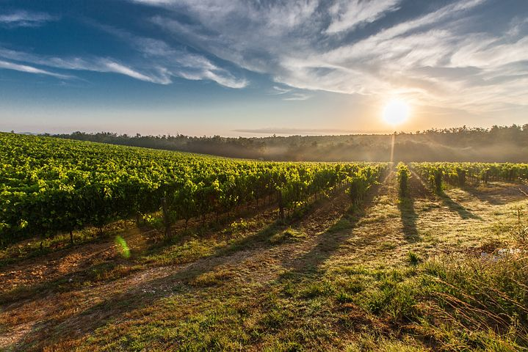
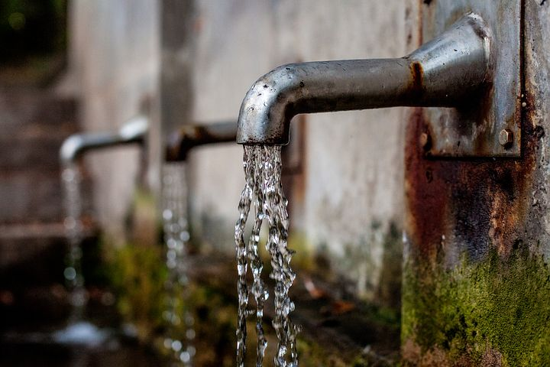
Development challenges and the food-energy-water-climate nexus
900 million people are under-nourished
2 billion people lack food security
1.1 billion people without access to electricity
Almost 3 billion people without access to modern fuels or technologies for cooking/heating
900 million people lack access to safe water
2.6 billion do not have adequate sanitation
Mounting concerns over climate change and other pollution related health and environmental hazards
Notes:
The bottom billion people in developing countries lack subsistence-level access to food, energy and water goods and services; the lower middle-income people finds themselves spending increasingly larger proportions of their incomes to gain such an access; the upper-middle and high-income people overuse them with a substantial share wasted.

Slide 6













Sustainable development: food-energy-water-climate nexus
Sustainable development: food-energy-water nexus and CLEWS
Notes:
Direct, inner circle, and indirect, outer circle, links with the 2030 Agenda for Sustainable Development and the SDGs.
The objective is to illustrate the links among four components (water, land, energy and climate). They are featured in the SDGs, but beyond this, there are natural/structural interrelationships. There are also important indirect links to other issues.
The food-energy-water nexus directly relates to No Poverty (SDG 1), Zero Hunger (SDG 2), Clean Water and Sanitation (SDG 6), Life on Land (SDG 15), Renewable Energy (SDG 7) and Climate Action (SDG 13), among others.
The CLEWS framework can be used to assess the following issues:
i. The sustainability of infrastructure development (e.g., water and energy)
ii. Broader impacts of activities along production value chains
iii. How climate change impacts different sectors of the economy
Both food-energy-water nexus and CLEWS approaches can be employed in planning and capacity-building efforts.

Slide 7

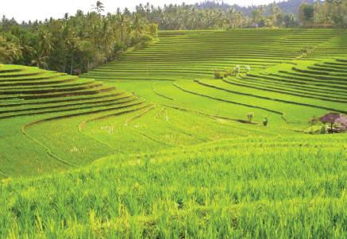
Interlinkages: water use for agriculture
Production of food accounts for the largest component of the human water footprint.
About 70% of freshwater withdrawals worldwide are for agriculture
In Ethiopia it is approximately 90%
Notes:
When efficient irrigation is combined with steps for increased productivity and water efficiency, farmers produce more food and become better stewards of their land. There is greater protection against rain runoff, soil erosion, water or heat stress on plants, flooding and desertification. Policy reform (water pricing, water rights, subsidies, etc.) and technology are vital. Free or underpriced inputs lead to wasteful practices.

Slide 8
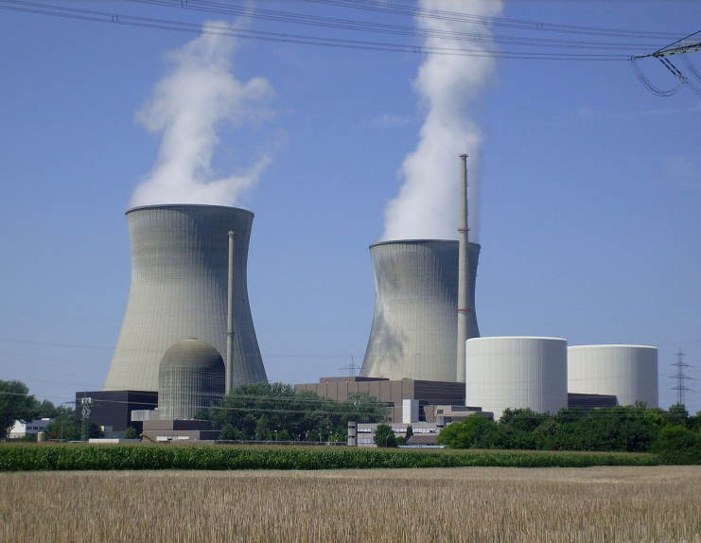
Interlinkages: water for energy supply
Approximately 20% of freshwater withdrawals globally are for industrial purposes.
Cooling thermal processes in the power and manufacturing sectors
Primary fuel extraction
Fuel refining and conversion
Emissions control
Biofuel/biomass production
Hydropower contributes 16% to global electricity supply (over 90% in Ethiopia)
Notes:
Water is important in the energy sector:
Used for cooling in thermal and nuclear power plants
Used (not consumed) in hydropower plants
Heavily used for fuel extraction and refining
Emissions control technology
Growing fuel crops like jatropha, sugarcane, etc.

Slide 9
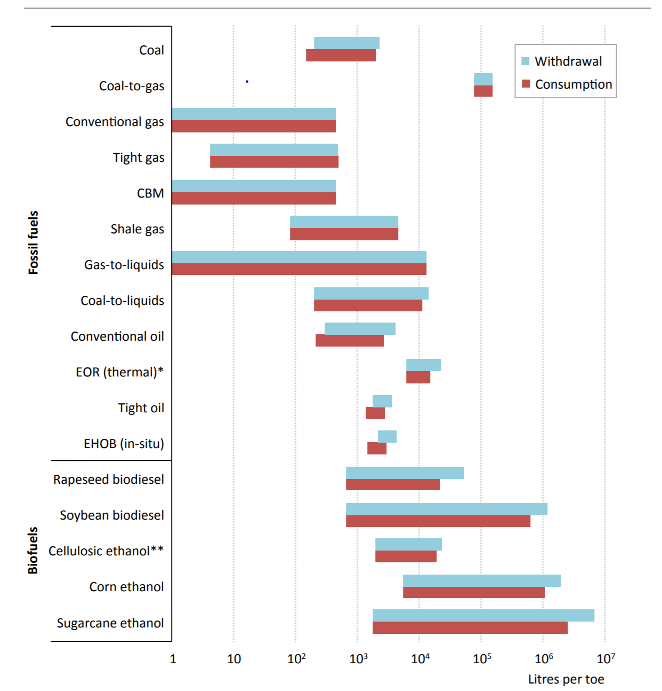
Interlinkages: water for energy resource extraction,
refining and fuel production
Source: International Energy Agency, World Energy Outlook 2016
Notes:
Explain the difference between water withdrawal and consumption.
Explain the change in unit on the x-axis.

Slide 10
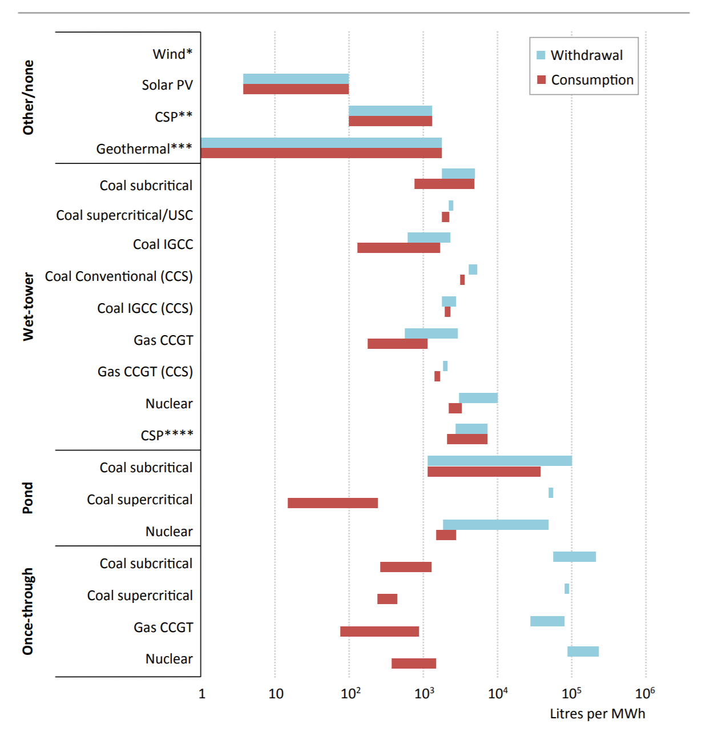
Interlinkages: water for electricity generation
Source: International Energy Agency, World Energy Outlook 2016
Notes:
Explain the difference between water withdrawal and consumption.
Explain the change in unit on the x-axis.

Slide 11
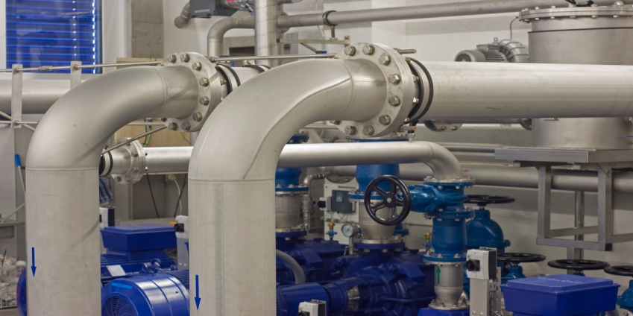
Interlinkages: energy for water supply
The water supply chain is energy intensive (4% of electricity consumption worldwide, up to 10% in Middle East and India)
Supply:
  Surface water: 0-2,400 kWh per million litres for transportation depending on distance and change in elevation
  Groundwater: Varies with depth (e.g., 140 kWh per million litres at 35 metres and 530 kWh per million litres at 120 metres)
Treatment:
  26 kWh per million litres for high-quality groundwater
  300-1400 kWh per million litres for brackish groundwater desalination
  3,600-4,500 kwh per million litres for seawater desalination
Distribution:
  Average of 290 kWh per million litres, but varies widely depending on distance and change in elevation
Notes:
Water needs to be brought from the source to where it is needed. While some water supply systems are gravity driven, many need pumping to bring the water to consumption centres. The amount of energy required will vary widely from system to system, mainly determined by distances the water needs to be conveyed and topography. For groundwater, the energy requirement is directly related to the depth of the water table. As the water table drops, the amount of energy needed to lift water to the surface increases accordingly.
The treatment of water (before and after consumption) is dependent on treatment technology, the quality of the water source, and the desired quality of water for consumption.
Distribution from treatment facilities to the end-user also requires pumping.
As water demand increases and we need to access lower quality sources, such as seawater or brackish water, supplying water becomes more energy intensive. Technological improvements are making treatment more energy efficient, however. With the world population congregating in cities, the demand for water will become increasingly concentrated and intensify the need for water transportation
Sources: Cambridge Energy Research Associates, Natural Resources Defense Council and Pacific Institute (2004) “Energy down the drain: The hidden costs of California’s water supply.” US Department of Energy (2006). “Energy Demand on Water Resources: Report to Congress on the Interdependence of Energy and Water.” Electric Power Research Institute (2000). “Water and sustainability: US electricity consumption for water supply and treatment—The next half century.”

Slide 12

Interlinkages: land use for energy
Development challenges
A growing share of land is dedicated to supplying energy
Bioenergy accounts for a little more than 10% (60 EJ) of the world’s total primary energy supply (Over 90% in Ethiopia)
15% of maize and oil seeds and over 20% of sugarcane are used for biofuel production
About 500 TWh of electricity is produced from biomass annually. Equivalent to about 2% of world electricity generation
Notes:
The importance of land for energy:
Growing crops for producing biofuel is leaving a big footprint on land use.
Land use is an important factor in large-scale photovoltaic power plants and wind turbines.
There are some innovative ways to increase efficiency in the use of land for solar energy, such as by placing the panels on top of canals and on land with scattered vegetation.

Slide 13
Interlinkages: land use for electricity production
Source: V. Fthenakis and H. C. Kim (2008). “Land use and electricity generation: A life-cycle analysis.” Renewable and sustainable energy reviews.
Notes:
Different technologies have widely different land footprints (note the break in the y-axis).
This chart shows land transformation; land occupation would rank technologies differently.

Slide 14
Interlinkages: land use for bio-energy
Source: International Energy Agency (2011). “Technology Roadmap—Biofuels for Transport.”
Notes:
Examples of the ranges of land use for bioenergy sources.

Slide 15

Interlinkages: energy for agriculture and food
Energy is required to power agricultural machinery for field preparation, crop harvesting, drying and processing
Energy is required to produce fertilizers, pesticides and other agricultural inputs
Combined direct and indirect uses comprise 4-5% of final energy consumption
Notes:
Energy, primarily electricity and fossil fuels, is vital for agriculture. It is actually used throughout the life cycle of crops: from transportation of seeds to the farm, all the way to transporting agricultural products to markets for consumption.

Slide 16
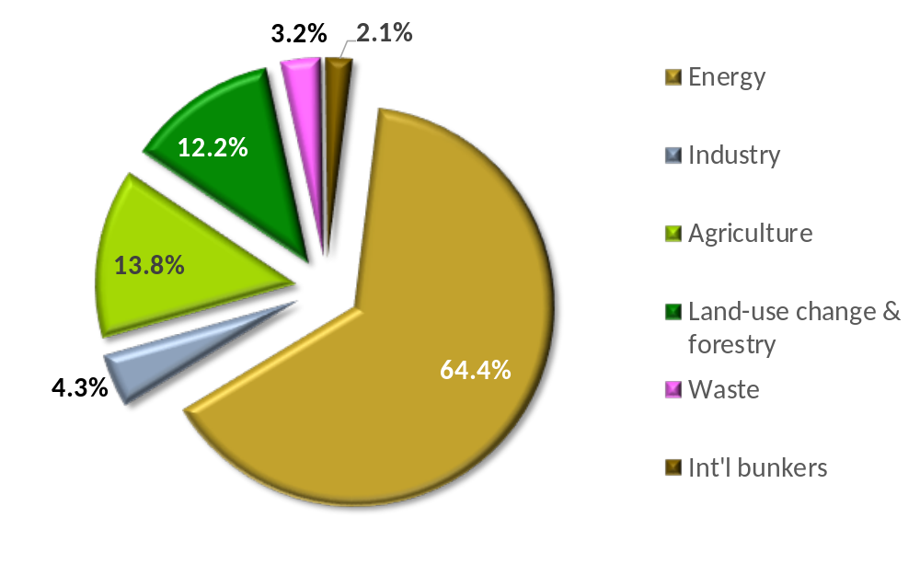
Greenhouse gas emissions and
the food-energy-water nexus
Global emissions by sector
Notes:
The food-energy-water nexus is important in terms of emissions. There are several ways to account for anthropogenic emissions.

Slide 17
Greenhouse gas emissions from electricity generation
Notes:
Electricity generation and other energy uses are major contributors to carbon dioxide emissions.

Slide 18
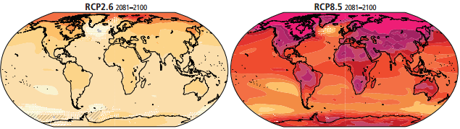
Climate change and the food-energy-water nexus
Climate change is often said to “manifest through water”
More frequent extreme weather events (e.g., more droughts and floods)
Shifting precipitation patterns
Potential for major impacts on agriculture
Impact on energy infrastructure
Sea level rise could have dramatic consequences for land use
Global mean temperature prospects
Notes:
Climate change = changes in mean and variability over decades:
Temperature
Precipitation
Wind patterns
Insolation
Sea level rise
Extreme weather events = occurrence of a value of a weather or climate variable above or below a threshold value near the upper or lower end of the range of observed values; changing patterns (frequency, intensity, timing) of:
High/low temperature and precipitation
High winds/storms
Hail
Lightning, etc.
Coal and uranium:
Flooding open-pit mines
Dust from coal stockpiles
Oil and gas:
Melting permafrost -> destabilizing equipment
Sea level rise: inundating coastal and offshore sites
Sea level rise and winds: damage to onshore wells and offshore platforms
Hydropower:
Higher evaporation losses
Changes in water availability (including indirect changes due to need for more irrigation and water cooling for thermal plants)
Wind power:
Changes in wind resources
Climate change:
Changes in the spatio-temporal wind resource distribution; mean wind power densities over Europe and North Africa likely within ±50% of current values
Less frequent icing with increasing temperatures
Lower precipitation: more dust deposition
Sea level rise: inundating coastal and offshore sites
Climate change and extreme weather events:
Winds: structural damage
Low temperatures and precipitation: ice formation on blades reducing efficiency, structural damage
Lightning: structural damage
Solar power:
Changes in insolation
Climate change:
Increasing temperatures: lower photovoltaic and concentrated solar power efficiency
Changes in cloudiness and average insolation
Climate change and extreme weather events:
Increased precipitation, high winds, hail and high temperatures can each damage photovoltaic and concentrated solar power
Drought and winds: more sand and dust deposited on collectors, reducing efficiency of photovoltaic and concentrated solar power
Ocean-going ships:
Less ice means more opportunities for passage
Sea level rise may affect ports and limit options for large vessels
Inland ships:
Difficult passage with extreme low and extreme high water levels
Extreme low temperatures: ice
Rail and roads:
Freeze-thaw cycle leads to damage
High temperatures: tracks deform, roads soften
Low temperatures: railroad switches freeze, roads crack
Pipelines:
Low temperatures can weaken/damage pipelines
High temperatures: increased corrosion and greater energy requirements for compression
Thermal climate change: temperatures increase
Thermal efficiency decreases by 0.1-0.2% per 1 C° increase
Cooling efficiency decreases: capacity loss of 1-2% per 1 C° average temperature increase
Climate change and extreme weather events:
Temperatures: larger efficiency loss and cooling challenge
Drought: even less and warmer cooling water
Temperature and drought: acute cooling problem
Winds: can damage cooling towers
Refineries and climate change: sea level rise inundating coastal refineries
Climate change and extreme weather events:
Precipitation: flooding refineries
Winds: physical damage
Lightning: structural damage, fires
Hydropower and climate change: lower precipitation = lower long-term capacity and output
Electric grid:
Climate change: decreasing transmission efficiency of 0.4% per 1 C° increase
Climate change and extreme weather events:
High temperatures: lines and transformers overheat, capacity declines, outages
Low temperatures: ice -> damage and outages
Lightning: damage and outages
Winds: damage and outages
Flooding: damage and outages

Slide 19
Key weaknesses of sector policy design done in isolation
Policy formulation and assessments are quite often done in isolation by separate and disconnected institutional entities. This contributes to:
Lack of communication and coordination
Distrust
Incoherent, counterproductive policy formulation and decisions
High probability of inefficient use of scarce resources
Absence of an institutional structure and buy-in for integrated analyses and planning

Slide 20
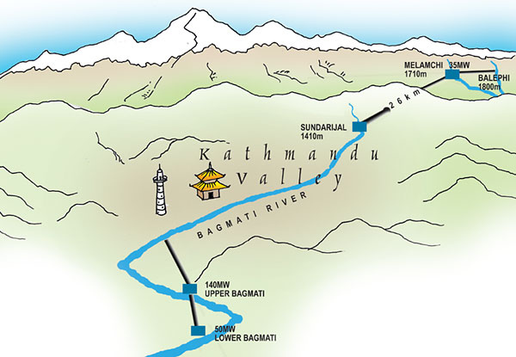
Example: Melamchi trans-basin water supply, Nepal
Plan to supply underserved consumers in Kathmandu Valley with water
  Large infrastructure project
  Trans-basin transfer of water
Potential for project to serve multiple uses
  Irrigation
  Hydropower component
Opposed by line agency
  Strong resistance to expand project scope
  Blocked role in project implementation by other agencies
Project went ahead as single-purpose urban water project
Notes:
The Kathmandu Valley has faced chronic water shortages for many years. Unmetered consumption is rife, as are technical losses from leaky pipes and tanks as well as severe pollution. Numerous studies from the 1980s by different donor agencies have suggested rates of leakage and water theft that are as high as 70 percent.
Diverting water from the upper reaches of the Melamchi River, a tributary of the snow-fed Sun Kosi north of Kathmandu, was identified as a viable measure to remedy the water shortage problem in the early 1970s.
The Melamchi project involves the construction of a tunnel located at an altitude of 1,700 metres on the upper reaches of the Melamchi River. It would bring water down to Sundarijal in the Kathmandu Valley at 1,400 metres, thereby creating a head of 300 metres so that about 25 MW of power could be generated. But the idea was later abandoned amid claims that it was not feasible. It is true that having to dig a 27-kilometre long tunnel just to generate about 25 MW of electricity sounds too expensive even at a cursory glance. But the fact that the tunnel had to be constructed anyway was filtered out by those pushing for a single-silo water supply project. In generating power from the same water, the incremental cost of the tunnel would have been low for the power generation component.
The principal Nepali line agency for this project is the Department of Water Supply and Sewerage of the Ministry of Housing and Physical Planning. Its mandate is water supply. There has been strong resistance to adding electricity or any other component that would involve sharing a project with other line agencies.

Slide 21
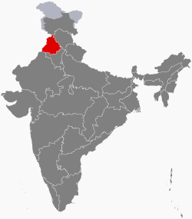
Example: Punjab, India
Punjab has only 1.5% of India’s land, but its rice and wheat production accounts for 50% of the grain the Government purchases and distributes to feed more than 400 million poor Indians.
Groundwater is being withdrawn faster than it can be replenished
  No restriction on landowners’ rights to pump water on their own land
  Government set prices incentivize planting of water-intensive crops
  Electricity provided free to farmers
Water levels drop; increased pumping is putting additional stress on an already fragile and overtaxed electricity grid
  Excessive pumping not only leads to overexploitation of aquifers, but also to high electricity demand
  Irrigation accounts for about 15-20% of Punjab’s total electricity use
Notes:
A key driver for water depletion is food demand (i.e., 1.2 billion mouths to feed).
As the law stands, landowners have the right to draw as much as they see fit from their wells. A system of government set prices encourages farmers to plant water-intensive crops such as sugarcane and rice. And state governments in India provide electricity to farms at no charge or at heavily subsidized flat rates, making the water completely free to pump in many areas (as long as the water level doesn’t drop so low that you need a new well or a pump).

Slide 22
The need for integrated planning
These issues highlight the challenges faced by governments pursuing sustainable development.
A complex web of interwoven concerns and vested interests.
Decisions can have far-reaching consequences outside the targeted area, sector or jurisdiction.
Impacts can be unintended and unforeseen.
Cross-sectoral and cross-system impacts may be either positive or negative (or both).
A coordinated and integrated process to develop policies and measures with adequate attention given to cross-cutting aspects is needed.
Includes the concerns and perspectives affected agents/sectors.
Assesses the complementarity and conflicts among policy goals.
Stakes out a path that makes appropriate compromises (trade-offs) to pursue overall development.

Slide 23
Climate, Land, Energy and Water Systems (CLEWS)
Water-land interactions in the hydrological cycle,
Water needs for food, feed, fuel and fibre crops (rain-fed and irrigated), water-
Biomass for biofuel production and other energy uses,
Energy required for field preparation and harvest
Energy for production of fertilizer, pesticides and other agricultural inputs
Land and agriculture system
Climate
GHG emissions
Energy system
Water system
.
Precipitation, temperature
Energy for water processing and treatment,
Energy for water pumping
Energy for desalination
Water for hydropower
Water for power plant cooling
Water for (bio-) fuel processing

Slide 24

The CLEWs framework
Time horizon typically one or more decades
  Intended for longer term assessments and studies
Bottom-up analysis
  Representation of physical systems
  Full value chain (e.g. “well to wheel” or “field to fork”)
  Each asset described by its technical and economic characteristics
  Identify cost-effective strategies subject to constraints
Scenario based analysis
  Explores alternatives, risks and uncertainties through scenarios and sensitivity analysis
  Assesses the role of technology, technology choice and technology change
  Tests policies and measures
Flexible
  Model user chooses system boundaries
  Model user chooses level of detail
  Model user chooses geographical coverage

Slide 25
Simplified illustration
Simplified illustration
Coal mine
Coal
Coal PP
Electricity
Home appliances
Gas
field
Natural gas
Gas
PP
Industrial equipment
Water
resource
Water
Water
Treatment
Treated Water
Drinking water
Land resource
Land type X
Maize farming
Maize
Household nutrition

Slide 26
The CLEWs framework
The aim is not to:
  Forecast or predict
  Be prescriptive
But rather to provide stakeholders with policy relevant:
  Insights into key inter-linkages and dynamics of the energy-food-water nexus
  Robust findings to support cohesion in policies and measures
  Knowledge of risks and opportunities

Slide 27
The CLEWs framework
Provide policy relevant insights, information and quantitative estimates
  Can help identify interlinkages among sectors
  Can help determine likely quantitative aspects of such interlinkages
  Identify robust relationships (i.e. impacts/relationships that are true for a wide range of conditions/assumptions)
  Identify key risks (impacts/relationships that are true under certain circumstances)
  Explore technology and policy alternatives to mitigate unwanted outcomes (i.e. minimise impact of trade-offs)
  Explore technology and policy alternatives to realize co-benefits (i.e. maximise synergies)

Slide 28
Land and water representation
Resources
Land
Withdrawals for human uses
Withdrawals from surface water
Final demand
Public sector, households, comercial sector, industrial sector
Agriculture
Power generation, energy sector
Precipitation
Water balance by land cover type
Precipitation
Run-off
Evapotranspiration
Transboundary water flows
Groundwater
Groundwater recharge
Withdrawls from groundwater

Slide 29
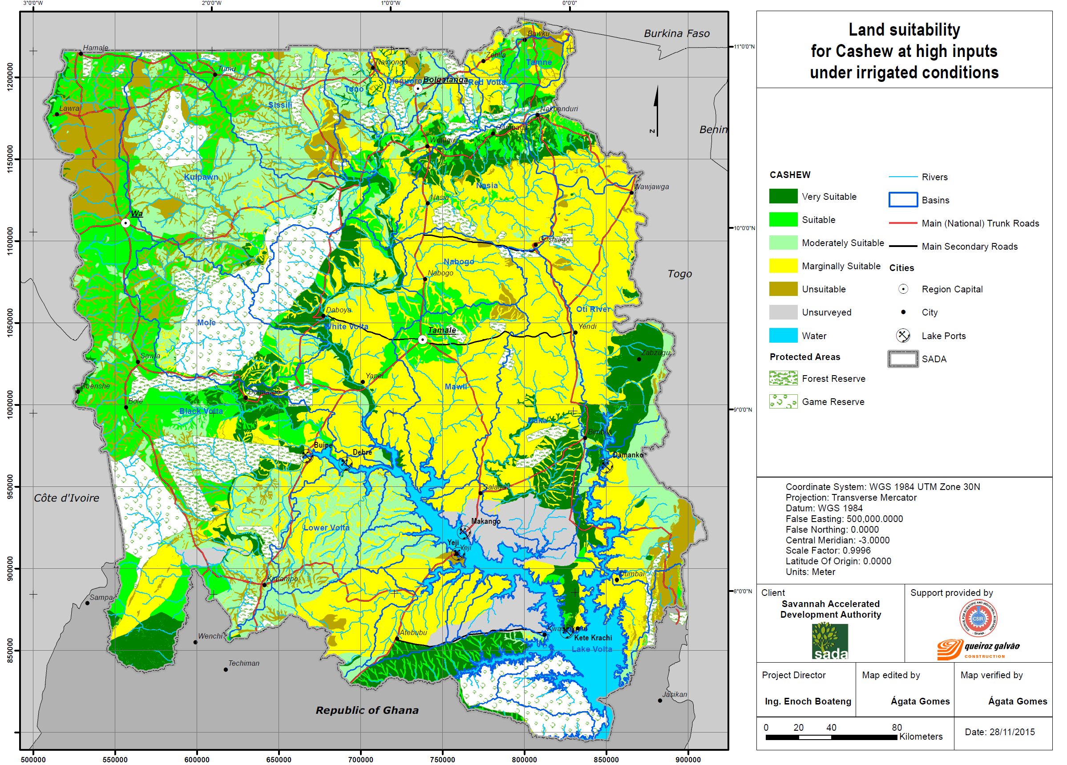
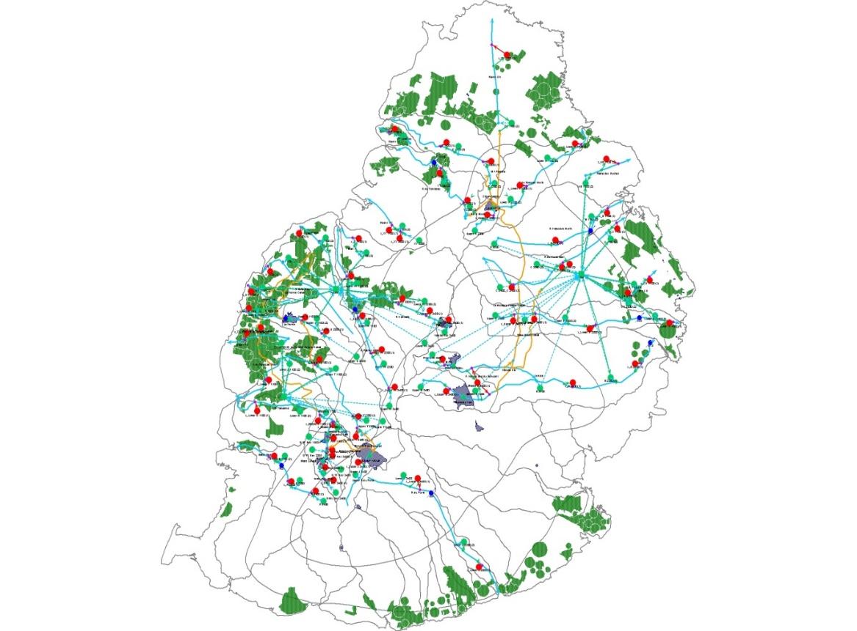
Land and water representation

Slide 30
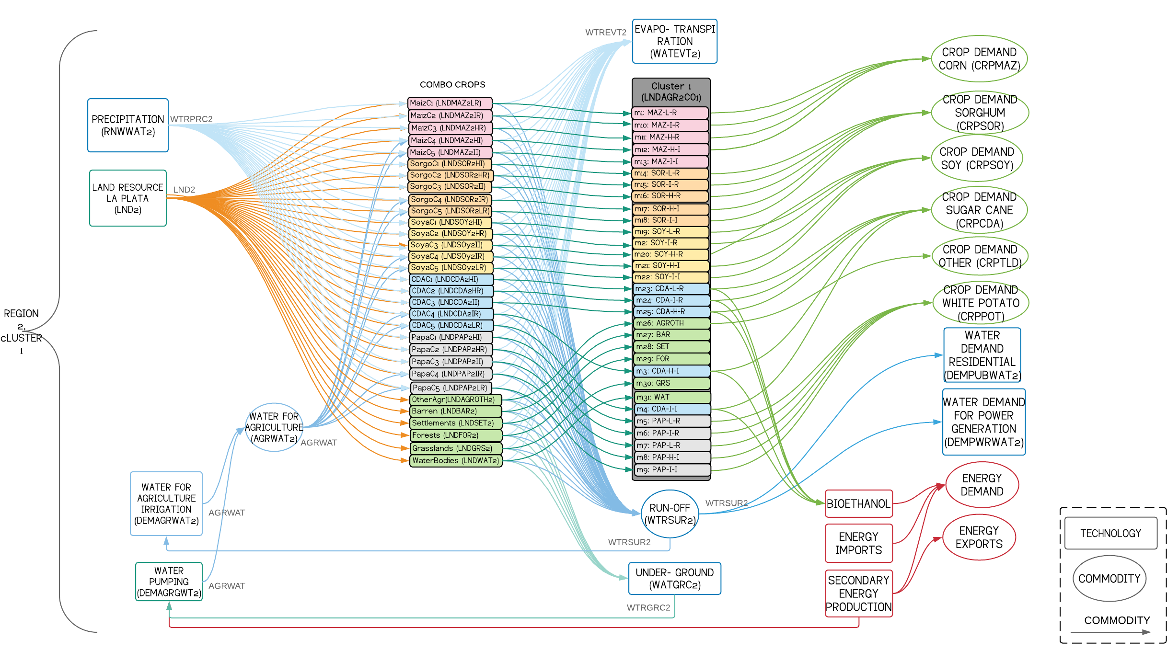
Land and water representation

Slide 31
Integrated CLEWs optimization tool
Integrated CLEWs optimization tool
Is not a crystal ball
  Relies on assumptions about markets, technology and the environment that cannot be known with certainty
  Assumes all relevant information is readily available
Idealized representation
  Simplification is inevitable
  Rational economic actors
  Does not directly capture institutional and behavioural aspects
  Transaction costs, behavioural and other impediments to efficient solutions implemented through user defined constraints
Some policies and measures cannot be represented directly

Slide 32
Thank You!
For questions or further information please contact:
Thomas Alfstad
Inter-regional Adviser
Development and Policy Analysis Division
United Nations Department of Economic and Social Affairs
Thomas.Alfstad@un.org

