Slide 1
Demographic Dynamics for Development
Bakary Dosso, Chief of section
Sub-regional office for West Africa (SRO-WA)
2020 Second Quarter Accountability and Programme Performance Review Meeting
8 – 10 July 2020
[Virtual]

Slide 2
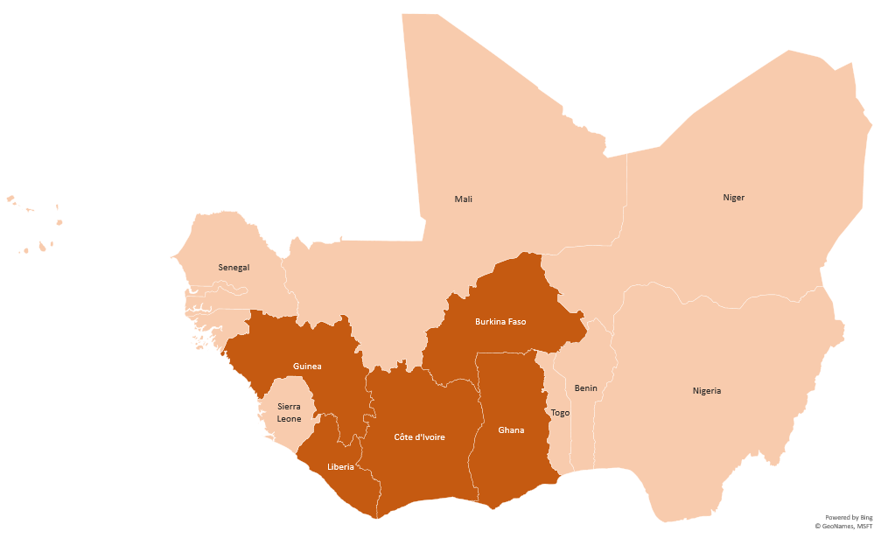
Map- West African countries of focus
Cabo verde
Gambia,The
Guinea-Bissau
5 CoFs covered by DDD interventions in Q1 & Q2

Slide 3
2020 Progress on achievements (all budget sources: 18, 23, 11, 35)
Objective: achieve inclusive development and regional integration in West Africa
RA1: Mainstreaming demographic dynamics in development plans and policies at national and subregional levels
PM: Increased number of national officials trained in demographic dynamics and working to influence public policy formulation processes (Baseline (2019) – 30; Target (2020)- 30; Actual (2020) – 10)
Preliminaries results of DDD research agenda including indicators (Life cycle deficits, economic dependency covered index, economic support ratio, demographic windows of opportunities) and analysis at national and subregional levels to inform and influence policies in demographic dynamics Work on the Public Budgeting framework sensitive to Demographic Dividend was rolled out in Mali (pilot) and was endorsed by the country to inform its 2021 national budget deliberations. Elaboration of an online courses on NTA methodology has started to increase number of national officials trained in demographic dynamics and working to influence public policy formulation processes

Slide 4
2020 Progress on achievements (all budget sources: 18, 23, 11, 35)
Objective: achieve inclusive development and regional integration in West Africa
RA1: Mainstreaming demographic dynamics in development plans and policies at national and subregional levels
PM: Increased number of national officials trained in demographic dynamics and working to influence public policy formulation processes (Baseline (2019) – 30; Target (2020)- 30; Actual (2020) – 10)
Work influenced the outcomes of the Virtual Youth Policy Conversation on “Building Back Better with Young Africans” held on 9 June 2020. The ECA/SRO-WA jointly with AUC Office of the Youth Envoy, and GenU/UNICEF successfully mobilized more than 900 young people in the dialogue. Consequently, the outcome of the Youth Policy Consultation was presented at the AUC Special Technical Committee (STC) meeting of Ministers in charge of Youth, held on 17 June 2020 and informed their deliberations. Furthermore, the outcome document will inform ECA’s future programming on empowering the youth as a pathway to harnessing demographic dividend for the region’s Structural transformation and sustainable development Attendance metrics of the AUC Office of Youth Envoy, generated on 16 June 2020.

Slide 5
2020 Progress on achievements
Publication of two (2) Structural Transformation Profiles (STEPS Profiles) for 2 countries of focus: Liberia and Cote d’Ivoire, addressing SDG Goal 8
Publication on economic and social structural transformation in West Africa: Study on DDD and structural transformation in West Africa (1)
An issue paper produced on "Maximizing investments to achieve optimum demographic dividend (DD) in West Africa” as the core theme of the forthcoming 23rd Session of the Intergovernmental Committee of Senior Officers and Experts in West Africa
A preliminary version of a Population model was produced using system dynamic modelling targeting the Sahel region, 2 countries of Focus (CoFs): Burkina Faso and Côte d’Ivoire, and Senegal
A study on the impact of COVID-19 on West African countries was produced. This has informed country specific analyses of COVID19-Socio-economic Response Plans of Niger, Guinea-Bissau, Togo and Senegal, and 3 CoFs: Cote d’Ivoire, Ghana, Guinea
THINK-TANK

Slide 6
2020 Progress on achievements
Mali High level dialogue on budget sensitive to DD resulted in strengthening partnership with Mali’s National DD Observatory, an institutional watchdog to harnessing DD
National consultations on mainstreaming gender in DD policies in Niger to inform the DD Observatory
UN legal ID successfully rolled out in Niger, in partnership with ACS, resulted in an agreed action plan between Government and Partners to integrate ID into CRVS
Youth related policy proposition (from Virtual Youth Policy) conveyed at the African Union Specialized Technical Committee of Ministers of Youth, Culture and Sports
CONVENING

Slide 7
2020 Progress on achievements
Development of DD Gender Index in Niger which will inform the double mainstreaming i.e.DD and gender into policy formulation and programming
Budget sensitive to DD endorsed by Mali’s National Parliament , Ministry Economy and Finance and Population National Observatory. Will influence resource allocations to DD related sectors
Five demographers/statisticians from Burkina Faso, Cote d’Ivoire, Niger, Senegal and ECOWAS Commission trained in population modeling
A centralized and integrated database developed for UEMOA in partnership with ACS
OPERATIONAL
OPERATIONAL

Slide 8


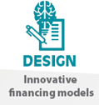


HOW? Delivery modalities – RA1
Alignment with ECA’s strategic directions
Target countries
Joint delivery in Countries of Focus
  ECOWAS 15 member States with a special focus on:
  Burkina Faso;
  Cote d’Ivoire;
  Ghana;
  Guinea
  Liberia;
  Comprehensive analytical insight into the socio-economic effect of Covid-19 in partnership with RCOs, MGD and external partners (AfDB; UNDP; World bank; IMF) to inform policy and decision-making
Response to COVID-19
  Study on the socioeconomic impact of Covid-19 on West Africa
  Specific country analysis in Niger; Côte d’Ivoire, Ghana, Guinea (3 CoFs); Guinea-Bissau, Togo and Senegal
  Mobilization of member States’ Ministers of the Economy, Budget and/or Finance to participate in the regional process of coordinated COVID-19 responses

Slide 9






HOW? Delivery modalities - RA1
Contribution to the SDGs
Follow-up on ARFSD res.
Partnerships (external)
Target 8.3:
Target 16.9:
Target 17.9;
Target 4.3 ; 4.4 ;
Target 5A.
  Research on COVID-19 impacts on African youth to inform investments policies to harness demographic dividend in Africa
  Partnership with CREG; NTA-Africa Network; Millennium Institute; national population observatories on DD research agenda to formulate evidence-based plans and policies.
  Partnership with AUC (office of youth envoy); GenU/UNICEF to echo youth voices and engagement as leaders
OIBCs (if applicable)
Gender Mainstreaming
  Use of National Transfer Account (NTA) to understand demographic dividend (OIBC 1 and 3)
  Implementation of budget sensitive demographic dividend in Mali (OIBC 3)
  National consultation on mainstreaming gender in DD policies in Niger informed by gender demographic dividend index
  Advocacy for the production of gender responsive data
Notes:
SDG 8 target 8.3 promote development oriented policies that support productive activities, decent job creation, entrepreneurship, creativity and innovation, and encourage the formalization and growth of micro-,small-and medium-sized enterprises (MSMSE policies, and progressively achieve greater equality, to
SDG 16(), target 16.9: By 2030, provide legal identity for all, including birth registration
SDGl 17), target 17.9 Enhance international support for implementing effective and targeted capacity building in developing countries to support national plans to implement SDGs,
SDG 4 target 4.3 By 2030, ensure equal access for all women and men to affordable and quality technical, vocational and tertiary education, including university
SDG 5 Target 5A Undertake reforms to give women equal rights to economic resources, as well as access to ownership and control over land and other forms of property, financial services, inheritance and natural resources, in accordance with national laws

Slide 10


Status update: Key challenges and lessons learnt – RA1
Key challenges
Lessons learnt
ECA-wide quick and timely response to Covid19, momentum build and well recognized impact opened up opportunities for long term policy and change
Reprioritization of work programme, to adapt to the Covid-19 context and related need to respond MS new requests
Strategic partnerships built with RCs/UNCTs, RECs as a cost effective strategy for wider outreach and timely responses to countries structural and emerging needs
Joint SROWA-IDEP promotion of distance learning training centered on DD (E-learning, self and/or on pace, assisted, tailored and/or mixed-training)
Important convening activities (ex. ICE) postponed due to COVID-19 impact
Pervasive insecurity and extreme violence in the Sahel region fuelled by the new geopolitical dynamics
Risks to jeopardizing ongoing efforts for sustainable development in the sub-region due to COVID-19 impact on 4 DD pillars: health, education, employment and governance.
Limited resources to respond to growing demands from MS due to Covid-19, among other and the need to support RCs

Slide 11
Status update on implementing partners
Support from the Regional Consortium in Generational Economy (CREG) and representing the Secretariat of NTA-Africa Network in the implementation of DDD research agenda

Slide 12
THANK YOU!

