Slide 1
Are Innovations in Statistical Operations Shortcuts to make Data Revolution Happen?
Shelton KANYANDA

Slide 2
Contents
Innovations in statistical operations
What does it take to embrace innovations

Slide 3
Innovations in statistics operations
Innovations may cover
  Institutional: legislation, NSDS, digital activism, humanitarian response, open data etc
  Organizational: data management, skills development, standards, PPPs, crowdsourcing etc
  Technological: technical infrastructure, web scraping, mobile data collection, visual analytics etc
Innovations can be used to improve
  financing, collection, compilation, dissemination, sharing and other uses of data

Slide 4
What can innovations bring?
Innovations bring solutions that can
  fill data gaps
  reduce costs &
  improve efficiency
Innovations include:
  using hand held devices for collecting data
  satellite imagery for estimating hhold income levels
  use of alternative sources of data ‘big data’ to complement official statistics
  dissemination platforms
  open data initiatives
  data exchange standards
  other uses of software
  ….

Slide 5
Outcomes of innovations in statistics
Innovations have boosted availability of data
Expanded coverage of data sources
Created opportunities on use & re-use of data
Improved statistical service delivery &
Reduced burden on providers, producers, and users

Slide 6
How do we incorporate Innovations?
Need supportive regulations
  Eliminate detours and roadblocks that cause innovations to fail
Adapt staff and future statisticians’ skills to the emerging demands
Successfully sell ideas up and across the entire organization
Develop, define and package new ideas with power and clarity to the public & policy makers

Slide 7

Incorporating innovations
Systematic input output process
  Input: Identifying bottle necks (GSBPM)
  Output: Solutions/innovations to address bottlenecks
Innovations can accelerate Data Revolution!

Slide 8
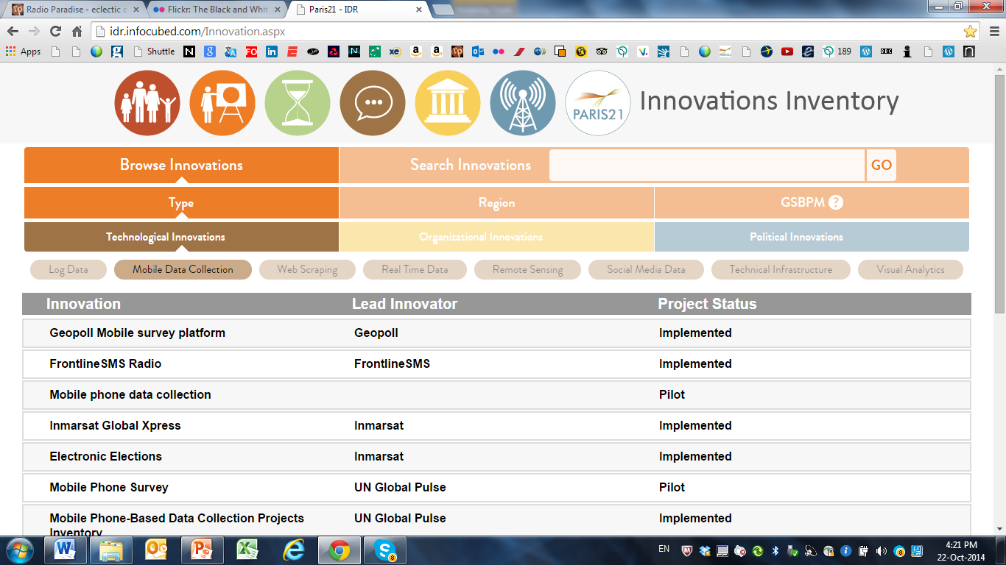
The Innovations Inventory

