Slide 1
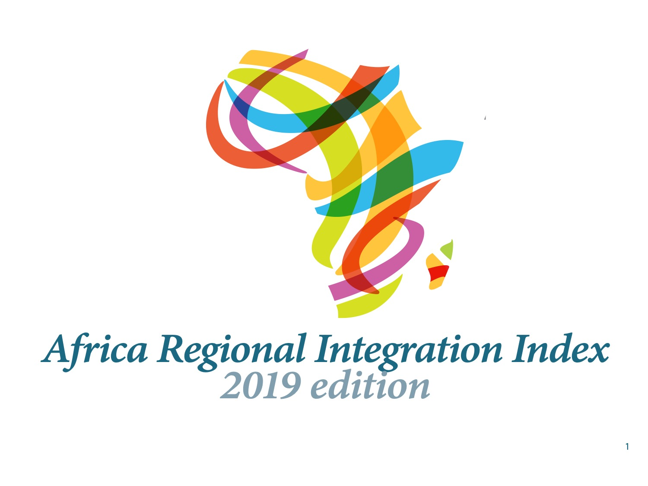

Slide 2
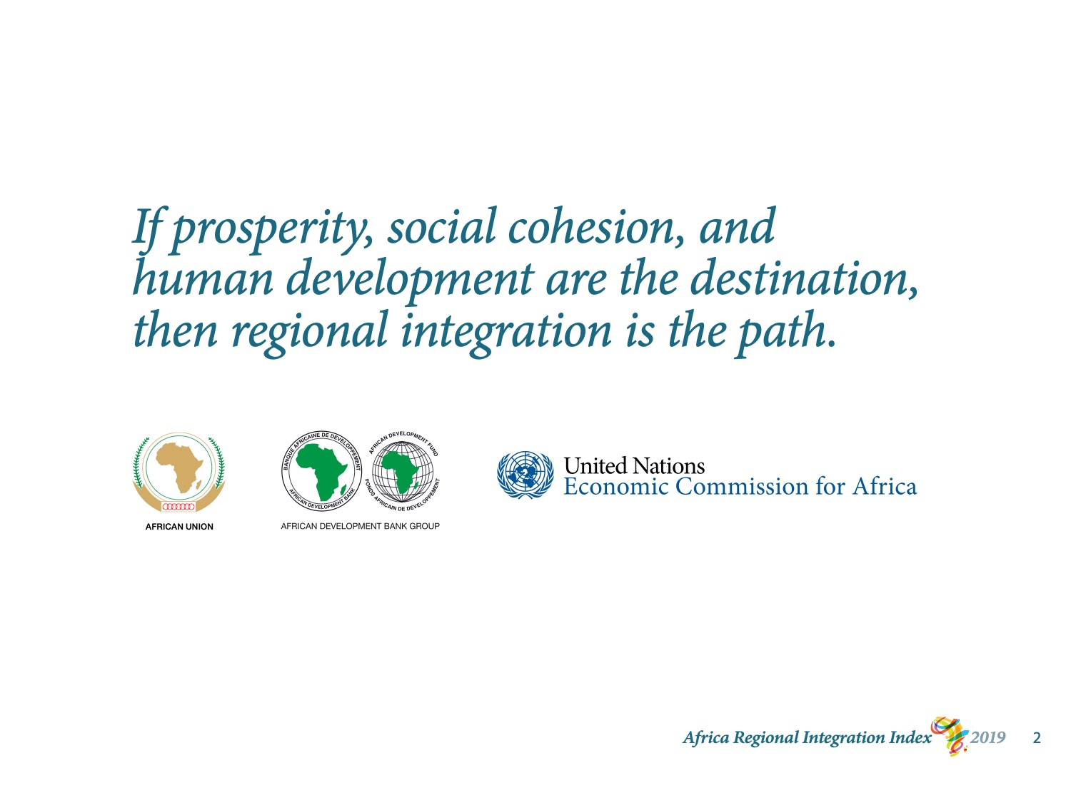
Notes:
The African Regional Integration Index (ARII) is produced by three institutions: The African Union, the African Development Bank, and the United Nations Economic Commission for Africa.
This is ARII’s second edition. The first was published in 2016.

Slide 3
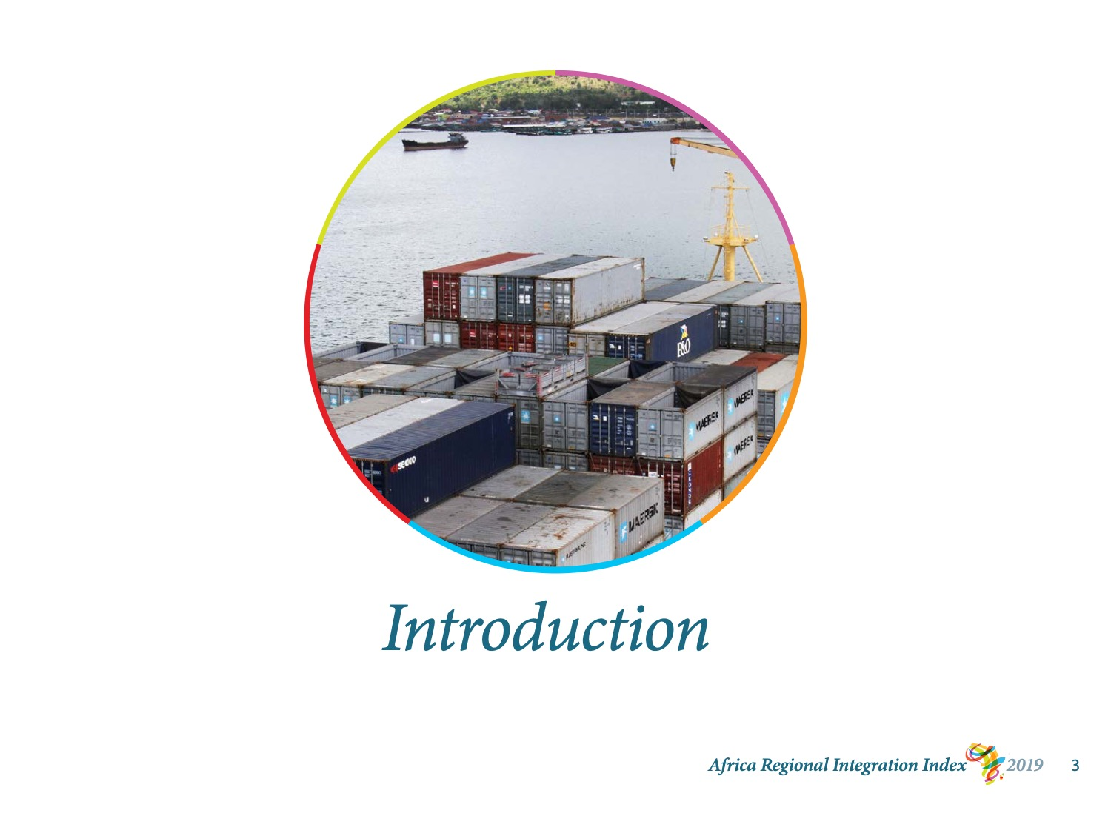
Notes:
I will start by introducing ARII and explaining how the tool works.
Then I will summarize ARII’s main findings and share its principal recommendations.

Slide 4
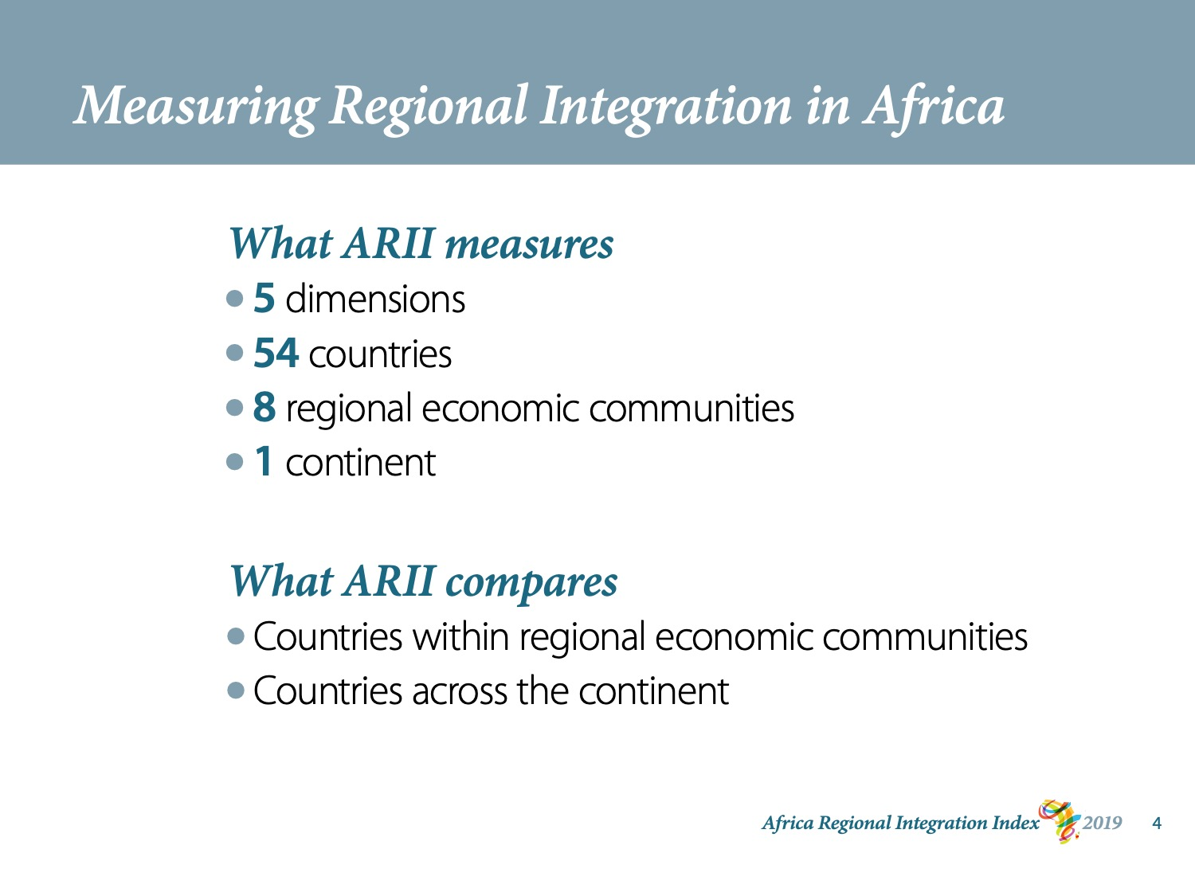
Notes:
Why measure regional integration?
We believe that robust monitoring and consistent benchmarking will help accelerate regional integration in Africa.
ARII is the tool we developed to do this work.
ARII evaluates 5 dimensions of regional integration for 54 African countries and for the 8 RECs recognised by the AU. It also calculates regional integration scores for the continent.
The scores reveal areas where policies work well and where they work less well.
ARII also compares the extent to which each country is regionally integrated compared to other countries in its REC and to the countries of Africa as a whole.
These comparisons can help us pinpoint success factors or serve as an early warning system. Users can spot countries and regions whose performance has fallen and do the necessary to correct course.

Slide 5
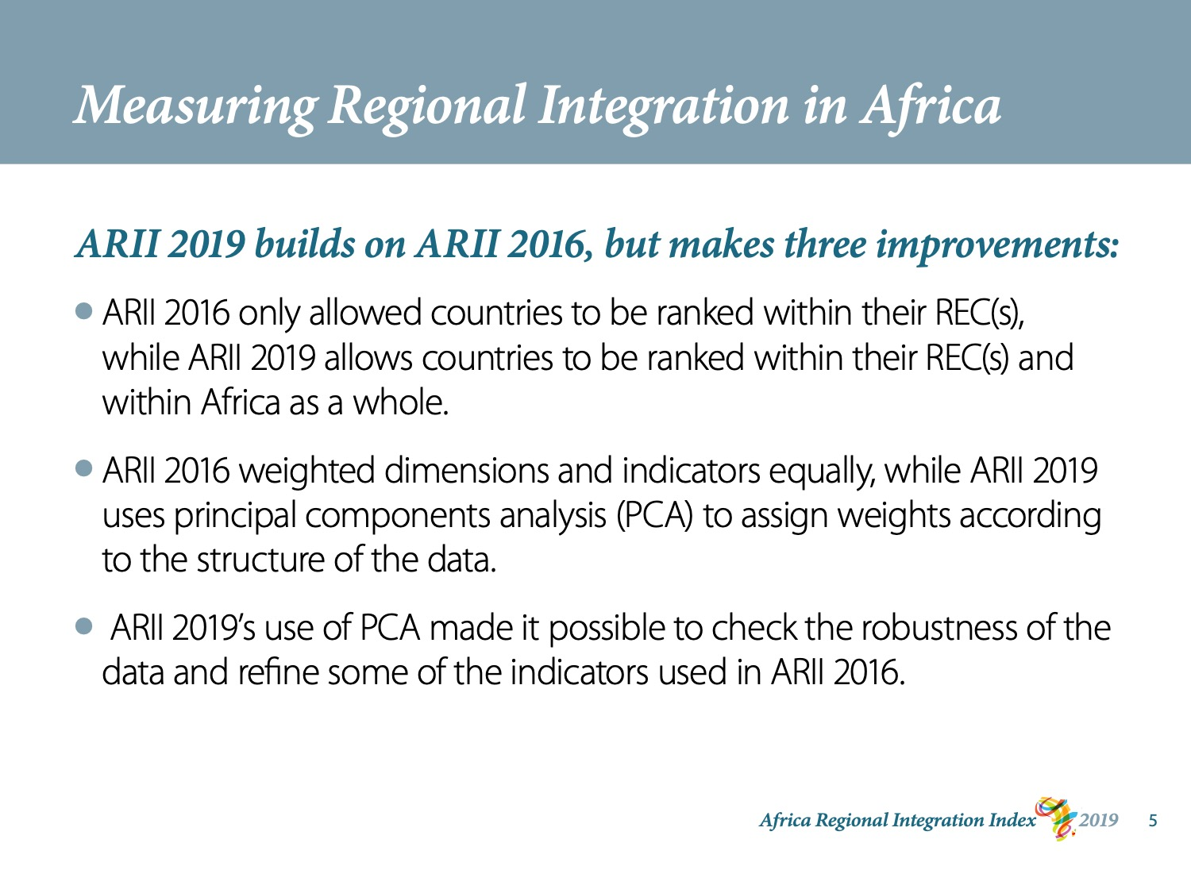
Notes:
ARII 2019 builds on ARII 2016, but makes three principal improvements:
* ARII 2016 only allowed countries to be ranked within their REC(s), while ARII 2019 allows countries to be ranked within their REC(s) and within Africa as a whole.
.
* ARII 2016 weighted dimensions and indicators equally, while ARII 2019 uses principal components analysis (PCA) to assign weights according to the structure of the data.
* By using PCA, ARII 2019 was able to check the robustness of the data and refine some of the indicators used in ARII 2016.

Slide 6
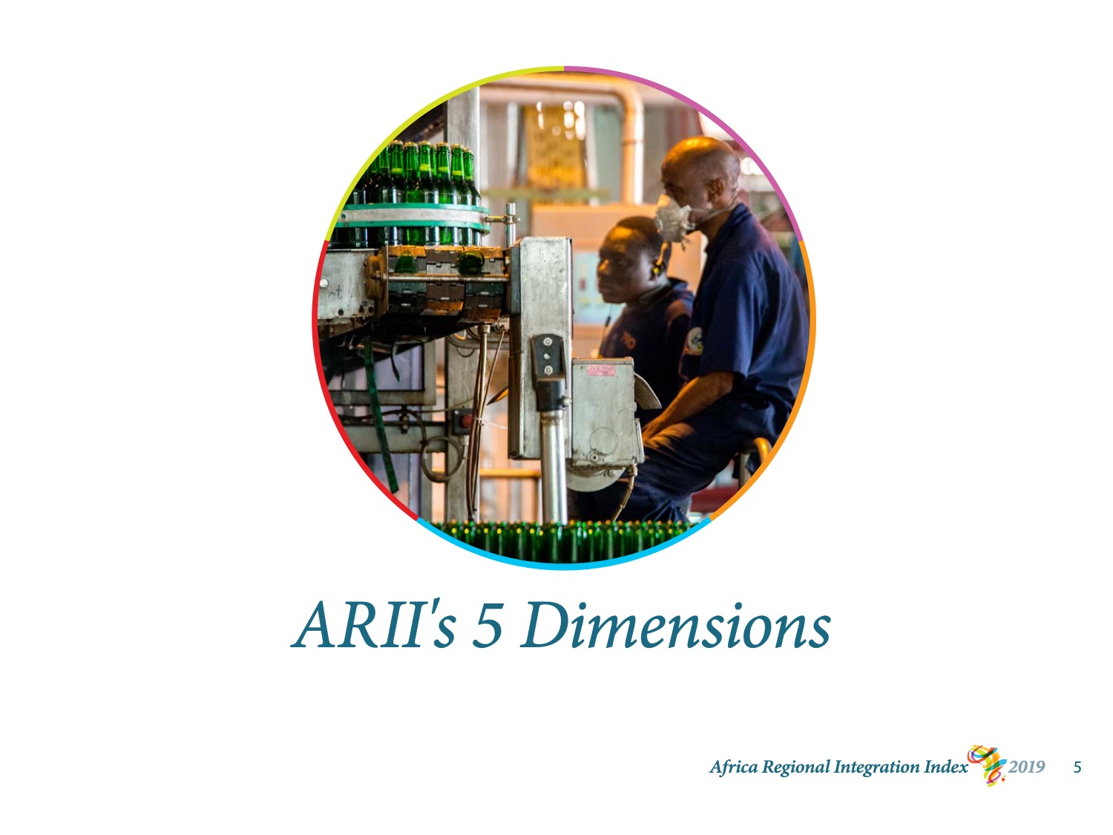
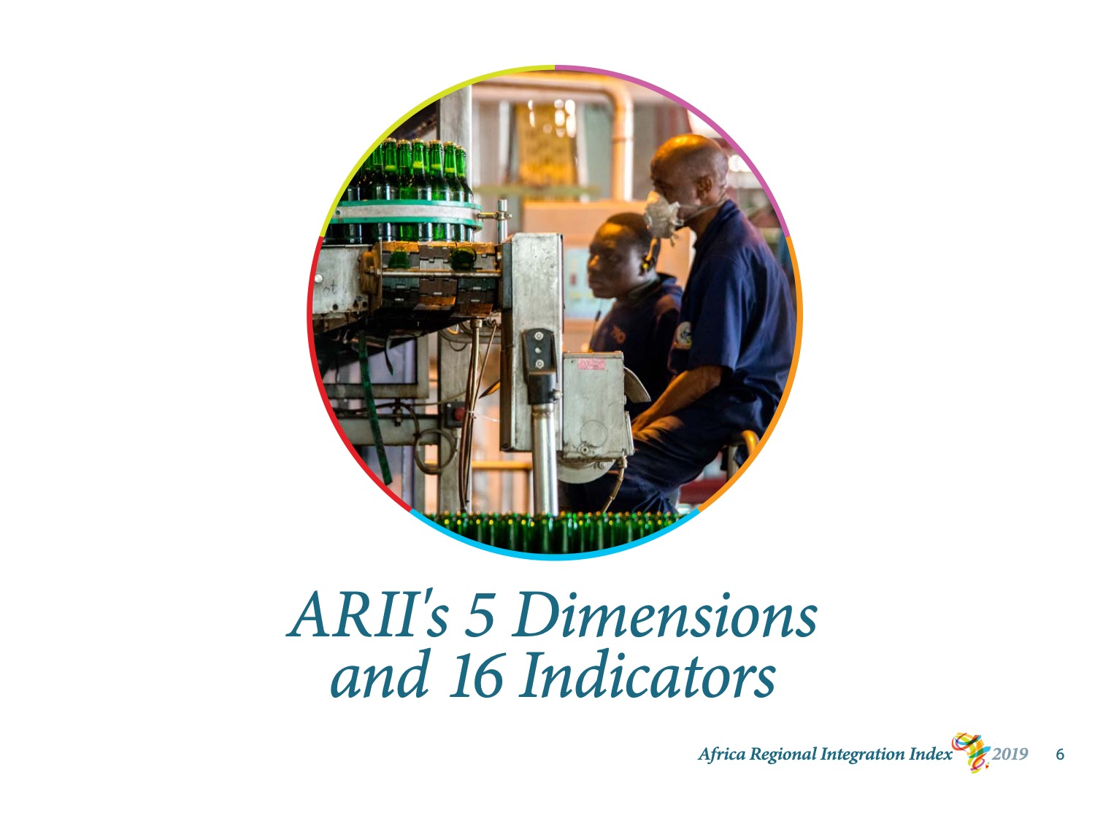
Notes:
To measure regional integration, ARII draws on 16 indicators grouped into 5 dimensions.

Slide 7
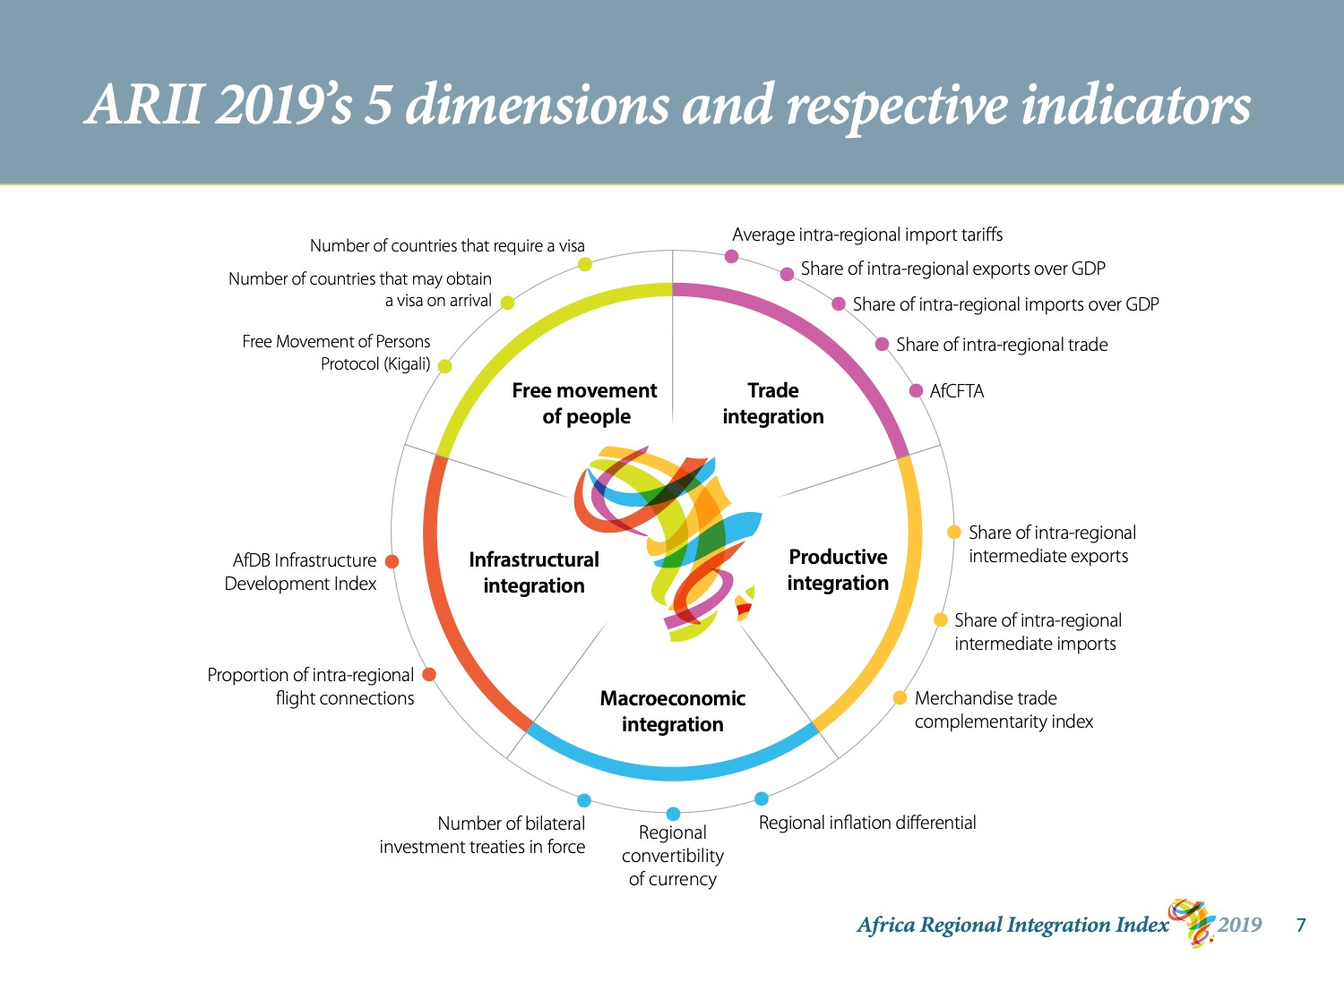
Notes:
The 5 dimensions are trade, production, macroeconomics, infrastructure, and the free movement of people. ARII evaluates each one in terms of its regional connections.
The regional aspects of trade, production, and macroeconomic policy are well-established and are closely monitored in the European Union, the Asia-Pacific, and elsewhere.
ARII also measures regional infrastructure and human mobility.
In developing countries, regional infrastructure varies greatly.
As for human mobility, the degree to which the factors of production, including people, can move freely within a region makes a big difference to a region’s economic and social development.

Slide 8
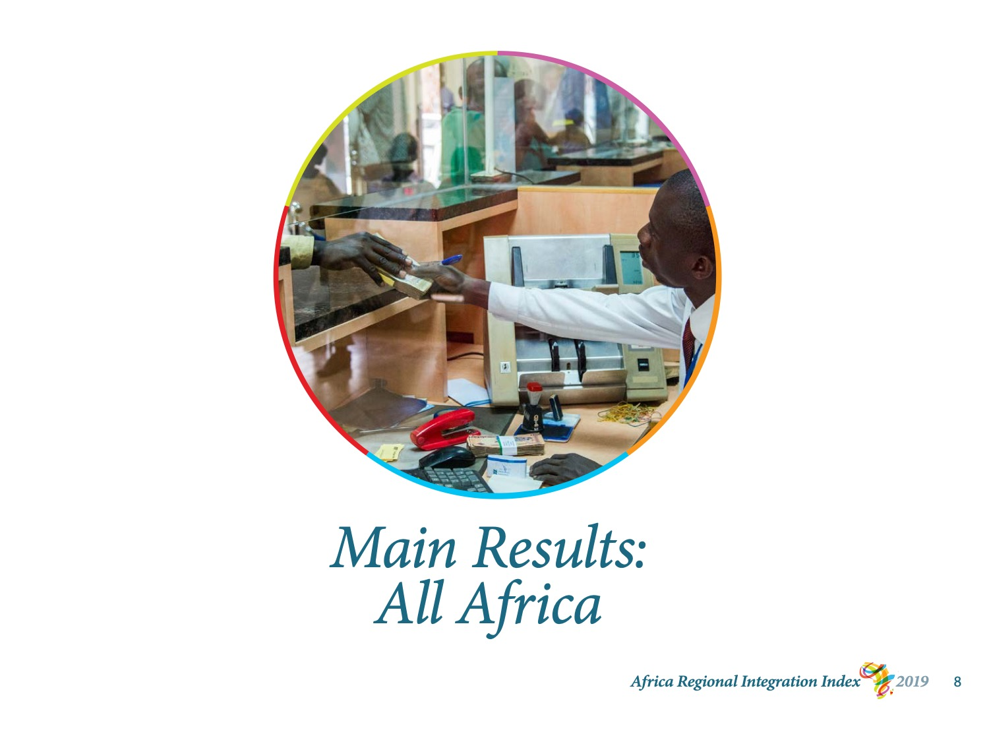
Notes:
I’ll now present ARII’s main results for 2019.
I will start at the continental level. I’ll then talk about regional economic communities, countries, and finally ARII’s 5 dimensions.
The full findings are available in the 2019 report. This is a publication on paper and in pdf form online. The results are also on ARII’s interactive website, integrate-africa.org.

Slide 9
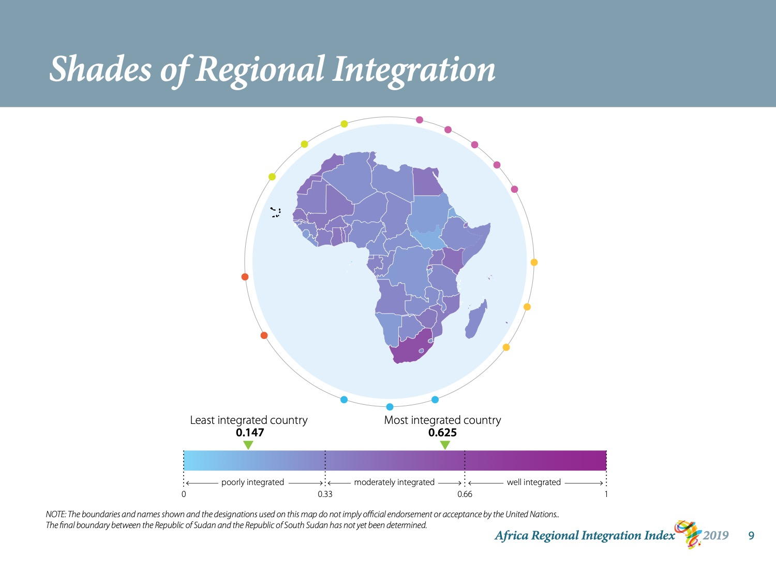
Notes:
This map gives us an idea of areas where regional integration is stronger or weaker.
The darker the shade, the more integrated the country.
You see from the scale below the map that even though 20 countries score above average, no country falls into the “well integrated” zone.
Almost all of the countries fall in the lower 2nd and 3rd quintiles of performance.
Even the most integrated country, South Africa, only scores 0.625, meaning that it only reaches about two-thirds of its potential on our scale.
The least integrated country, South Sudan, scores 0.147.

Slide 10
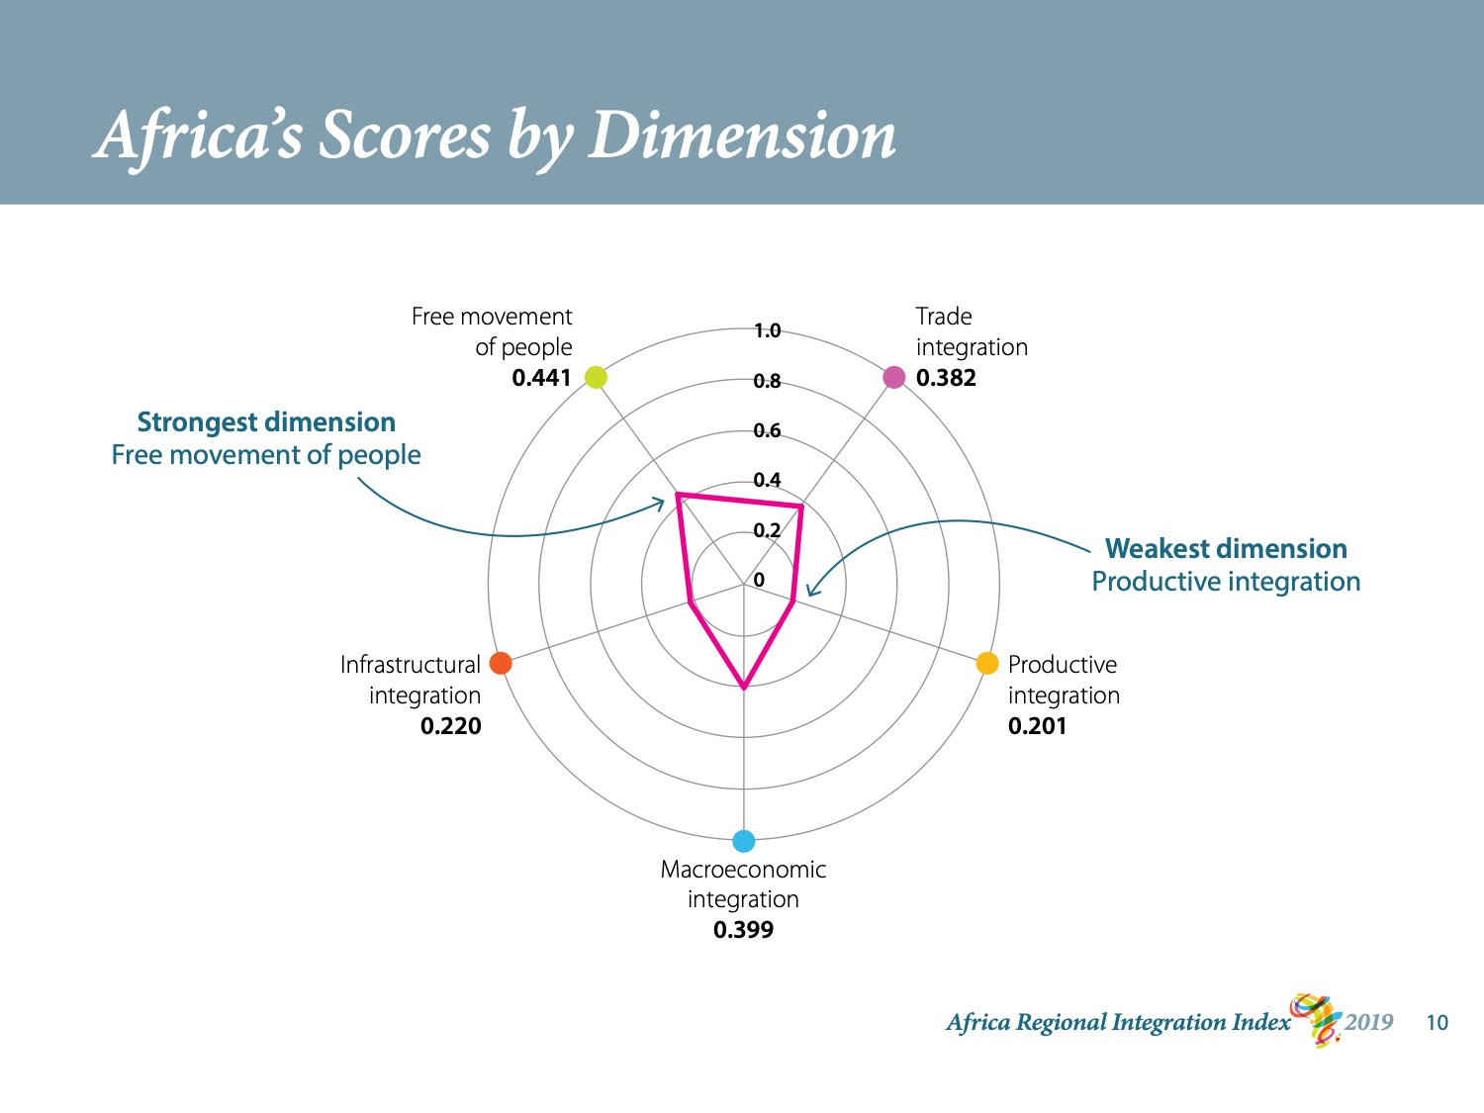
Notes:
This graph shows Africa’s average for each dimension of regional integration.
Africa scores highest on the free movement of people dimension: 0.4.
This means that Africa is near the mid-point of its potential on that dimension.
Africa does least well on productive integration, only 0.2. Infrastructure is not far behind.
These 2 dimensions of regional integration are the foundations for the other dimensions to function properly.
Turning them around would reap significant rewards.
I draw your attention to the pink line. This is the African average. You can see that the average for all 5 dimensions lies within the second-lowest quintile of possible performance.

Slide 11
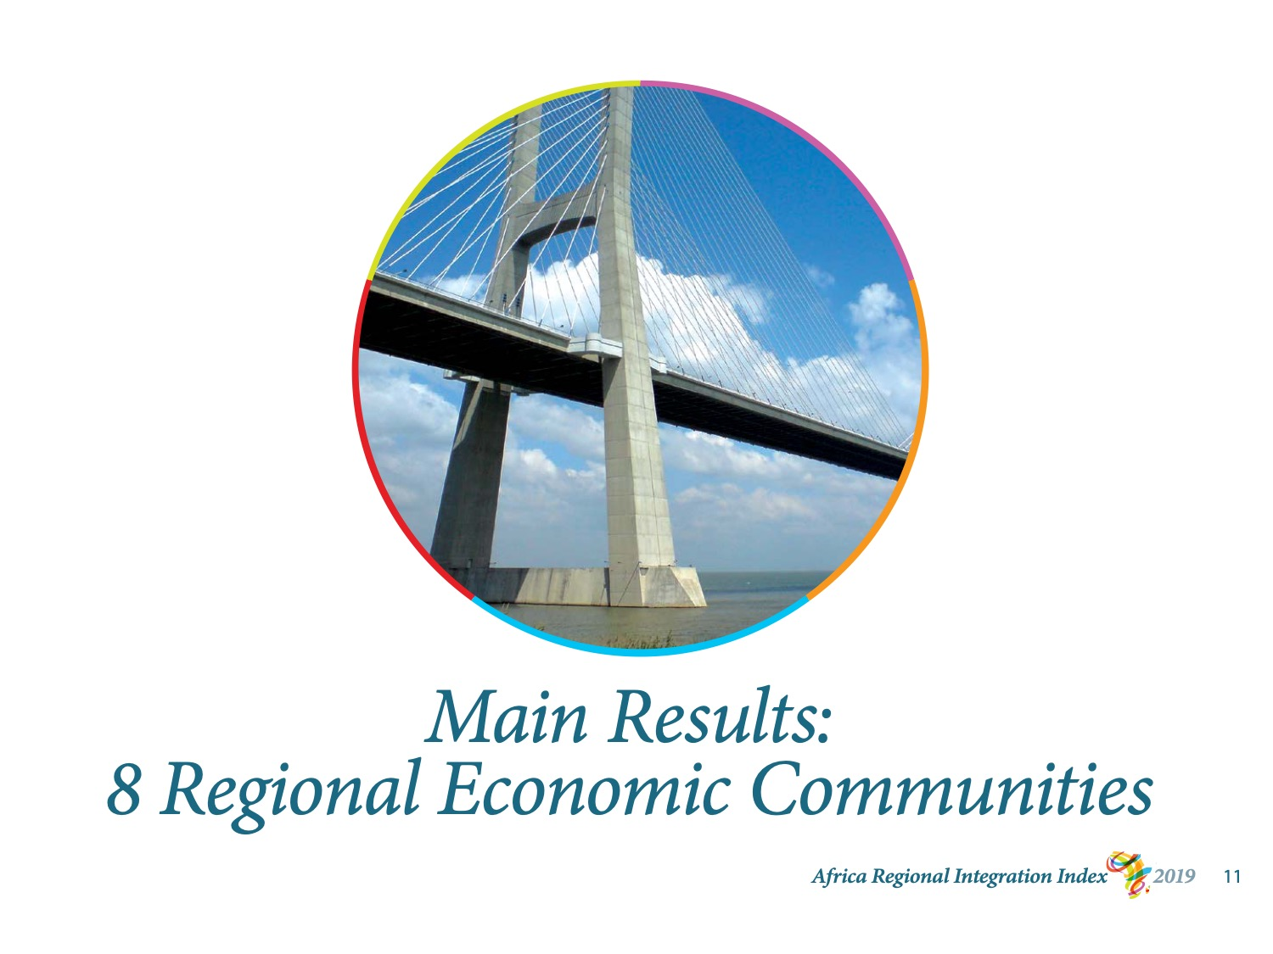
Notes:
Now let’s go over the main results for the 8 regional economic communities.
I don’t have time to analyse the results for each REC in detail, but the highlights are revealing.

Slide 12
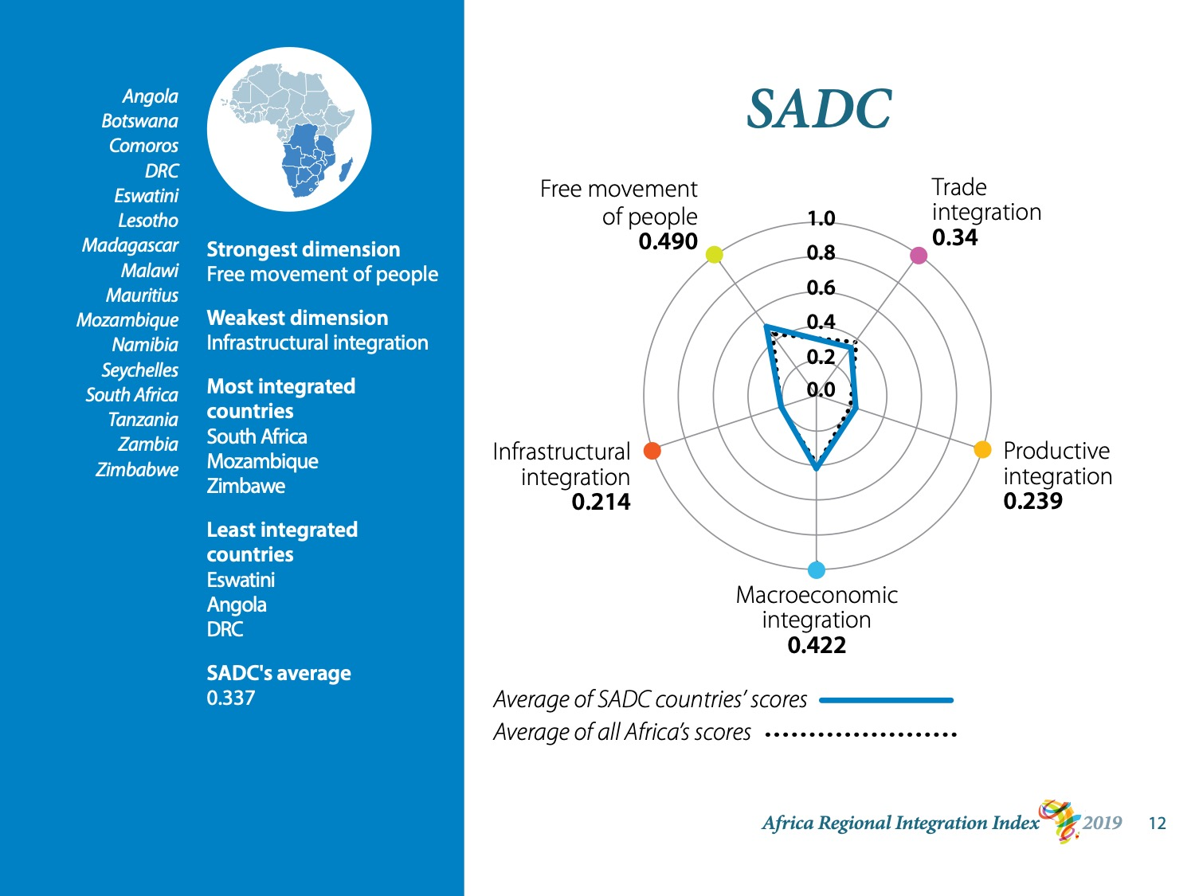
Notes:
The Southern African Development Community has 16 members.
Their average for overall regional integration is quite low: 0.3 out of 1.
SADC performs best on the free movement of people dimension. This is the strongest dimension for 5 RECs out of 8.
SADC’s weakness is in regional infrastructure. South Africa scores nearly perfectly on this dimension, but the next two performers, Seychelles and Mauritius, only score around the half-way mark. The bottom 5 performers score near 0.
SADC’s average for productive integration is not much higher.

Slide 13
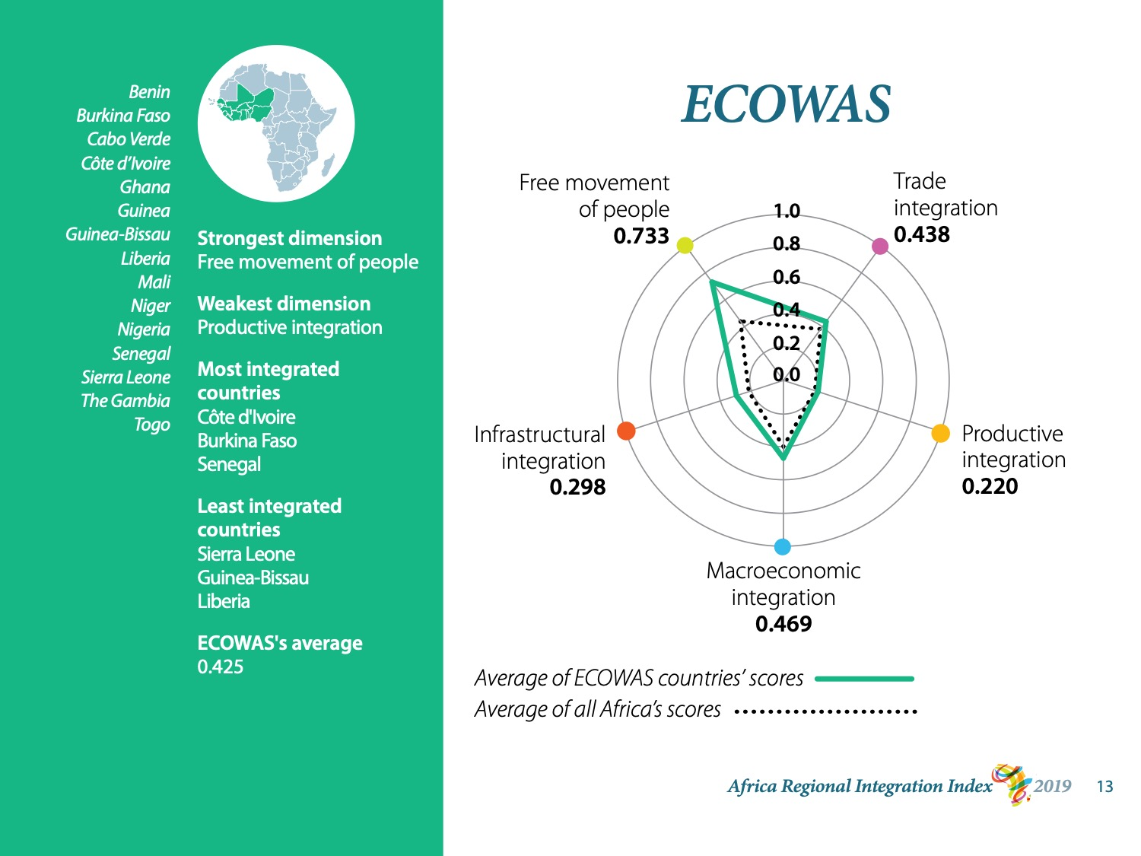
Notes:
The Economic Community of West African States also scores most highly on the free movement of people dimension.
One of ECOWAS’s goals is to create a borderless region and its members have open visa policies.
This said, only 3 countries – Burkina Faso, Mali, and Togo – have adhered to the Free Movement of Persons Protocol. This is why ECOWAS’s average for this dimension is not higher than 0.7.
ECOWAS’s average is pulled down by a near-total lack of productive integration in 7 of its 15 members, which score 0.1 or lower. Niger scores 0.

Slide 14
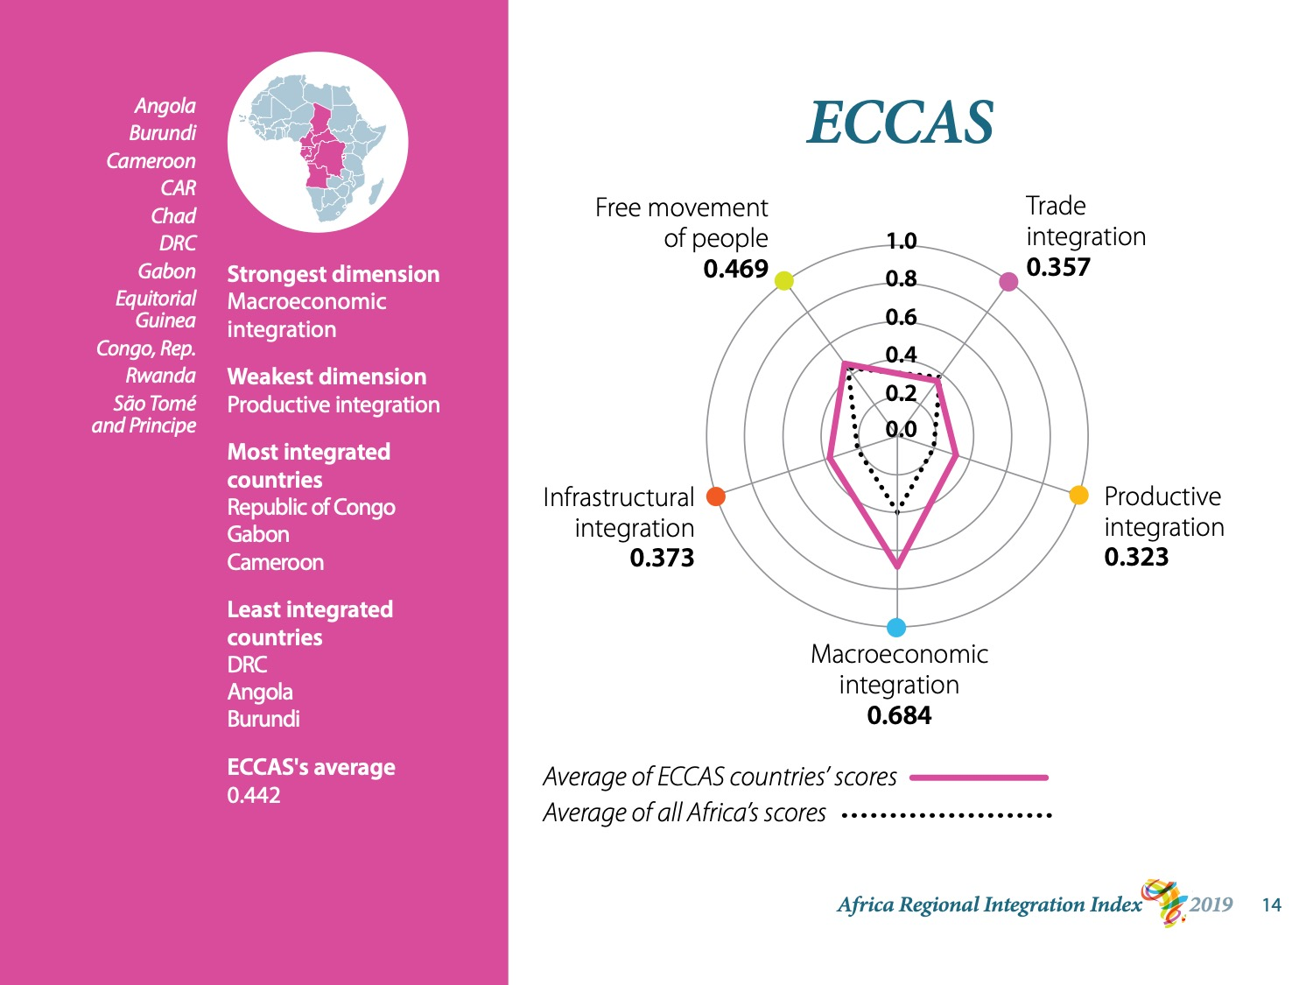
Notes:
The Economic Community of Central African States is 1 of only 2 RECs whose strength lies in macroeconomic integration. The other is the Arab Maghreb Union.
8 of ECCAS’s 11 members score highly in macroeconomic integration and two members score well. Angola scores 0.
We should note, though, that none of ECCAS’s members has a bilateral investment treaty in force. Because of this, ECCAS countries’ macroeconomic integration is only assessed on the basis of the regional convertibility of their currency and their inflation differential.
ECCAS’s scores moderately on the free movement of people dimension.
Scores on the other 3 dimensions of regional integration fall around 0.3 / 0.4 out of 1.
Members’ scores vary widely.

Slide 15
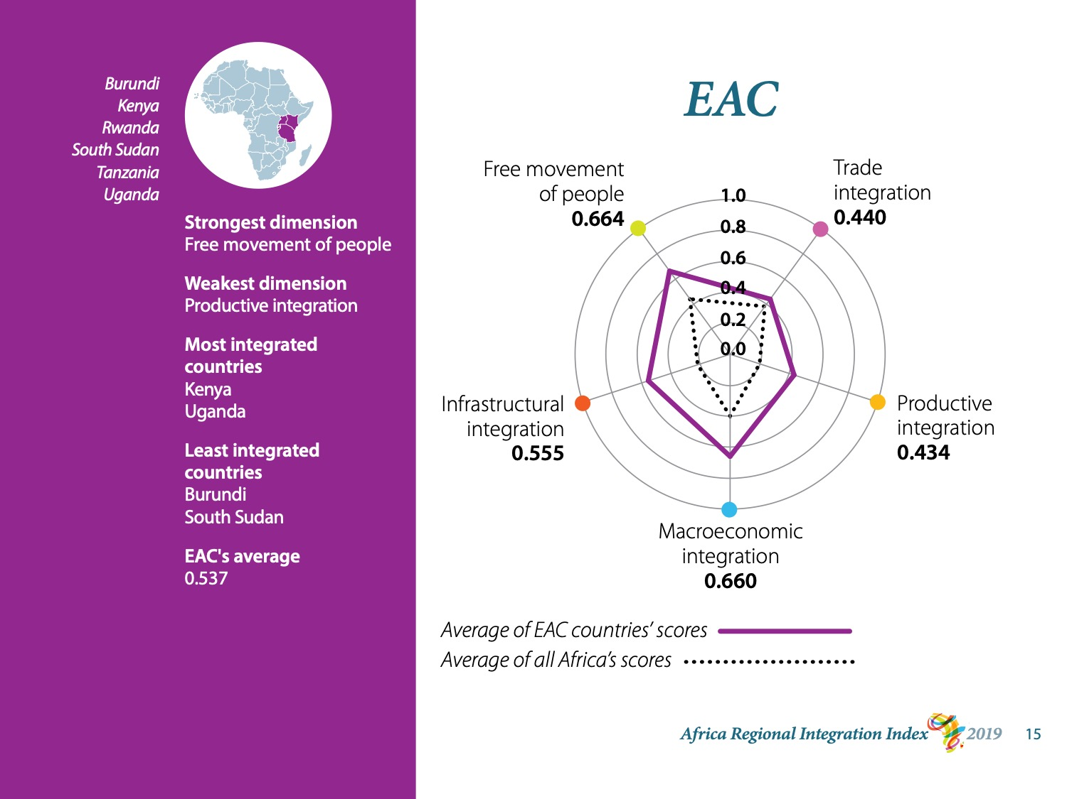
Notes:
The East African Community has only 6 members.
It scores highest on the free movement of people dimension, but macroeconomics is not far behind.
No EAC member has a bilateral investment treaty in force, but the currency of Rwanda is easily convertible and Tanzania has the community’s best inflation differential.
EAC’s weaknesses lie in productive integration and regional trade.
Insofar as productive integration is concerned, Kenya and Uganda are very strong but Burundi scores near 0 and South Sudan not much higher.
EAC’s score on regional trade is not high either. The community has eliminated tariffs between members but countries do not trade much within the region.

Slide 16
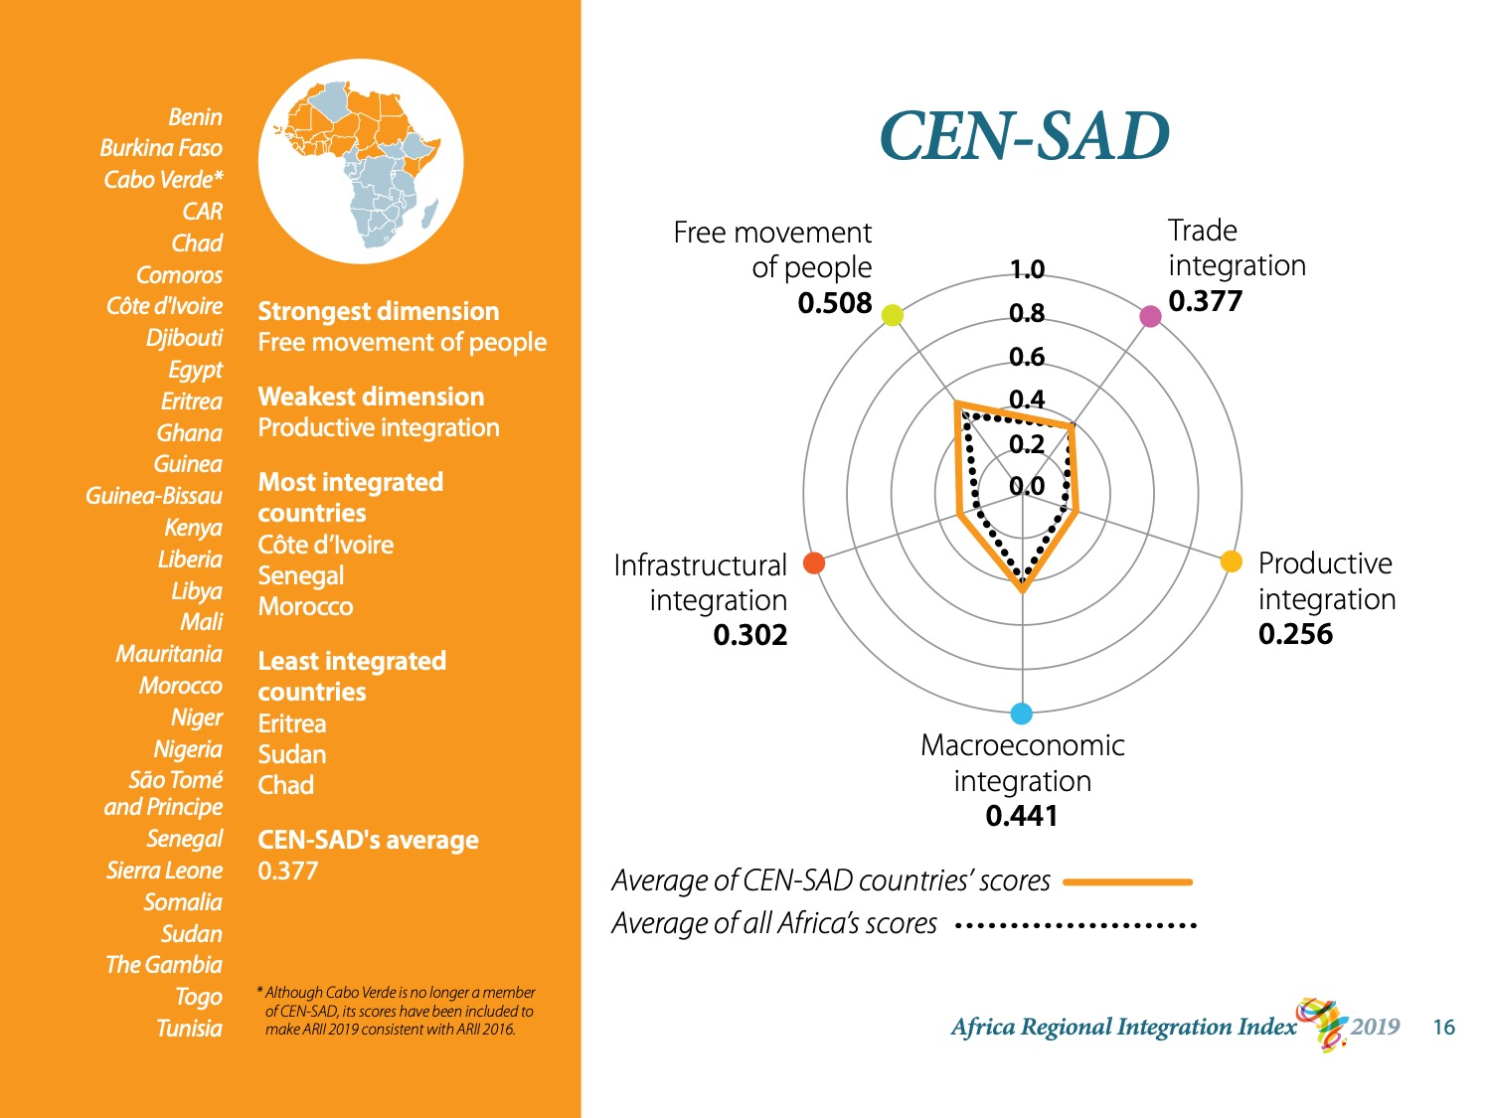
Notes:
The Community of Sahel-Saharan States is similar to EAC in that it performs best on the free movement of people and worst on regional production.
It’s a vast community. It has 29 members and it covers almost all of the northern half of the continent and part of the horn of Africa.
Côte d’Ivoire and Senegal score highly in part because they trade fuel and lubricants with each other.
Morocco has a near-perfect score on macroeconomic integration and has the most bilateral investment treaties in force.
CEN-SAD averages near 0.4 and its highest achiever scores a little over 0.5.
Note that even although Cabo Verde is no longer a member of CEN-SAD, its scores have been included to make ARII 2019 consistent with ARII 2016.

Slide 17
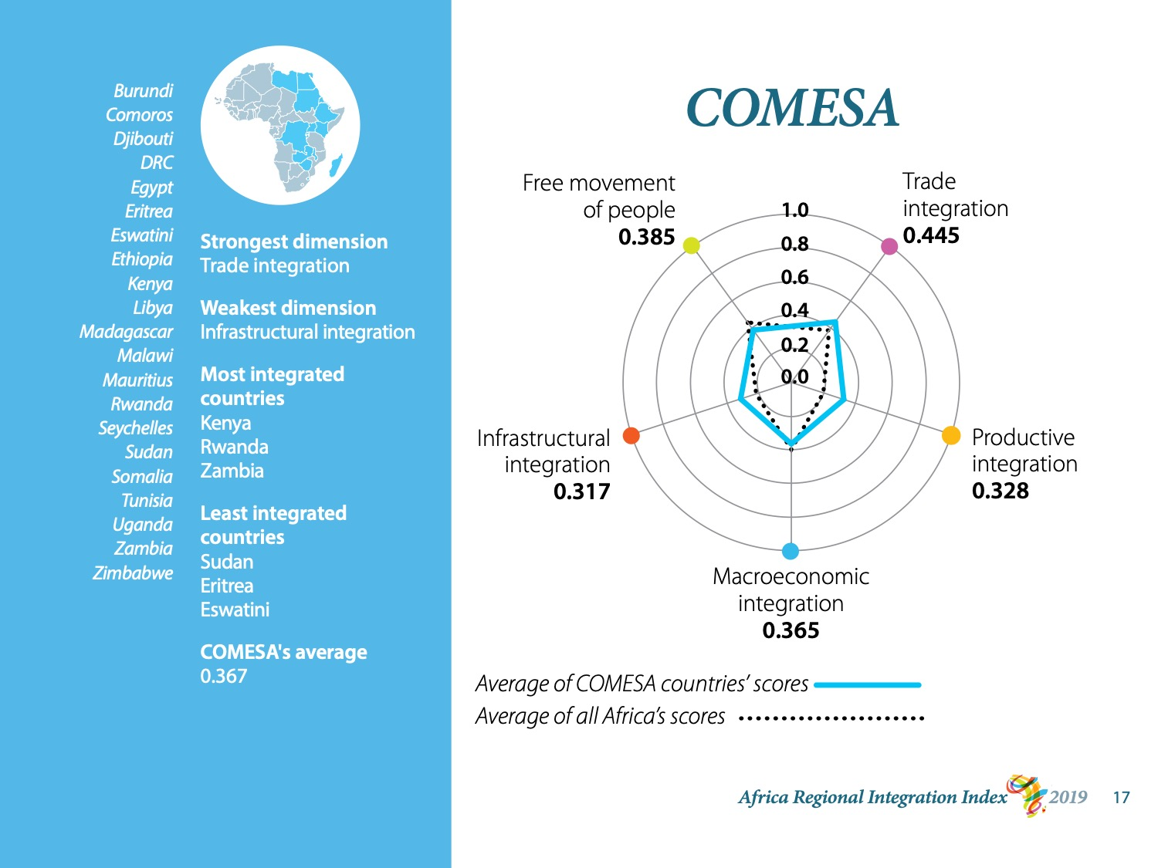
Notes:
The Common Market for Eastern and Southern Africa also covers a vast territory.
COMESA is the only regional economic community that performs best in trade.
The variance in performance among dimensions in COMESA is lower than in most other RECs.
The difference is only 0.1 / 0.2. Whereas the difference in ECOWAS is over 0.5.
The main outlier in COMESA is Zambia, which achieves nearly 1 on trade integration.
Kenya, Rwanda, and Zambia are the three most integrated countries in COMESA.
COMESA’s other high performers include Comoros, Djibouti, and Somalia, which achieve a perfect score on the free movement of people dimension. On the other dimensions of regional integration, though, their highest score is 0.4, achieved by Djibouti in trade.

Slide 18
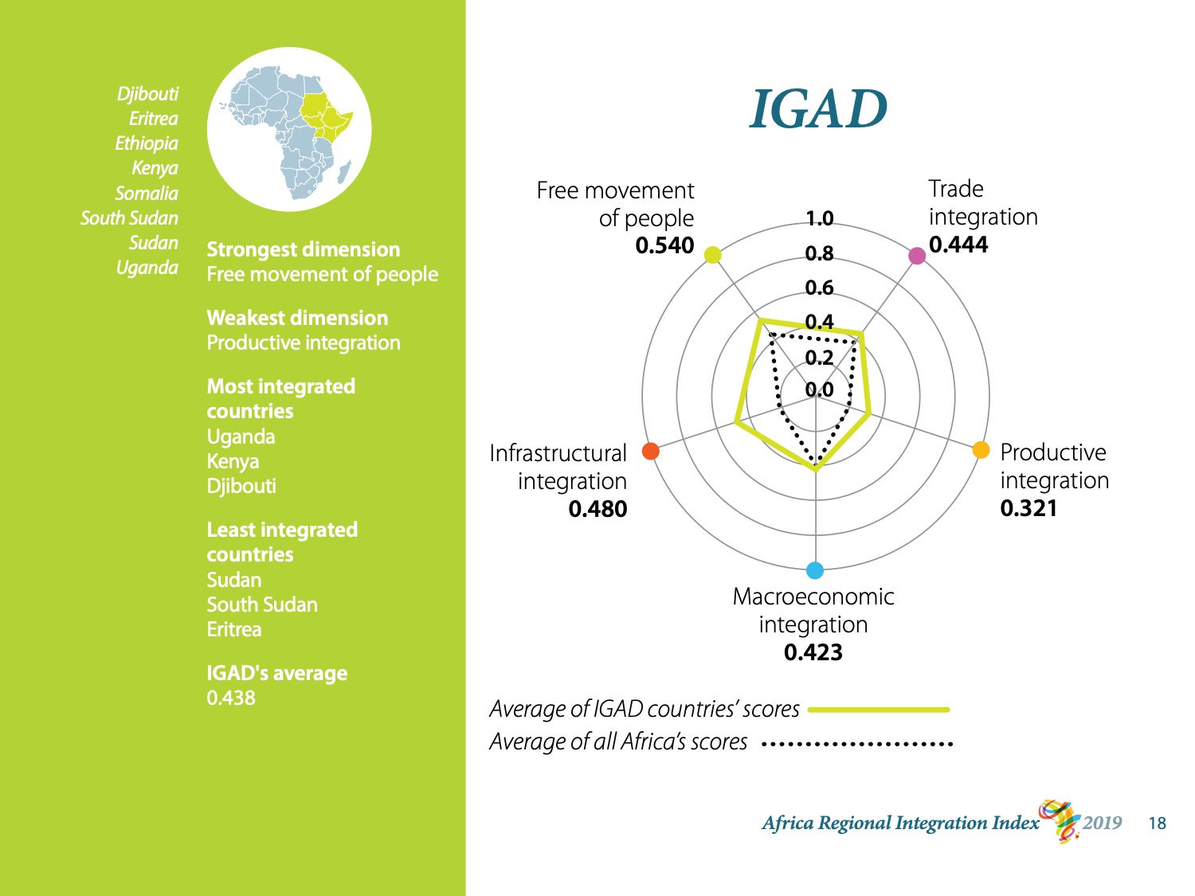
Notes:
The Intergovernmental Authority on Development is one of the smaller RECs. It has 8 members that range from economically small Somalia to Kenya, a continental powerhouse.
Like EAC, CEN-SAD, and ECOWAS, IGAD performs best on the free movement of people and worst on production.
Its leaders are Uganda, Kenya, and Djibouti.
Uganda leads on integrated production and integrated trade. It has the highest score for the export of intermediate goods in the region. It also has the best share of trade within the region, and the second-best share of exports.
Kenya is first in integrated infrastructure, leading both on the AfDB’s infrastructure index and in terms of flight connections.
As for the free movement of people, Djibouti achieves a perfect score.

Slide 19
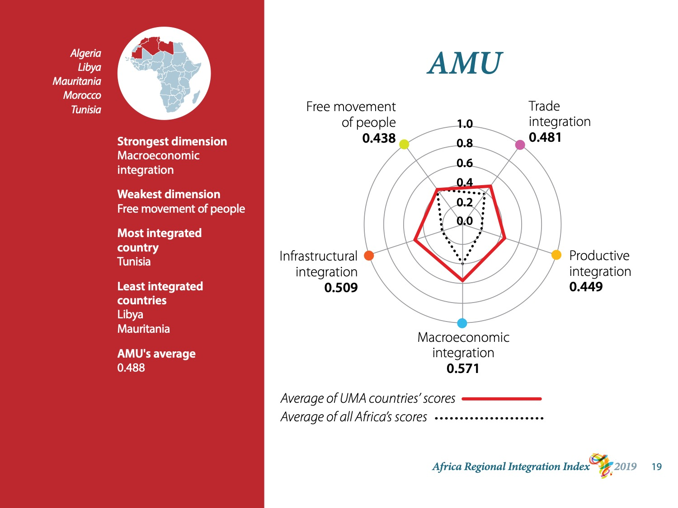
Notes:
The last REC that ARII evaluates is the Arab Maghreb Union. AMU is Africa’s smallest REC in terms of membership. It has 5 members.
Because of this, the scores of AMU’s outliers have a stronger effect on the region’s average than do the outliers of other RECs.
AMU is itself an outlier in that the free movement of people is its weakest dimension.
It performs best on macroeconomic integration.
As for the other 3 dimensions, AMU’s score on regional trade is moderate. As much as its members may trade outside of Africa, their exports within the region are low.
AMU’s score for productive integration averages about the same as for trade but scores vary greatly, from near 0 for Mauritania to nearly 0.8 for Tunisia.
Tunisia is also AMU’s leader on infrastructural integration (0.9), with good flight connections within the region and a good score on the AfDB’s infrastructure index.
AMU’s next 3 performers on this dimension– Algeria, Morocco, and Libya – are grouped around 0.5 / 0.6.
Mauritania scores 0.

Slide 20
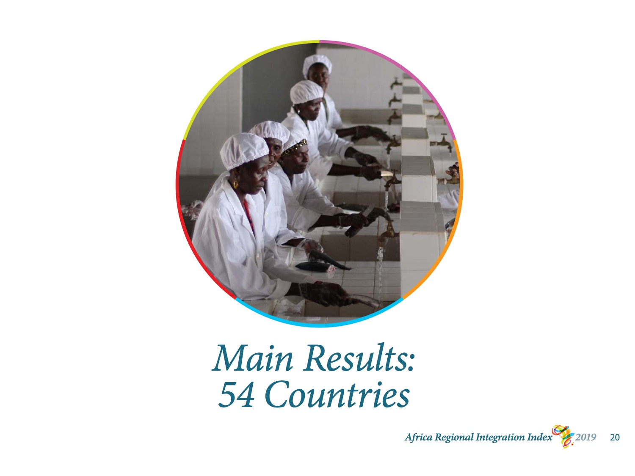
Notes:
I will now explain what findings ARII makes available for each country.
We don’t have time to present ARII’s findings for each country, but the full results for all countries are published in the annexes to the publication and on the integrate-africa website.

Slide 21
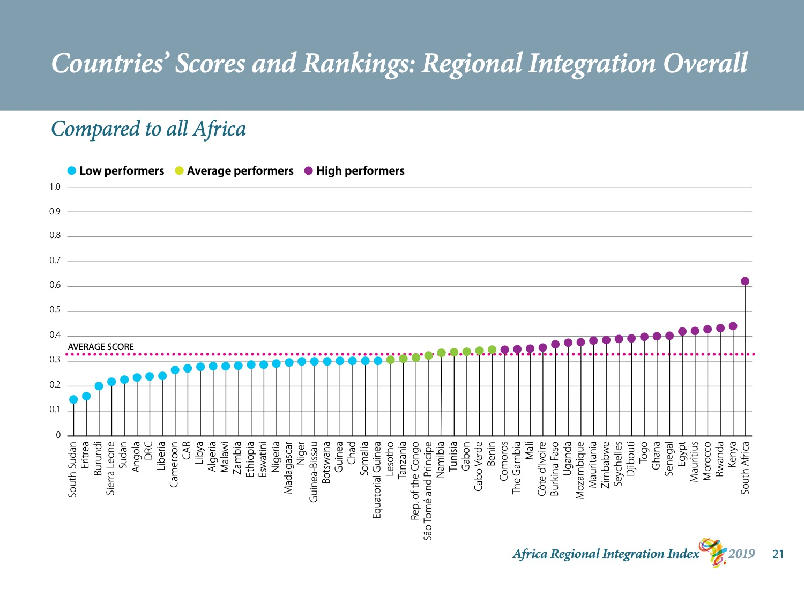
Notes:
I mentioned earlier that ARII calculates each country’s score on regional integration overall.
This graph shows how each country ranks vis-à-vis the other countries on the continent. All of ARII’s graphs are colour-coded to show whether countries score above, within, or below the average range.

Slide 22
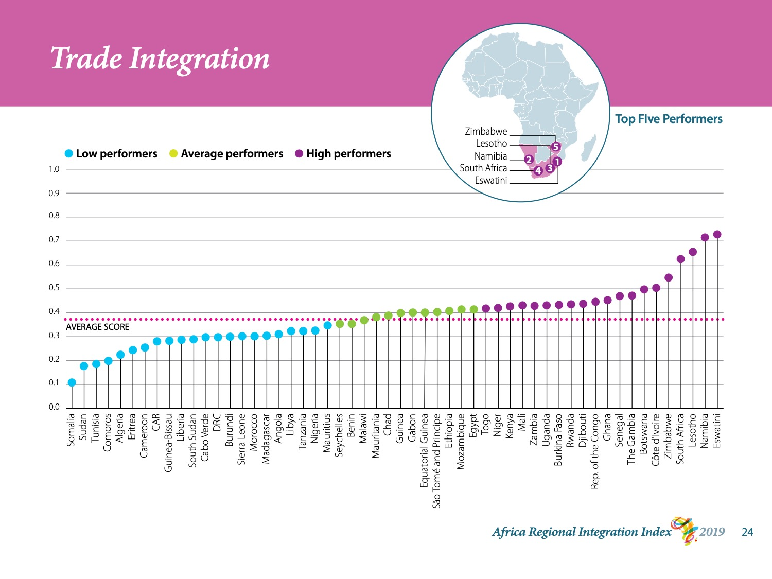
Notes:
Let’s begin with trade: the extent to which countries trade within their region.
With a score of 0.7, Eswatini is Africa’s best performer on trade integration, followed by Namibia. Lesotho, South Africa, and Zimbabwe are not far behind.
4 of the top 5 performers are members of SACU. SACU has a high level of trade liberalisation and a full customs union that renders its economies strongly interdependent. Botswana, SACU’s remaining member, ranks 7th in trade integration on the continent.
The countries whose trade is the least integrated with their region are Somalia, Sudan, Tunisia, Comoros, and Algeria.
You see from the dotted line that the continent’s average for regionally integrated trade is a little under 0.4. Africa has the highest import duties and the most non-tariff barriers in the world.
As more countries ratify the AfCFTA agreement and trade liberalises within the continent, regional exports and imports will grow and scores on this dimension will rise.
This will increase the demand for production capacities and regional infrastructure, two other dimensions of regional dimensions.

Slide 23
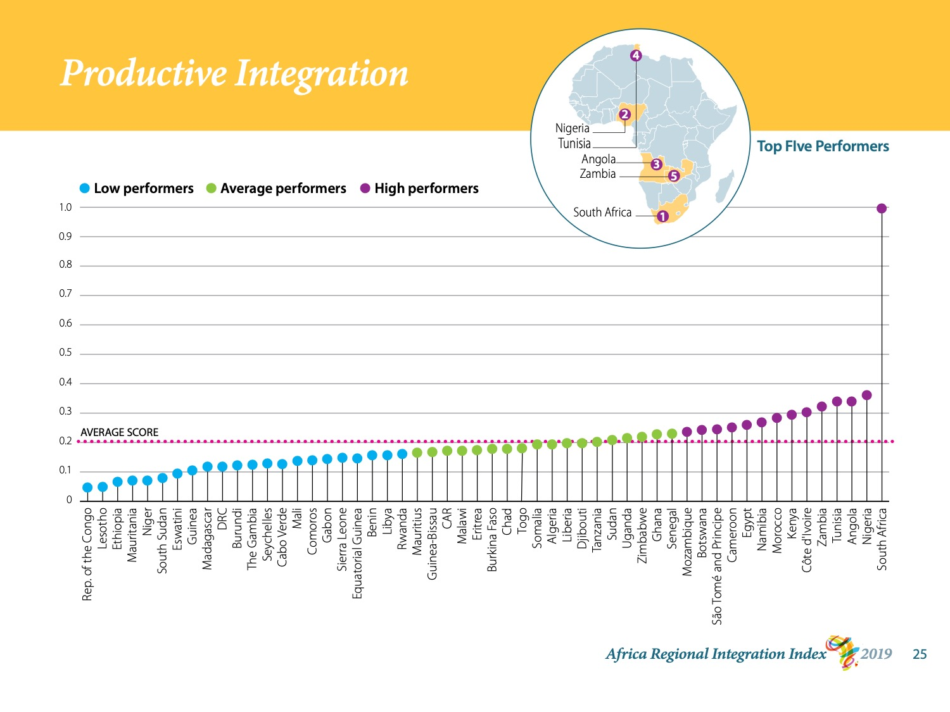
Notes:
Next we have productive integration.
This graph showcases South Africa, which scores the maximum of 1.
The import and export of intermediate products account for a larger proportion of regional trade in South Africa than they do in any other country on the continent.
South Africa also has Africa’s highest score on the merchandise trade complementarity index.
Nigeria is the second-most trade-integrated country. It lies far behind South Africa, with a score of less than 0.4.
Nigeria’s ranking is attributable in part to its flourishing fuel exports.
Integrated production is Africa’s weakest point. The continental average is only 0.2, and 33 countries score even lower.
This tells us that production is not evenly dispersed across the continent and countries are not developing comparative advantages or making the most of the comparative advantages they have.
This may be because of poor or inexistent logistics. Well-functioning logistics are necessary to regional supply chains.
By “logistics,” we mean not only infrastructure but also trade and investment policies.

Slide 24
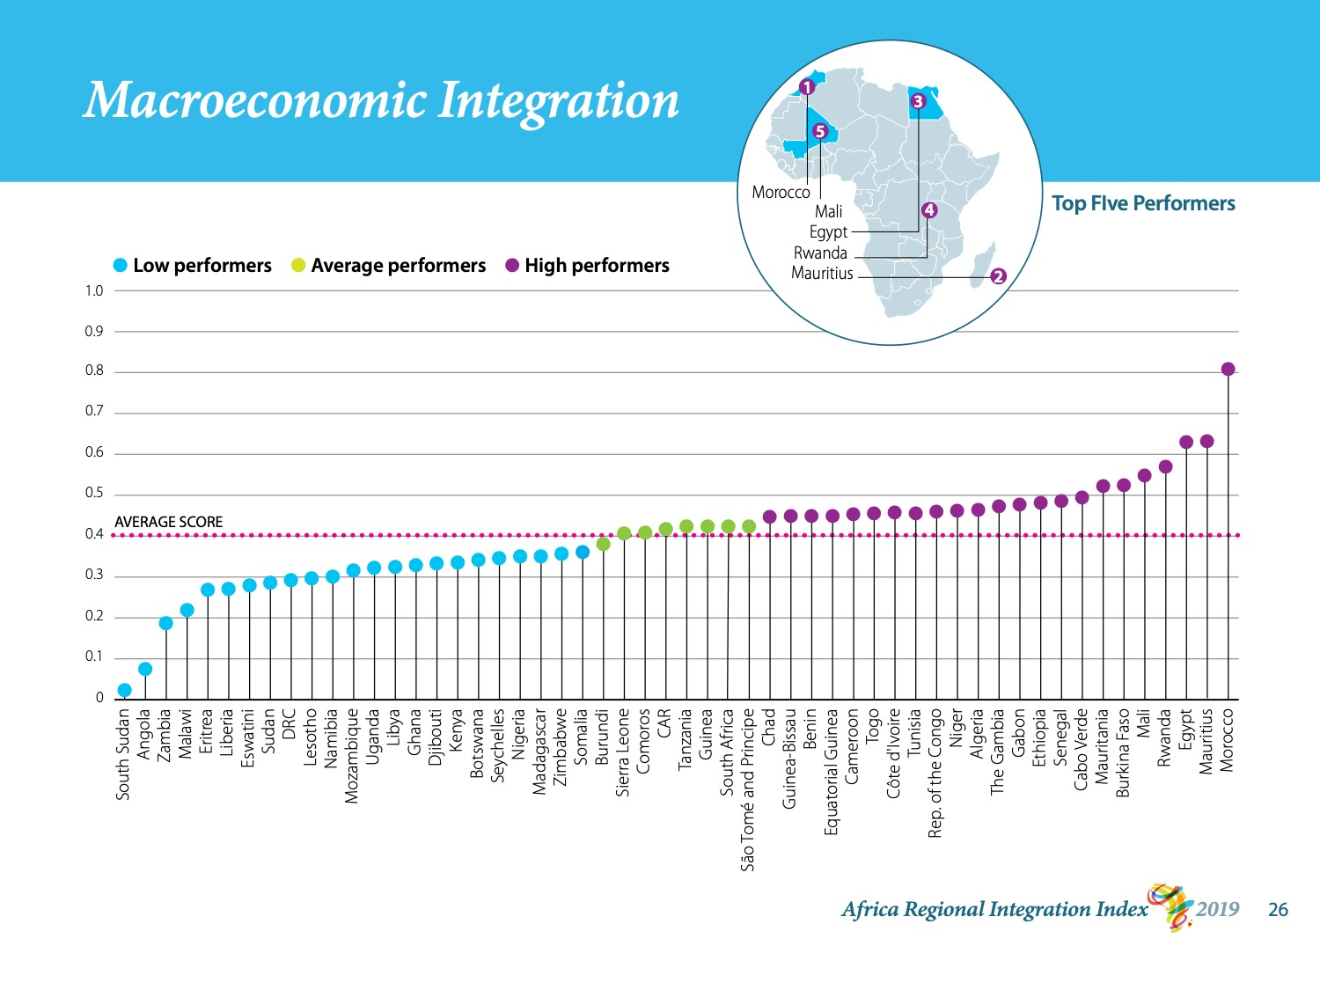
Notes:
This brings us to the next dimension: macroeconomic integration.
Morocco is the most integrated country on this dimension. It scores 0.8, far ahead of the runner-up, Mauritius, which scores 0.6. These two are followed by Egypt, Rwanda, and Mali.
The top performers tend to be countries whose currencies are easily convertible to other currencies.
The continent’s average is close to 0.4, which is moderate. The gap between the most and least integrated countries is nearly 0.8. This difference is mainly driven by exorbitant inflation in some countries.

Slide 25
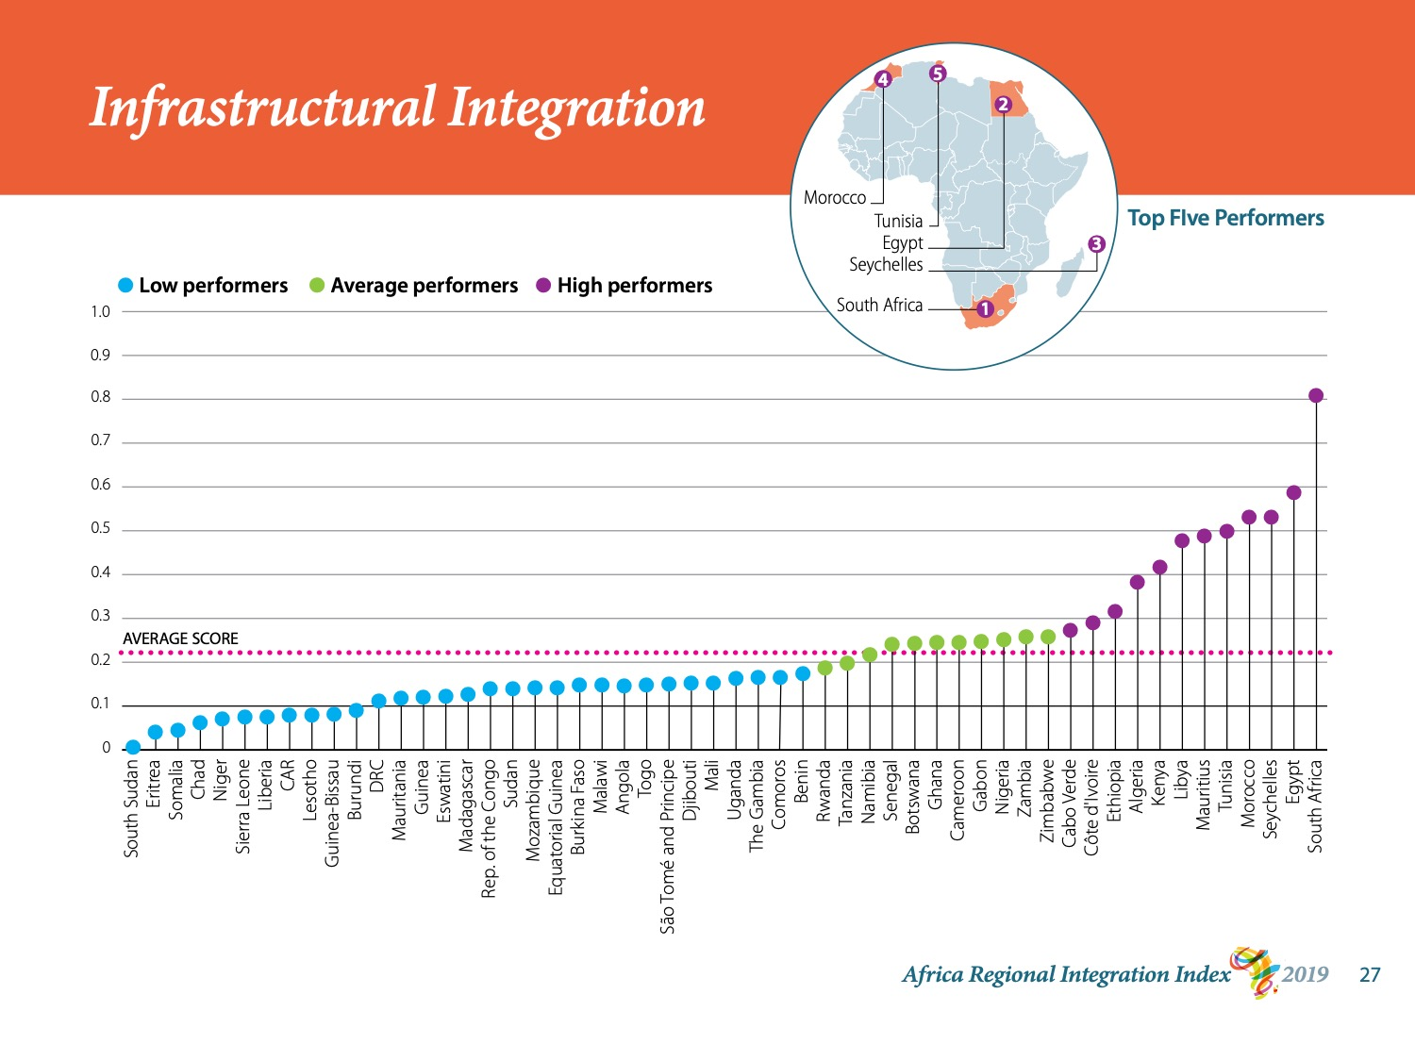
Notes:
South Africa is the continent’s leader on the infrastructure dimension, like it was on the productive dimension. With a score of 0.9, South Africa far outstrips the other most integrated countries.
South Africa has the best flight connections within the continent.
The next-strongest performers are Egypt, Seychelles, Morocco, and Tunisia, which score between 0.5 and 0.6.
South Sudan, Eritrea, Somalia, Chad, and Niger score near 0.
Africa’s overall score on this dimension is only 0.2.
Only 11 African countries have infrastructure that is moderately well integrated with their region.

Slide 26
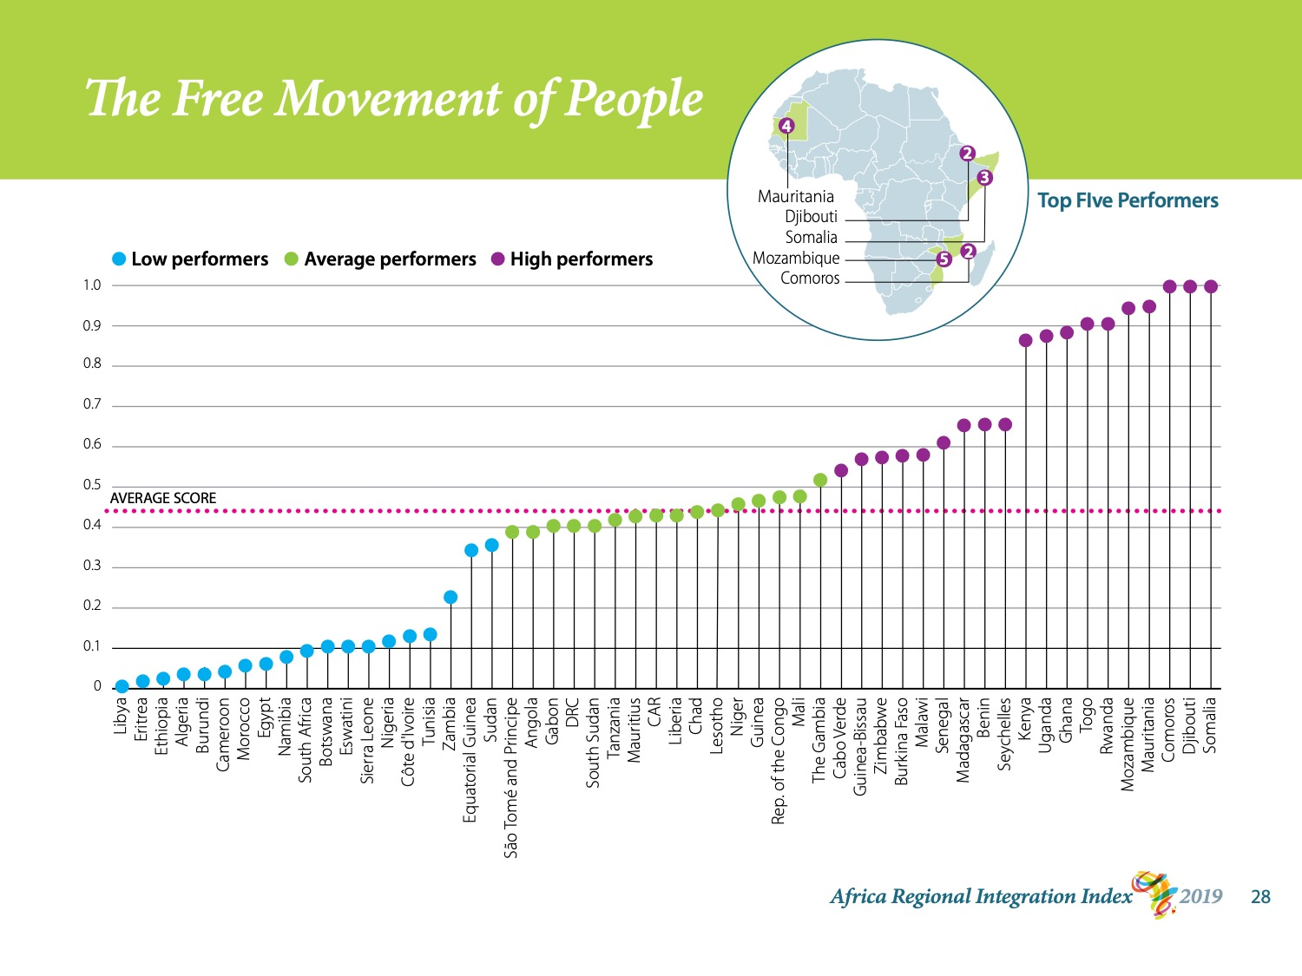
Notes:
The last dimension concerns the free movement of people.
Comoros, Djibouti, and Somalia all have a perfect score.
Citizens from all other African countries can obtain a visa on arrival in these countries, all three of which have adhered to the Free Movement of Persons Protocol.
Mauritania and Mozambique follow with scores around 0.95. They have signed the protocol as well.
Libya, Eritrea, Ethiopia, Burundi, and Algeria score near 0, and the African average is only 0.44.
What this means in real terms is that African citizens encounter numerous roadblocks when they travel.
This makes it hard to conduct business, visit other places, study, and create the social links that help keep regions stable.

Slide 27

Notes:
I will conclude by running over the principal recommendations that we draw from ARII’s findings.
These recommendations are generalisations that apply to the continent as a whole. Not all countries and regional economic communities have the same priorities.
Nonetheless, we can agree on one thing: Africa scores low on regional integration.
So the question is, where and how can we improve?

Slide 28
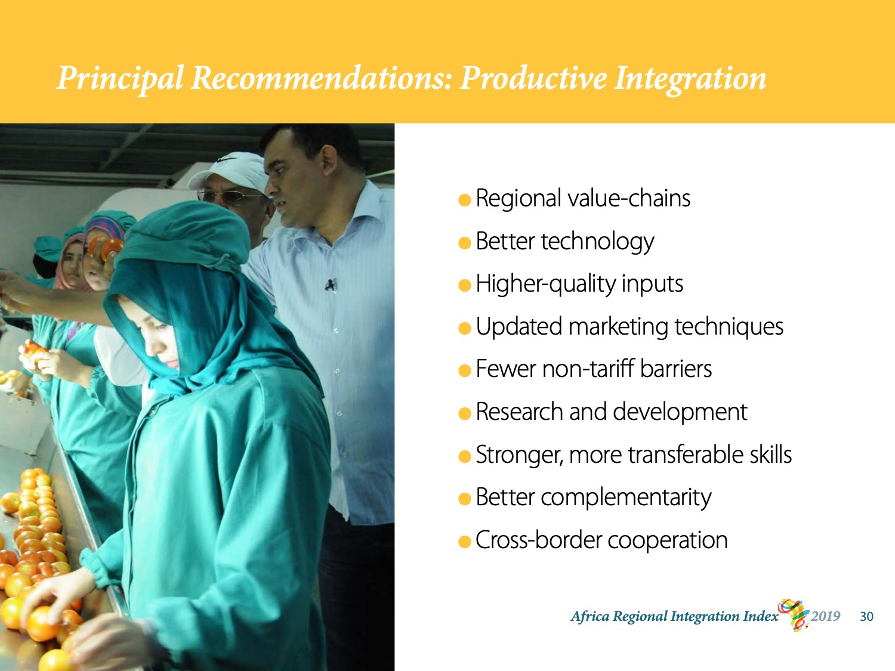
Notes:
We have seen that Africa’s most pressing concern is sluggish production.
Our first recommendation is to investigate opportunities to build innovative, regional value-chain frameworks in different sectors.
With the AfCFTA now in its operational phase, production and exports are likely to increase. But for growth to be sustained, production-related decisions must be strategic and made with a view to the long term.
Among other things, that means that productive facilities should embed state-of-the-art technology and use higher-quality inputs.
We also need to update marketing techniques and dismantle our many non-tariff barriers.
Africa also needs more investments in research and development.
Global value chains do not function without people. We have a labour goldmine: we should dig into it by identifying skills gaps, enhancing skills across borders, and making sure that skills are transferable.
Studies show that for industries to succeed in today’s global economy, literacy, numeracy, and problem-solving are of absolute importance. At the same time, global production is expected to become more and more fragmented and sophisticated. This makes it all the more crucial that populations develop the skills that can adapt to a changing labour market.
Through it all, countries and regions have to think strategically. They have to look for ways to complement each other’s strengths and cooperate across borders.

Slide 29
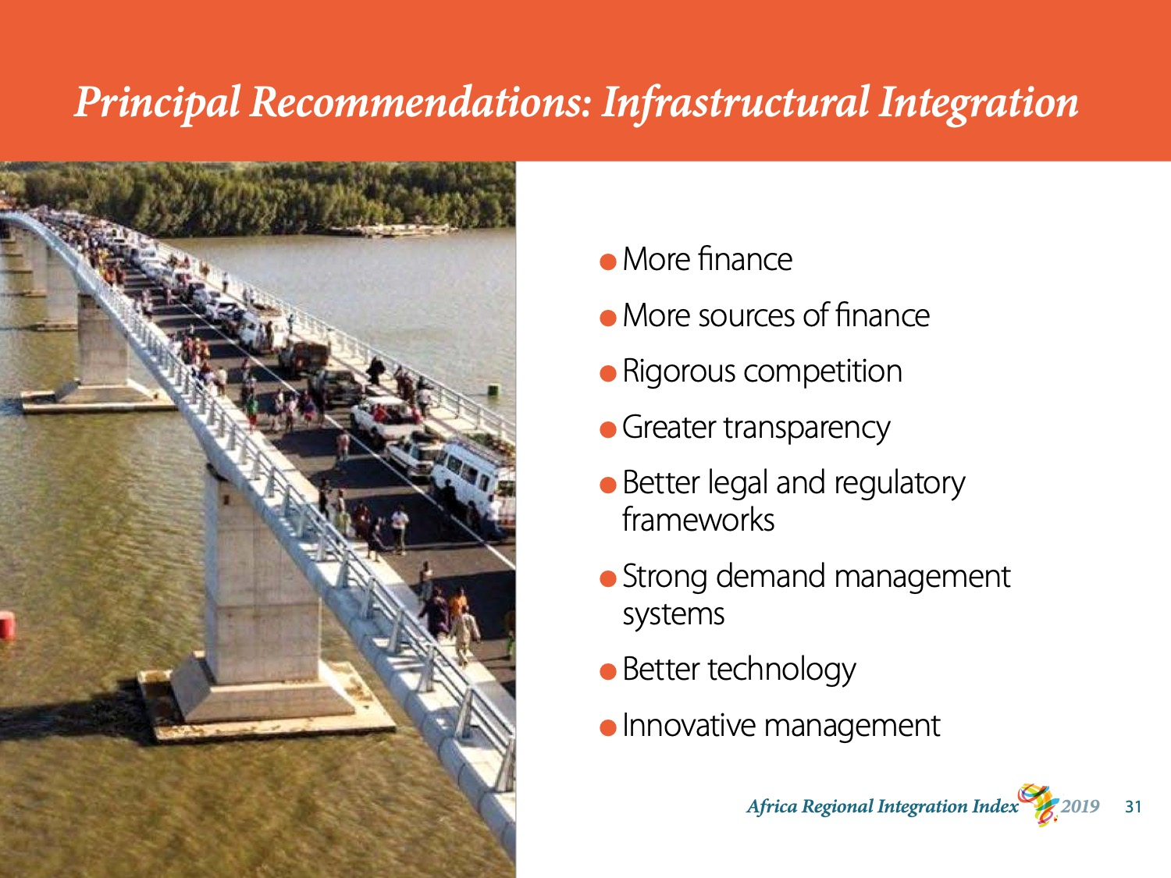
Notes:
After productive integration, Africa’s weakest area is regional infrastructure.
Africa’s infrastructure deficit is massive.
But the public sector cannot possibly afford all the infrastructure that Africa needs.
So we need to diversify sources of financing.
This means pursuing variants of public-private partnerships to attract more capital and expertise. Pension funds and insurance markets, for instance, are promising source of finance for low-risk projects.
But more finance does not solve the problem of poorly integrated infrastructure.
We need more rigorous competition in procurement processes and in construction, and we need greater transparency at all stages of a project.
Legal and regulatory frameworks should be reviewed and more efficient infrastructure demand management systems created to smooth the supply of services and products, better mitigate wear and tear, and cater to unforeseen events.
We should also invest more in new technology and innovative management strategies.

Slide 30
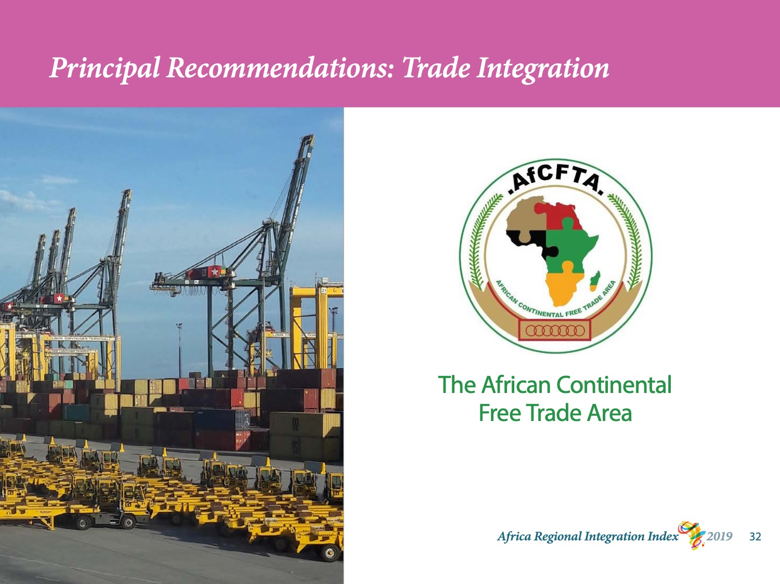
Notes:
Insofar as improving regional trade is concerned, we see tremendous promise in the AfCFTA.
The operational phase of the AfCFTA was launched in July 2019 and outstanding issues are currently being negotiated.
Once these issues are resolved, the AfCFTA expects to make up the world's largest continental free-trade area with a market of 1.2 billion people. Tariffs on 90% of goods will be eliminated over the first 5 years.
This is why ARII recommends moving decisively to implement the AfCFTA agreement while mitigating any harmful side-effects, such as lower tariff revenues, that sometimes accompany free trade agreements.
Operationalising the AfCFTA should be our first line of attack.

Slide 31
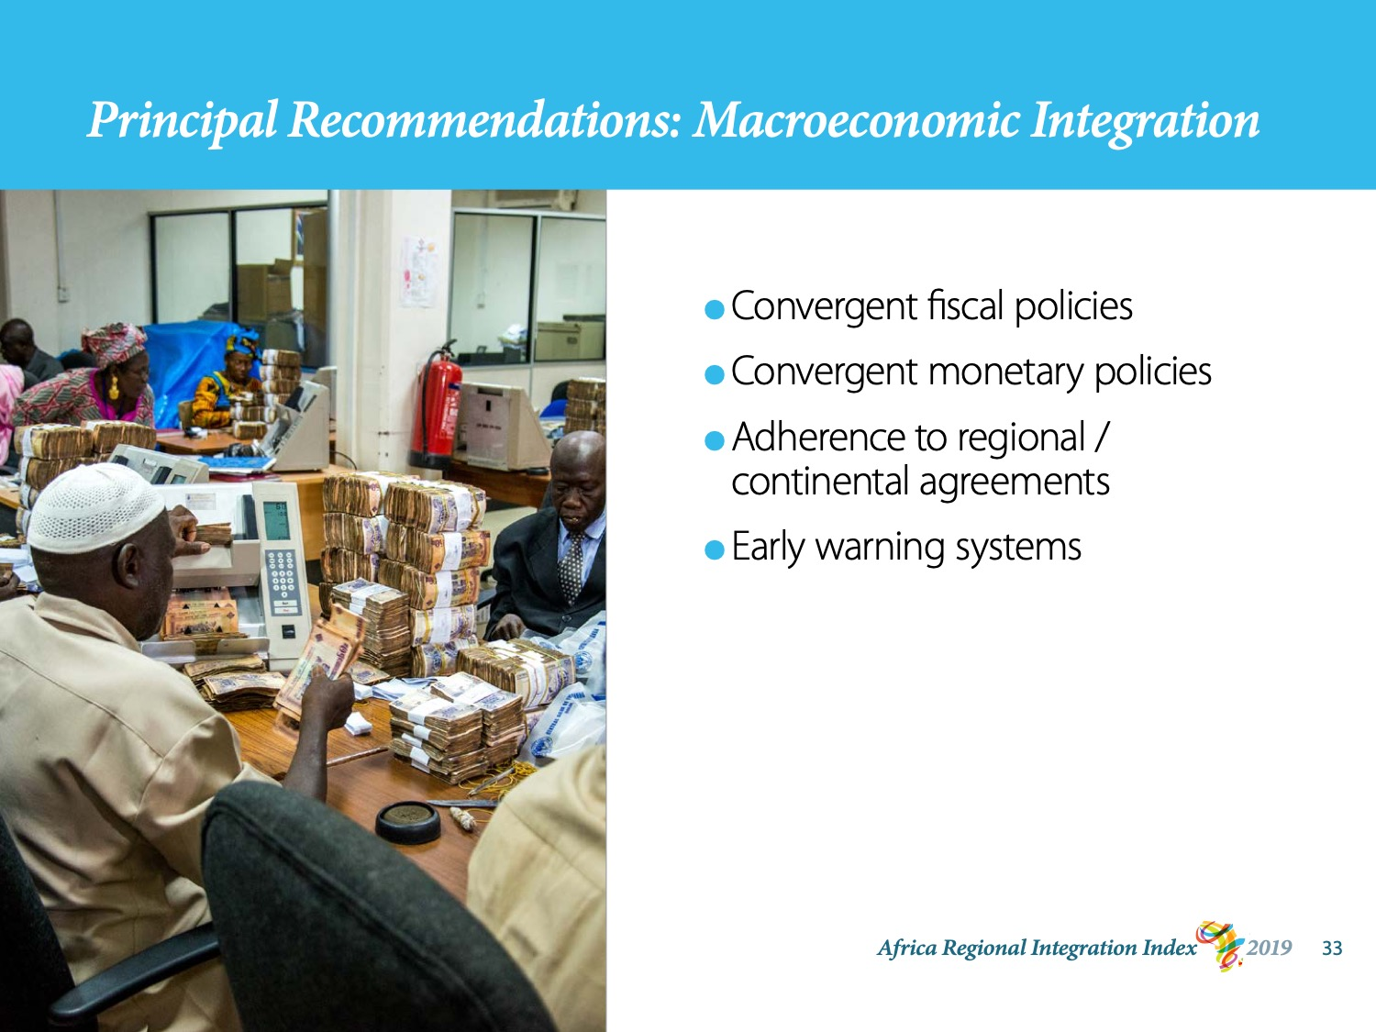
Notes:
When it comes to macroeconomic policies, the variance between countries is mainly driven by high inflation rates in some countries. Prioritising the convergence of sound fiscal and monetary policies would stabilise economies and increase cross-border investments.
So would ensuring adhering to agreements among RECs and at the continental level.
Policymakers should also establish early warning systems to better manage external shocks such as natural disasters and capital outflows.

Slide 32
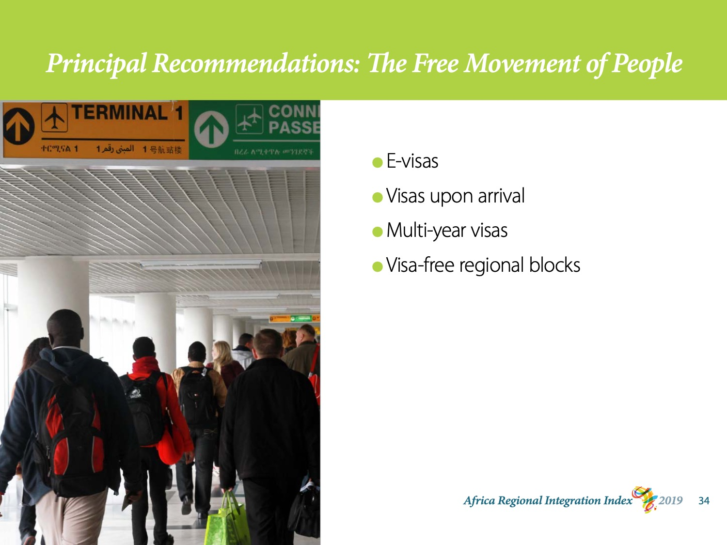
Notes:
We end with recommendations about human mobility.
Above all, we recommend greater visa openness with the ultimate goal of a visa-free regime for all African citizens and use of the African passport.
The 2019 edition of the Africa Visa Openness Index calculates a record 87% of African countries either improving or maintaining their score from 2018, with much of the progress coming from the adoption of e-visas and visas upon arrival for Africans.
This is good progress.
But Africa’s RECs can do more: from issuing multi-year visas after assessing an applicant, all the way to creating visa-free regional blocs.

Slide 33
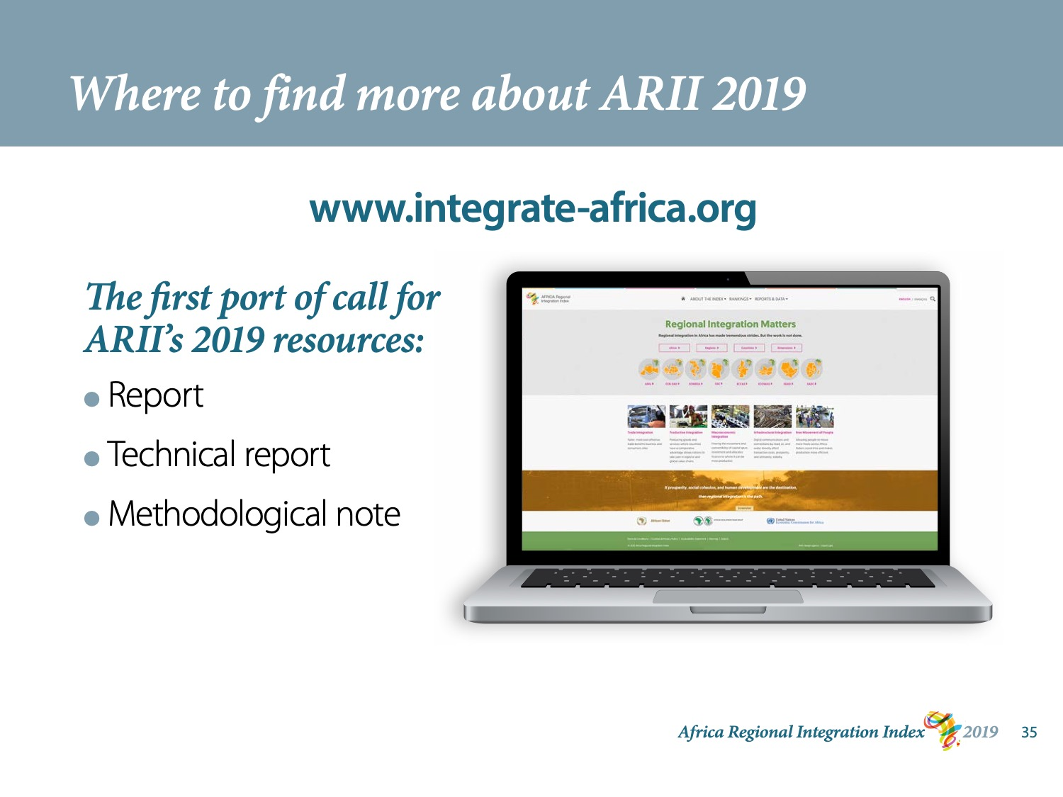
Notes:
If you’d like to investigate the data further, then www.integrate-africa.org is your first port of call. In just a few clicks, you can
compare a country’s performance to the performance of the other countries in its regional economic community
compare a country’s score on one dimension to another country’s score or to the REC average on that dimension
see how countries scored on each indicator that goes into the dimensions
download the raw data and prior reports
And much more.

Slide 34
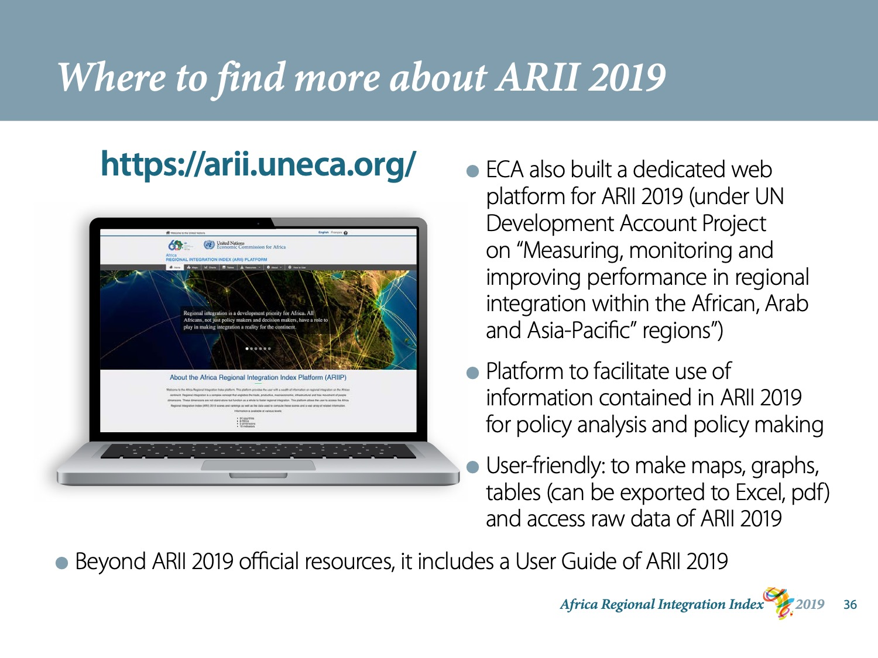
Notes:
Another wonderful source is ECA’s dedicated platform. This user-friendly platform
* Allows users to access the raw data for ARII 2019
* Allows the user to produce customised maps, graphs, and tables that can be exported to Excel
* Includes a User Guide

Slide 35
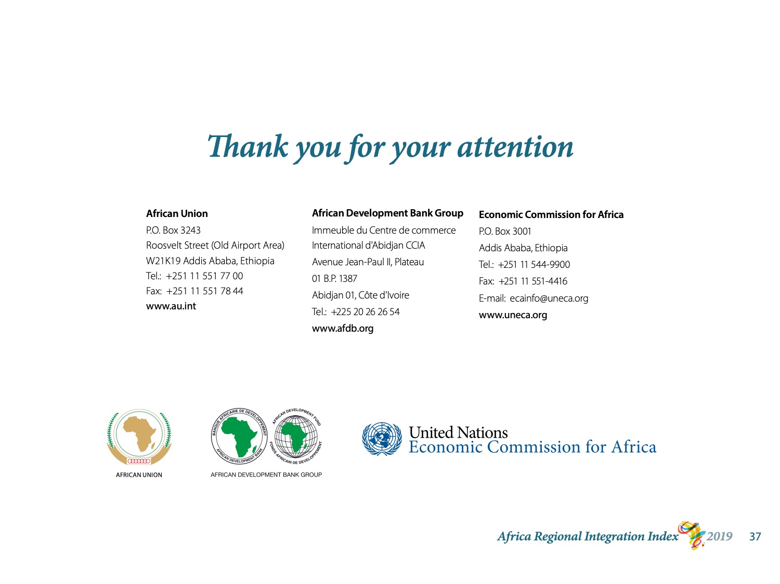
Notes:
This concludes my presentation.
I hope you find ARII useful and I encourage you to read the report and visit the website to learn more.

