Slide 2
Content
Background
Conceptual Framework
Current Epidemiological Situation and Response
Some Key Findings
Some Policy Recommendations

Slide 3
Background

Slide 4
The worst EVD outbreak!
Worst outbreak since the disease was diagnosed
Geographical coverage and duration
Number of people affected
Death toll and effect on the bereaved
Economic and social implications on affected countries, the region, and the continent
Impacts through two main channels:
H&F resources for the health and humanitarian response
Adverse effect (panic and hysteria)

Slide 5
The magnitude of the impacts?
Several attempts to quantify the impacts
On affected countries: well documented
Less focus on West Africa and the continent
Most projections on EVD impacts:
Scattered data and uncertainty about the future epidemiologic path
Strong assumption that the epidemic is likely to spread
Do not take into account the ongoing commendable response

Slide 6
The need for an ECA assessment!
Meaningful full assessment can only be done once the outbreak is contained
The current ECA assessment is expected to
Short term
Contribute to the preparation of countries’ policy responses for the post epidemic recovery
Contribute to the dissemination of country-based primary information on the epidemic and its implications
Support ongoing economic and social planning efforts that accompany the current health response
Medium and long term

Slide 7
Conceptual Framework

Slide 8
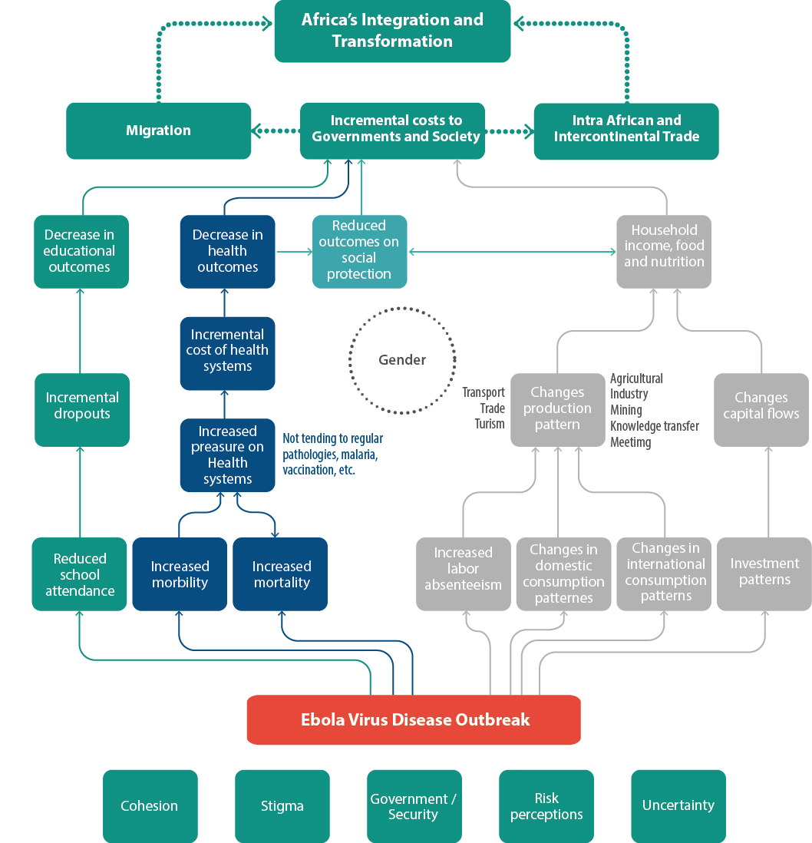
Conceptual framework

Slide 9
Methodology
Descriptive quantitative and qualitative analysis based on primary and secondary data collected in affected countries (ECA Task Team and ES)
Survey of non-affected countries to assess their preparedness to a possible EVD outbreak
WEFM: to model and analyse the escalating effects of the EVD on West Africa and Africa
Statistical text mining: perception of the EVD in the world and the image of Africa

Slide 10
Current Epidemiological Situation and Response

Slide 11
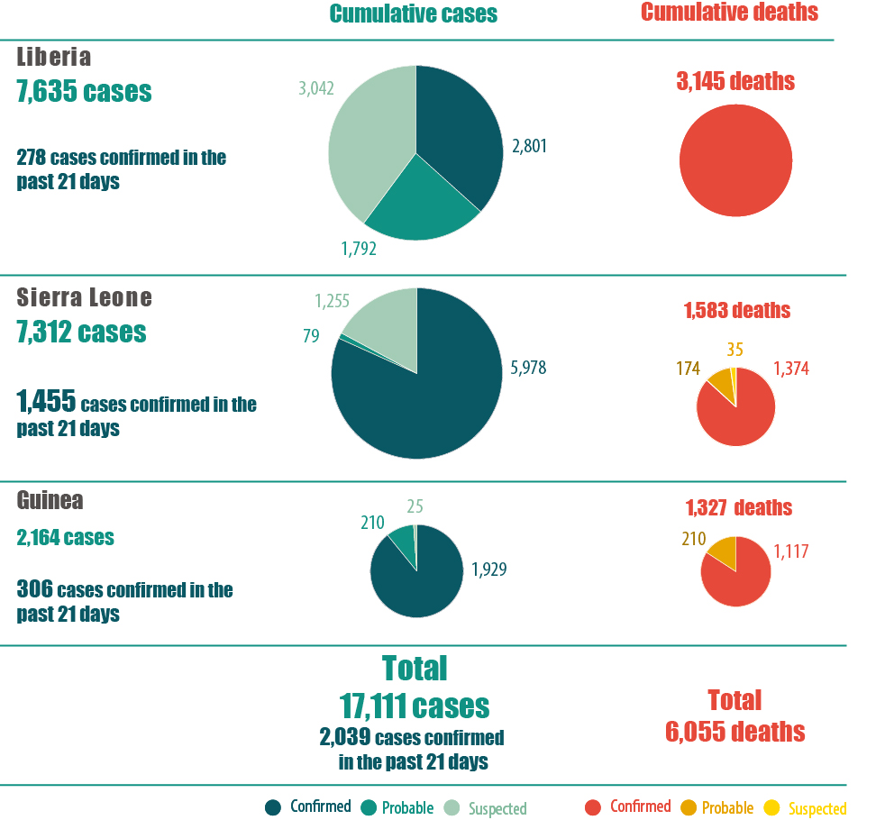
Current epidemiological situation

Slide 12
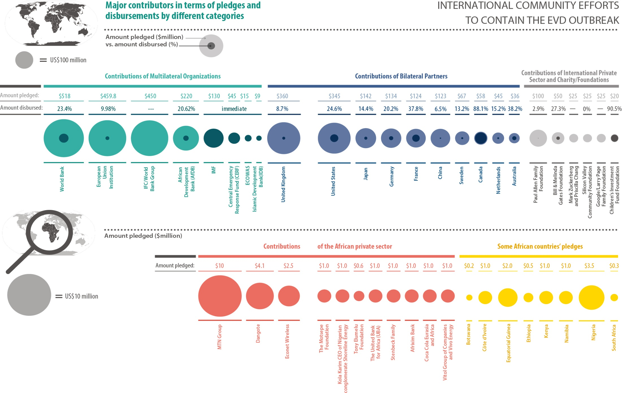
Scale of the response

Slide 13
Key Findings

Slide 14
Affected countries
EVD is not the biggest killer as compared to past and current diseases (malaria, tuberculosis, HIV/AIDS)
Beyond the death toll, the EVD has far reaching economic and social impacts in affected countries
Economic impacts:
Economic activities record a decline (agriculture, mining, trade, services etc.)
Public Finance: lowered revenues and increased expenditures
Fiscal deficits
Decrease in labor supply and productivity
Inflationary pressure
Etc.

Slide 15
Affected countries
Social impacts:
Rise in morbidities and mortalities of diseases NOT related to Ebola
Educational systems have shot-down
A rise in unemployment and commercial closures
Some population segments are more affected: rural populations, health workers, women, and children
Stigma is growing inside the countries and those saving lives are the most affected

Slide 16
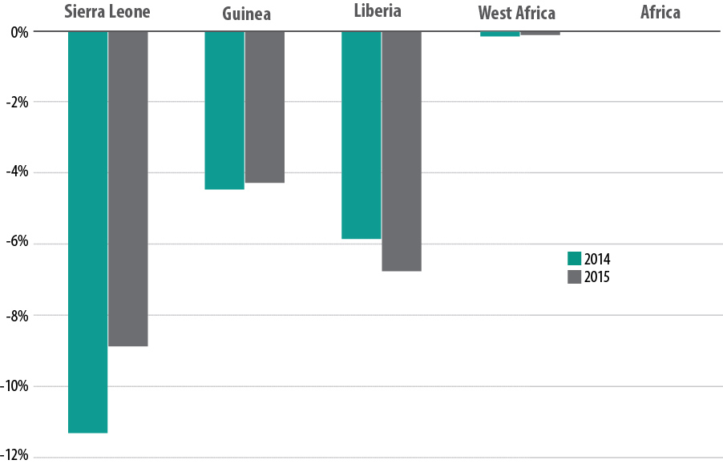
Effect on West Africa and the continent
ECA simulations based on country data

Slide 17
Vulnerability of health systems
Low capacity to react and manage outbreaks
Limited knowledge of health personnel
Health systems’ low ranking among government priorities
Common characteristics:
Under-infrastructured
Under-staffed
Under-resourced
Under-integrated (within the country and region-wide)

Slide 18
The role of perceptions
Fear factor and related panic (hysteria) for a disease that has no cure:
Main channel through which the EVD affects the economy
Refuels some assumptions on the assessment of EVD impacts
Perceptions and stigma fuel the impacts of the disease:
Borders closures and cancellation of flights
Cancellation of travels even to countries far away from the epicenter
Delayed or cancellation of investments
Effective communication:
Reduce the impacts on affected and non-affected countries
Efforts can be concentrated on combating the outbreak

Slide 19
Some Policy Recommendations

Slide 20
Epidemiological
Strengthening African health systems (EVD and other diseases)
Financing strategies (incl. domestic) for the health sector in general
Develop or strengthen systems for tracking morbidity in the population in real time
Strengthening civil CRVS in affected and non-affected countries to inform the prevention and combat against outbreaks

Slide 21
Economic
Reinforce border health checks rather than shut down borders given the economic impacts
G-L-S and their partners: engage in food aid efforts and emergency safety nets to address acute food shortages
G-L-S: provide special incentive packages to their farmers to help re-launch their agricultural sectors
Bilateral and multilateral creditors: seriously consider cancelling G-L-S’ external debts
G-L-S: recovery contingency plans for quickly reviving their economies (revise their MT and possibly LT national development plans)

Slide 22
Social
African countries: decentralizing their health services in order to enhance health response capacity locally
Social responses should not focus just on individuals directly infected by the virus, but should also consider those indirectly affected
Social protection and targeted safety nets should address groups that are disproportionally impacted by the outbreak
Ensure that children return to school and that the educational outcomes hurt by EVD are brought back to prior levels
Expand economic opportunities for women:
Recognizing and compensating women for the unpaid care work they do
Providing gender-responsive support services

Slide 23
Intangibles
AUC, AfDB and ECA: to present more accurate data and information on the disease and its impacts
African media: to provide accurate and fact-based accounts on EVD
AUC, AfDB, ECA: to prepare a joint, more detailed analysis of the socio-economic, political and cultural impacts of EVD when the crisis is contained
African leaders should ensure effective implementation of the decisions of the emergency session of the AU Executive Council:
Solidarity with affected countries
Breaking the stigmatization and isolation of the countries
Strengthening their resilience

Slide 24
Download the report
http://www.uneca.org
Follow the discussions: ECA_Official #EbolaImpact

