Slide 1
AfCFTA AND FISCAL SPACE FOR JOBS AND DIVERSIFICATION
Issues Paper
Stephen Karingi
11 - 15 May 2018
Addis Ababa, Ethiopia
2018 Conference of Ministers

Slide 2
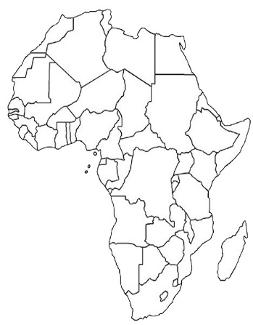
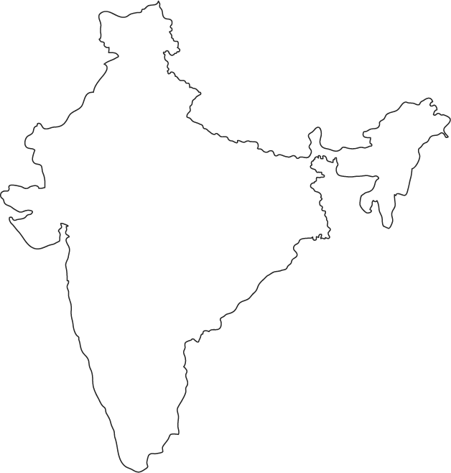
Rationale| African business
2
Africa’s economic structure is broadly similar to India’s
India | Africa
Population
1.3bn | 1.2bn
GDP
1.3bn | 1.2bn
Tax revenue to GDP
20.4% | 20%
India is a single consolidated market (7th biggest in the world)
Allows scale economies and competitive businesses
Africa is fragmented over 54 countries and 107 unique land border
Businesses face average tariffs of 6.9% non-tariff barriers
AfCFTA and fiscal space for jobs and diversification | Issues paper
UNECA.ORG

Slide 3
Rationale| African business
3
Opportunities for African businesses
The AfCFTA consolidates African market
Easing economies of scale and scope, and regional value chains
It also allows African businesses to gain from Africa’s good market dynamics
Africa’s Gross Domestic Product at current market prices (US$ trillion), forecasts
AfCFTA and fiscal space for jobs and diversification | Issues paper
UNECA.ORG

Slide 4
Rationale| Sustainable growth & jobs
4
Most African exports are extractives
Petroleum oils & gas, minerals, ferrous and precious metals
Volatile prices, produce few jobs, and fluctuating revenues
AfCFTA and fiscal space for jobs and diversification | Issues paper
UNECA.ORG

Slide 5
Rationale| Sustainable growth & jobs
5
In contrast, intra-Africa trade…
Only 40% is extractives (compared to 70% of exports to outside Africa)
More balanced and sustainable exports for sustainable growth
More labour intensive for creating jobs for Africa’s bulging youth population
Structural transformation and long-term sustainable growth
AfCFTA and fiscal space for jobs and diversification | Issues paper
UNECA.ORG

Slide 6
Rationale| Opportunities for all
6
Gains for different country types
ECA estimate all African countries to experience welfare gains.
More industrialized countries are well placed for manufactured goods,
RVCs can help suppliers from other countries.
Opportunities for satisfying Africa’s growing food security requirements.
Diversify exports for resource rich countries
Land-locked gain from trade facilitation, transit and customs cooperation
Also safeguards in case of import surges or threats of injury.
AfCFTA and fiscal space for jobs and diversification | Issues paper
UNECA.ORG

Slide 7
Fiscal space & sustainability| Tariffs
7
AfCFTA impact of tariff revenue to be small
Imports from other African countries only 14% of total imports.
(Existing retained for remaining 86% of imports).
56% of intra-African imports already free through pre-existing REC FTAs
Exclusion lists to protect important revenue products.
Implementation gradual: 5 years (15 for LDCs).
More gradual 10-13 years for “sensitive” products.
Tariff revenues only 15% of total tax revenue in Africa.
Tariff reductions will only affect a small share of tax generation.
AfCFTA and fiscal space for jobs and diversification | Issues paper
UNECA.ORG

Slide 8
Fiscal space & sustainability| Tariffs
8
AfCFTA will also have revenue benefits
Economic growth by 1 - 6% of GDP,
Increase broader tax base and boost revenue collection.
Actual economic boost could even higher:
Services and investment, which isn’t included in modelling.
The sectors that gain most produce more sustainable growth,
Manufacturing and processed agriculture
Better contribute to fiscal sustainability
AfCFTA and fiscal space for jobs and diversification | Issues paper
UNECA.ORG

Slide 9
Fiscal space & sustainability| Fiscal
9
It remains important for Africa countries
to enhance their fiscal positions
Taking full advantage of the AfCFTA for its opportunities
Will require investing new resources in the BIAT Action Plan
African countries need to mobilise resources in order for SDGs.
Needed for SDGs: $600bn to $1.2tr per year
It is important that tax revenues are more stable and reliable
External resources increasingly less so
Can better channel these resources towards its own objectives.
AfCFTA and fiscal space for jobs and diversification | Issues paper
UNECA.ORG

Slide 10
THANK YOU!
Follow the conversation: #2018COM
More: www.uneca.org/cfm2018

