Slide 1
Sub-programme 5 Technology, Climate Change and Natural Resource Management Division Economic Commission for Africa
Committee on Private Sector Development, Regional Integration, Trade, Infrastructure, Industry and Technology
11-12December 2019
Addis Ababa, Ethiopia

Slide 2
TCND in Brief
Green Economy, Innovation and Technology
Climate Change
Natural Resources Management

Slide 3
Background
GEITS Responds to two Expected Accomplishment
EA1: Enhanced capacity of member States to nurture and harness… new technologies ….for Africa’s development
EA2: Enhanced capacity of member States to formulate and implement policy reforms to foster a green economy in the context of sustainable development
Green
Economy
GEITS
Policy Research & Analysis
Field Project
Technical support
Advocacy and networking
STI
ICT

Slide 4
Progress 2018/2019

Slide 5
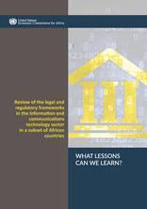
Thinktank function
Towards a Framework for Governing STI in the Republic of South Sudan,
Youth and Innovation for Improved Healthcare
Financing clean and digital technology firms alongside sustainable infrastructure in Africa
Towards an African Nanotechnology Future: Capacity, Policies and Regulation to meet SDGS
Harnessing Emerging Technologies for Enhanced Transportation

Slide 6
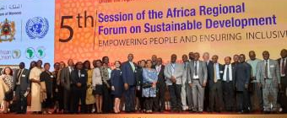
Convening
The first multi-stakeholder Africa Regional STI Forum co-organized with South Africa in Morocco.
Four Regional Consultations on Strengthening National Academies of Science of LDCs
Global Forum on Human Settlement in in the Digital Era (500 stakeholders from 50 countries)
Africa Regional World Summit on the Information Society organized in Cameroon

Slide 7
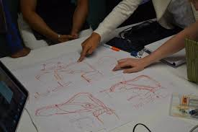
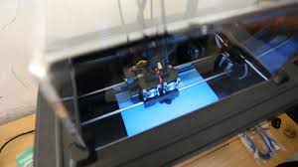
Operational
EU-Africa Health Innovation Platform launched and Innovators Design School organized in Uganda benefiting 60 students and researchers
Piloting a platform for digitization of tax assessments and administration in Guinea
Support to Cameroon and Ethiopia to expand their broadband infrastructures
Support to metrological agencies on the installation of automated weather stations
Training on Macroeconomic Frameworks for an Inclusive Green Economy in Africa (of 158 participants)

Slide 8
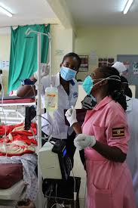
Status update: key results achieved
1. South Sudan to establish a Ministry for STI based on ECA Research
2. BME Curriculum in use, over 2000 students enrolled, 60 youths and researchers exposed to new technologies for design and prototyping of medical devices; 1 medical device completed first phase of clinical trials and 1 in the market. One of our researchers has won global patient safety award, African Innovation Prize Award and Johnson & Johnson Award.
EA 5: Advocacy for Africa through STI Forum, a strong partnership with UNESCO (co-funding the 2020) and with South Africa as co-organizers; AUC and AfDB for another STI Forum on African issues.

Slide 9
Alignment
Alignment to ECA SDs:
Contributions to the SDGs:
Beneficiary Countries: 30 LDCs; Cameroon, Ethiopia, Morocco, Uganda, Madagascar, Guinea, Mauritania , Burkina Faso, Tanzania

Slide 10
Partnerships
TCND
ACPC and Natural Resources Management Section
ECA
MGD, GPSD, RITD, ACS, PSDFD, IDEP, and SROs
Other UN
UNCTAD, ITU, WIPO, UNESCO, UN Environment, UNDP, FAO, DESA, OSAA, Other UN Regional Commissions, Secretariats of CBD, UNCCD and UNFCCC, and other UN entities
Non-UN
AUC, ABEC, Fintech Associations, ATU, AUDA-NEPAD, RECs, AfDB, APRM Secretariat, Global Green Growth Institute, Green Growth Knowledge Platform, GIZ-Partners for Review, Associations of Major Groups and other Stakeholders

Slide 11
Workplan for 2020

Slide 12
Ongoing work for 2020
Guidelines for Better STI Policy Design and Implementation in Africa
Scoreboard for Education, Science, Technology and Innovation (with AUC)
African Regional STI Forum 2020 – (with UNESCO)
WSIS Regional Review Meeting 2020
Pilot project on “Emerging Technologies for Improved Healthcare”
Study on Transitioning to Sustainable Transport Technologies
Study on Mobilizing Funding for Innovation and Entrepreneurship
Private sector opportunities to drive green economy

Slide 13
Thank you.

