Slide 1
Webinar on: Skills for Economic diversification in Central Africa: leveraging experiences from successful comparators and building partnerships UNECA
Leather Production
what to learn from Ethiopia
Nebiyeleul Gessese (PhD)
30 July 2020

Slide 2
Comparison of Livestock Population and RHS Productivity
Bovine Hides
Location | No of cattle (mln head) | Share of global herd (%) | Output of hides (mln pc) | Ratio of hide output to cattle head (%)
World | 1659.6 | 100 | 364.3 | 22.0
Africa | 291.7 | 17.6 | 40.9 | 14.0
Ethiopia | 54.6 | 3.3 | 3.3 | 6.0
Sheep Skins
Location | No of sheep (mln head) | Share of global herd (%) | Output of skins (mln pcs) | Ratio of output to sheep head (%)
World | 1163.7 | 100 | 550.0 | 47.3
Africa | 301.8 | 25.9 | 110.8 | 36.7
Ethiopia | 26.2 | 2.3 | 8.7 | 33.2
Goat Skins
Location | No of goats (mln head) | Share of global herd (%) | Output of skins (mln pcs) | Ratio of output to goat head (%)
World | 992.9 | 100 | 486.3 | 49.0
Africa | 345.1 | 34.8 | 114.2 | 33.1
Ethiopia | 24.7 | 2.5 | 8.1 | 32.8

Slide 3
Raw Hide and Skin (RHS) Trading Overview
Informal live animal trading
Animal Husbandry
Production
Trading
Animal holding practices and distribution around the Country
Slaughter practices (export or domestic)
Collection and delivery of RHS
Trade, sales, direct procurement from production sources to tanneries
 | Small holder farmers (99.3%) Commercial farmers (0.7%) | Export abattoirs (14) Domestic abattoirs (250) Backyard slaughter Formal live animal trade | Small scale collectors Medium/large collectors Traditional tanneries
The proportion of livestock under commercial ownership/ranching model is estimated to be less than 1%
Traceability and animal welfare issues are huge obstacles which need to be addressed through close knit collaboration between the Ministry of Agriculture and other relevant stakeholders
Trading of live animals in key areas is driven by the demand of the export abattoirs who have in turn driven down the slaughter age as a result of consumer demand pressures
Younger animals being traded means limited usability of the skin and ultimately low product diversity and portfolio-this creates a limit on a firm’s ability to compete

Slide 4
Animal Husbandry
There are 4 major animal husbandry challenges which have a direct impact on RHS as an input for the leather industry
Systems of raising livestock
Disease Prevalence and Management
Transportation and handling
Traceability

Slide 5
Raw Hide and Skin Production and Supply
4 - Common slaughter methods
Backyard slaughter
Rural Slaughter Slab Operation
Domestic Abattoir
Export Abattoir

Slide 6
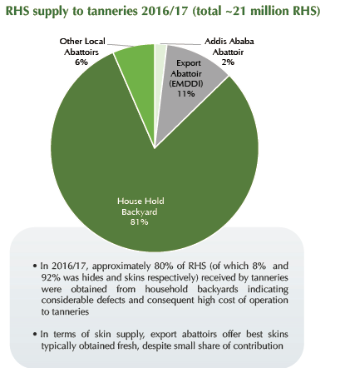
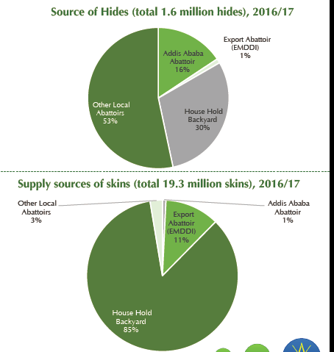
RHS Supply to Tanneries

Slide 7
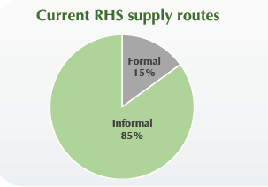
Key Steps Involved in Trading RHS
Production
Collection
Storing &
Preservation
Semi-processing (wholesale)
Collection
Tannery

Slide 8
Landscape – Tanneris
Current Breakdown of Investment
Joint Venture (JV) 3%
Foreign Direct Investment (FDI) 45%
Domestic Investment (DI) 52%
Total of 33 registered tanneries, of which 24 are currently operational
14 are FDI and 19 are DI
Of the total daily capacity of 1 million sq. ft. of fished leather about 60% comes from FDIs
FDIs focus more on skin than hides

Slide 9
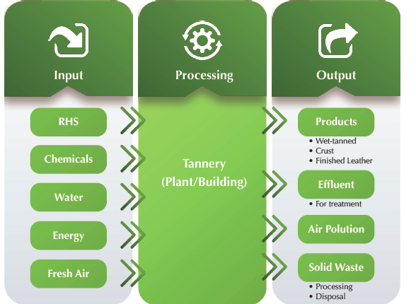
Tanning Process – Finished Leather

Slide 10
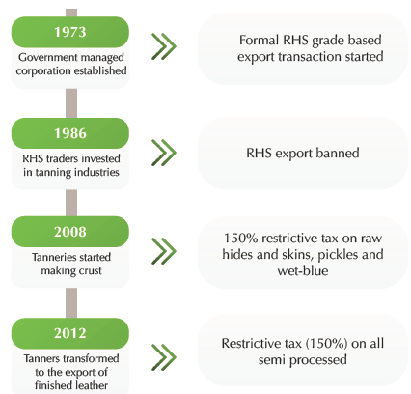
Transitions in the Ethiopian Tanning Sector Regulations

Slide 11
Estimated/Potential RHS Production and Tanneries Capacity
 | Annual estimated Raw Hide mln pcs | Annual estimated Raw Skin mln pcs
Estimated production with minimum kill rate | 4 | 21
Realized Recovery (2016/17) | 2 | 19
Tanneries installed soaking capacity | 4 | 46

Slide 12
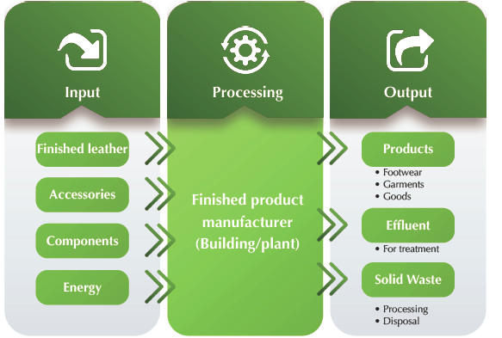
Product Manufacturing - Leather Goods

Slide 13
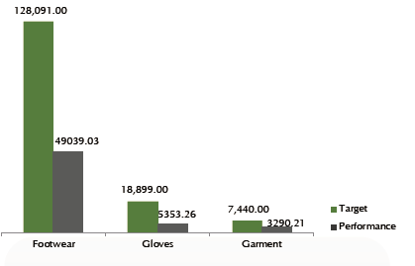
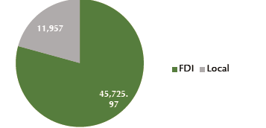
Target vs Actual Exports (USD ‘000) - Leather Goods

Slide 14
Constraints in the Ethiopian - Leather Sector
Environment and Sustainability
Compliance to International Standards
Export and Investments
Finance and Incentives
Institutional Coordination
Customs and Logistics
Workforce Development and Sustainability

Slide 15
Policy and/or Technical Interventions undertaken and envisaged – Leather Sector
Inputs supply (RHS, Chemical, Accessories etc.)
Policy | Technical
Introduce floor price mechanism for RHS at production and collection level to incentivize better collection rate Improve RHS management and inspection system Introduce Restricted Substance Lists (RSL) for leather manufacturers Enable existing FDI footwear factories to supply the domestic market with accessories and components and provide product development services. | Optimize utilization of existing abattoirs and encouraging modern/commercialized farms and abattoirs via new investment following the directive already approved by the Ethiopian investment board Develop pre-tanning process or pickling plant – by abattoirs, traders or tanners Focusing on animal health and handling

Slide 16
Policy and/or Technical Interventions undertaken and envisaged – Leather Sector … Cont’
Production Process
Policy | Technical
LIDI driving research and product development with incentive mechanism established within LIDI to encourage proactive support Incentivize R&D and technical laboratory set-up at the tannery and leather product factory premises Ensure the enforcement of standards such as Leather Working Group (LWG) Environmental Audit Protocol, Zero Discharge of Hazardous Chemical (ZDHC) Certification, and Restricted Subsistence List (RSL) certification which are key compliance requirements globally | Put in place a process control guideline/training system based on LWG standards so that tanners conform to specifications Encourage the principle of PPM (Planned Preventative Maintenance) through private service providers and consultants International expert support to ensure that the tanneries and factories are run as per international business standards

Slide 17
Policy and/or Technical Interventions undertaken and envisaged – Leather Sector … Cont’
Marketing
Policy | Technical
 | Build business network through experienced marketers and create a digital presence for easy access
Export and Investment
Policy | Technical
Enable domestic tanneries with indirect exports to access USD | Targeting international brands and manufacturers for increased export and induce new investment in Ethiopia Investment promotion via Industrial Parks

Slide 18
Policy and/or Technical Interventions - Leather Sector … Cont’
Environment
Policy | Technical
Increased and systematic checks of tanneries for installing primary and secondary treatment plant. Put in place a standard guide for responsible water usage | Finalize the Modjo Common Effluent Treatment Plan (CETP) plant construction
Incentives, Coordination, Logistics, and Customs
Policy | Technical
Introduce performance based new incentives for value addition and improve management of existing incentive mechanisms Create a joint taskforce between key supporting institutions to serve as a central coordinating body to drive necessary change Set logistic competitiveness target

Slide 19
Policy and/or Technical Interventions - Leather Sector … Cont’
workforce development
Policy | Technical
Establish a human resource development fund to support with worker training in both soft and hard skills Workers health and safety procedures and guidelines development and enforcement | Set-up worker service support centers to improve retention and address worker unrest related issues

