Slide 1
The Problematic: Breaking the Vicious Cycle
ECA SRO-CA

Slide 2
Why it Matters
In Africa, natural capital contributes up to 25% of GDP compared to 2% in OECD countries
For 23 African countries, 10% of annual output and 50% of their annual exports are from extractive resources: Central Africa is no exception
This high degree of concentration of exports in primary commodities exposes countries to the vagaries of commodity price fluctuation: It highlights their vulnerability to price shocks
COVI9 has exposed our vulnerabilities: It is a double jeopardy
Upgrading skills, competencies and putting innovation at the centre of development plans is key to breaking the vicious cycle

Slide 3
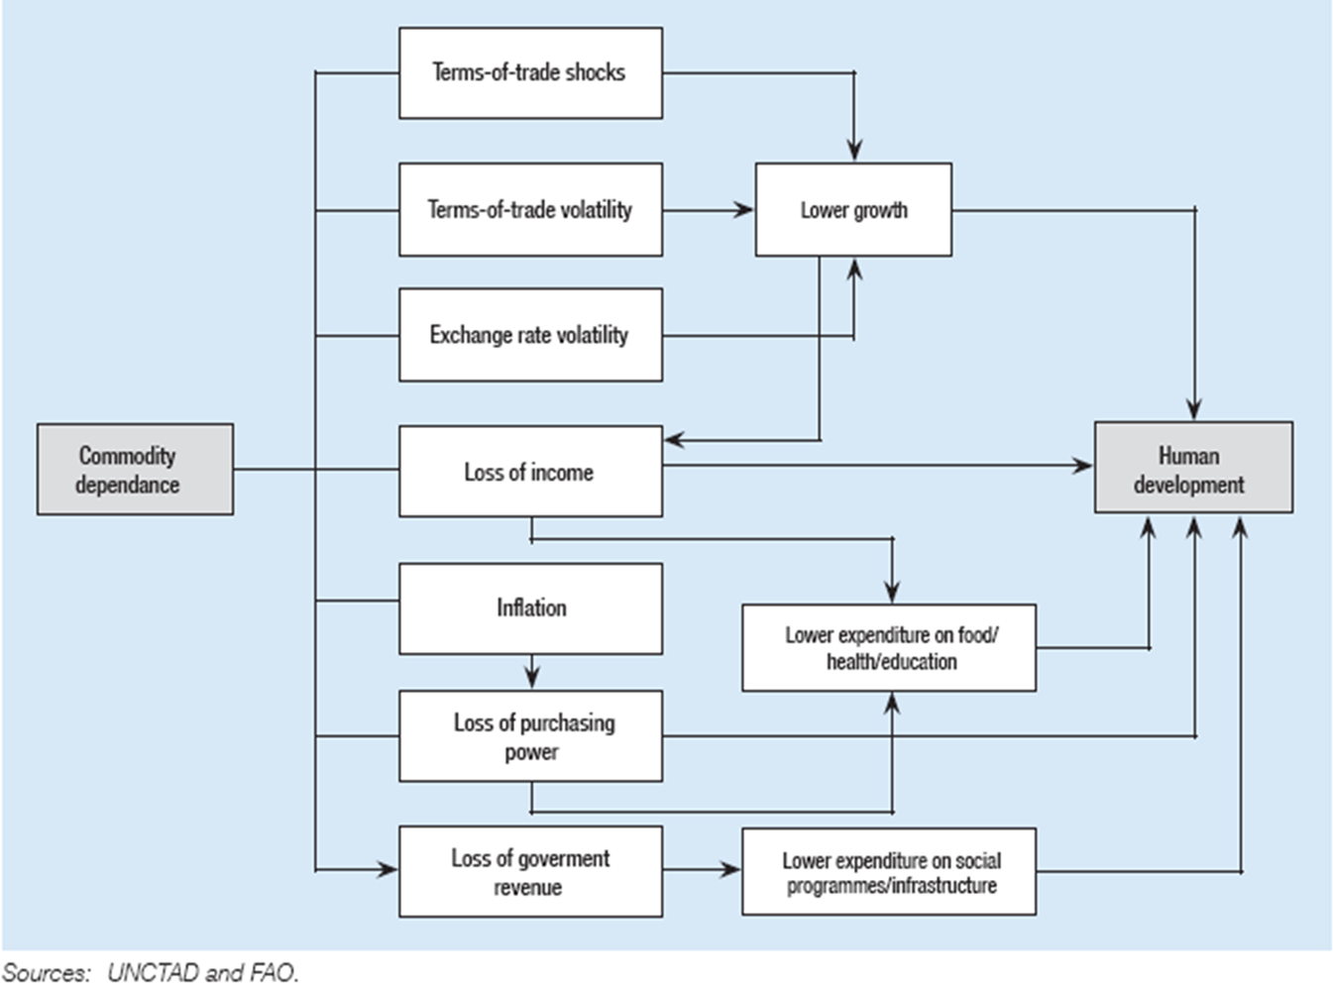

Slide 4
The Extractives Value Chain and Developing Countries
The value chain in many developing countries
ends here, at best
Developed countries
complete the chain
Least value
Most value
Exploration
Mining
Mineral
processing
Smelting
&
refining
Semi –
fabrication
Final
product
manufacture
1. Inputs
Consulting services (surveying, drilling, design, bulk earthworks)
Specialized equipment
Utilities and raw materials
Finance
Output/Sellable Product
Run-of-mine ore for sale to miners
2. Inputs
Run-of-mine ore
Consulting services
Specialized equipment
Raw material inputs
water and power
Labour
Output/Sellable Product
Concentrate for sale to traders
3. Inputs
Concentrate
Consulting services
Specialized equipment
Raw material inputs
water and power
Labour
Output/Sellable Product
Refined product for sale at metal exchanges
4. Inputs
Refined product
Consulting services
Specialized equipment
Raw material inputs
water and power
Labour
Output/Sellable Product
Semi-fabricated product for sale to manufacturers
5. Inputs
Semi-fabricated product
Consulting services
Specialized equipment
Raw material inputs
water and power
Labour
Output/Sellable Product
Final manufactured product for use
Source: Adapted from Lydall, 2010
5
Fostering Economic Diversification In Equatorial Guinea
UNECA.ORG

Slide 6



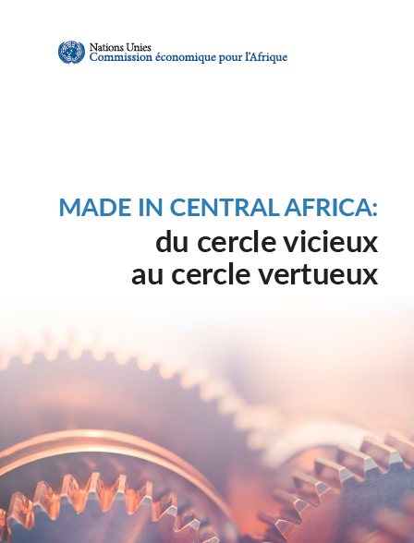

Slide 7
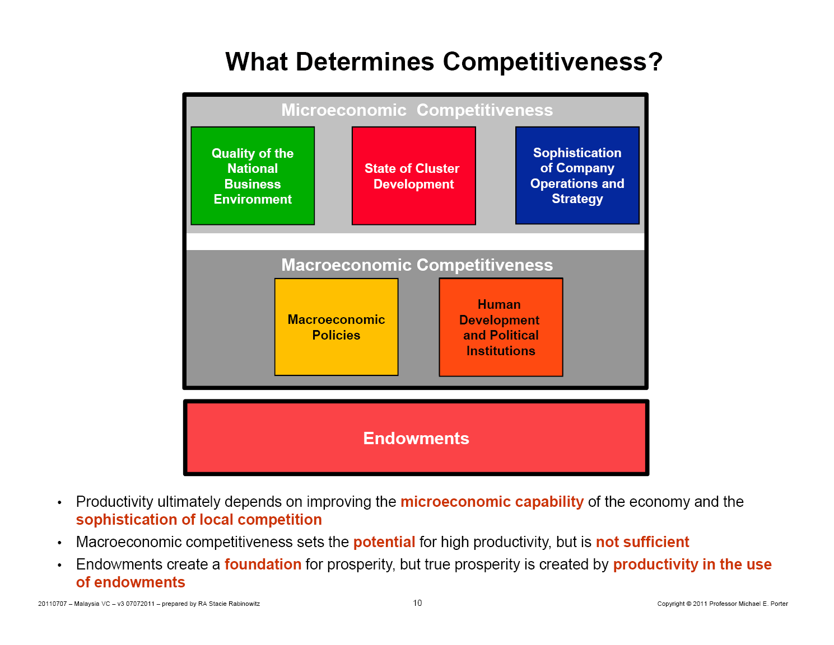

Slide 8
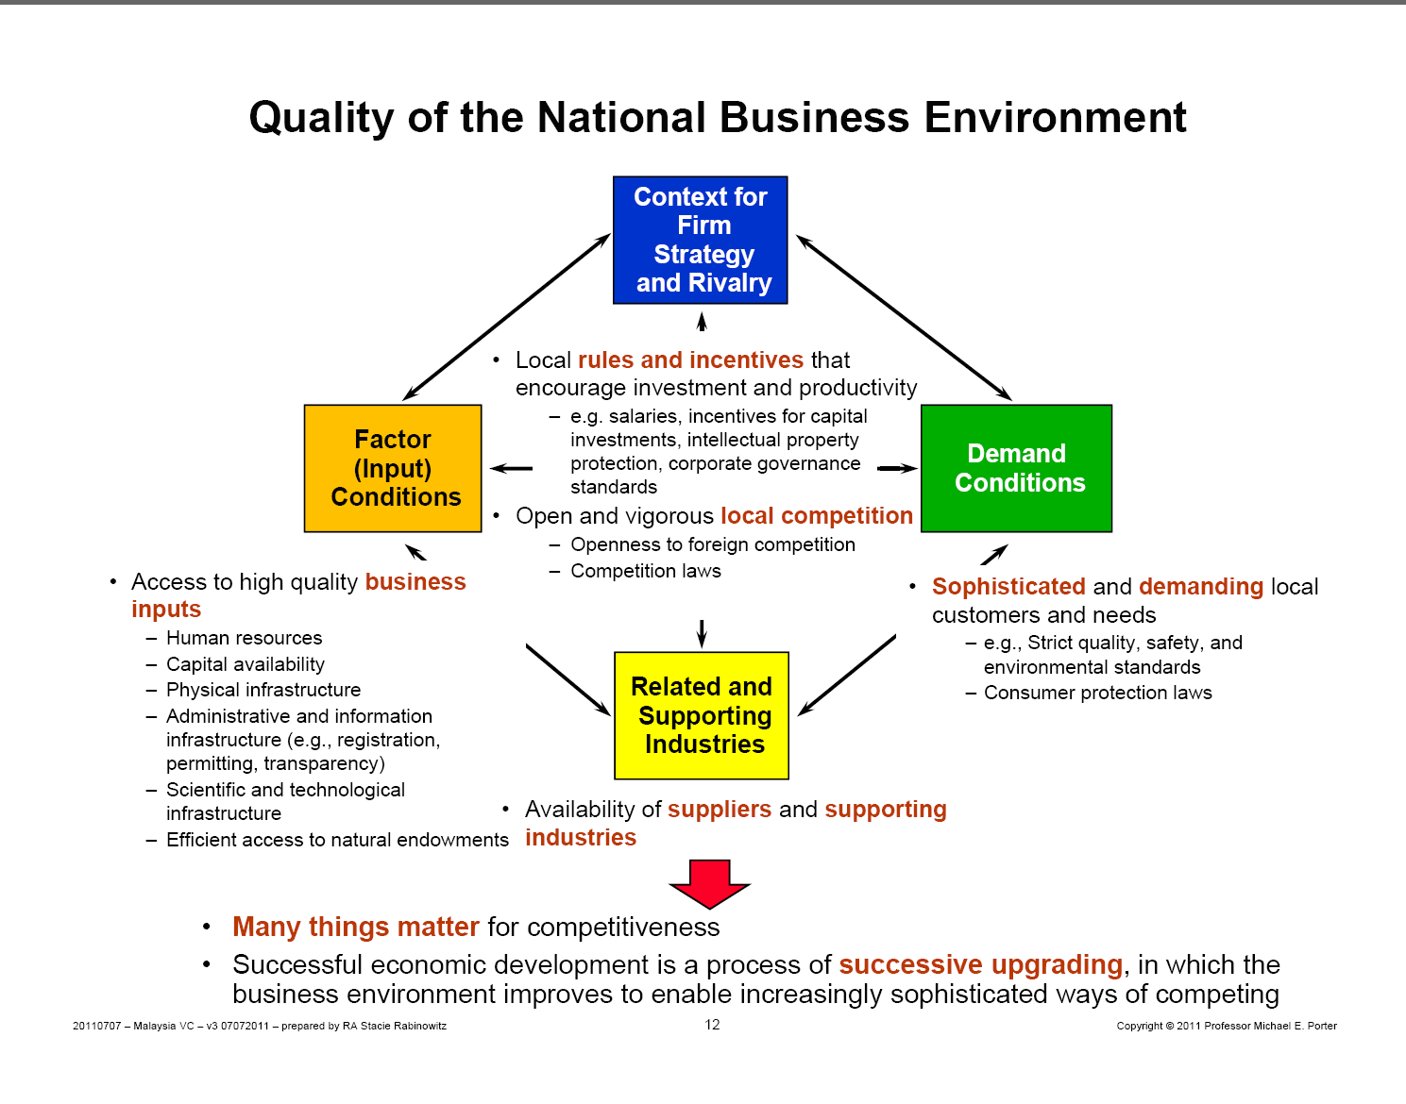

Slide 9
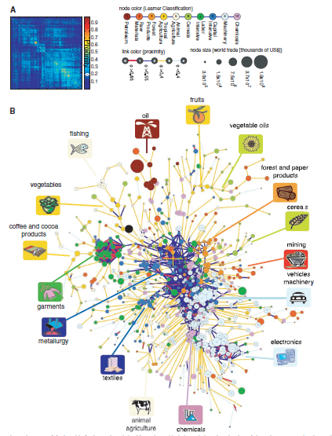
Diversification is path dependent:
What a country produces and exports matters more for long term economic development than the value that it gets out of that production. Because what a country is capable to produce in the present affects what it would be able to produce in the future (Freire, UNCTAD)

Slide 10
THANK YOU!

